Slide 1
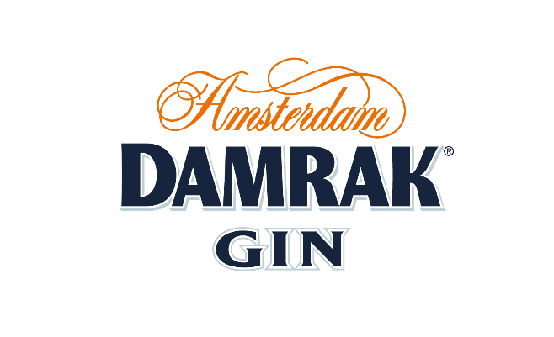
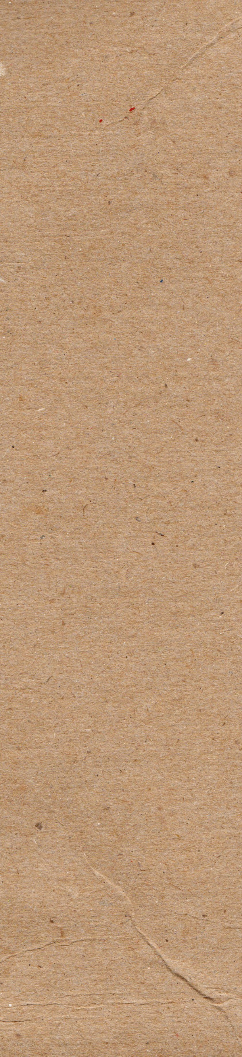
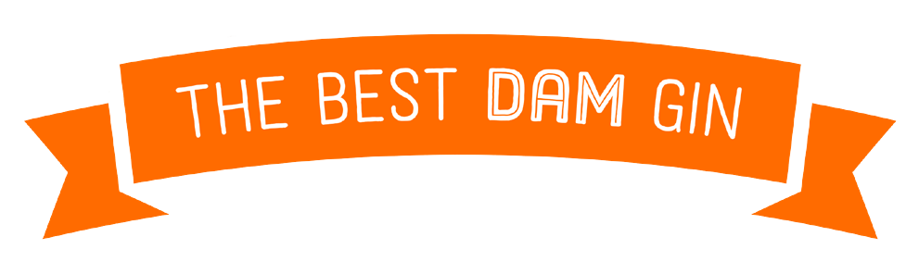
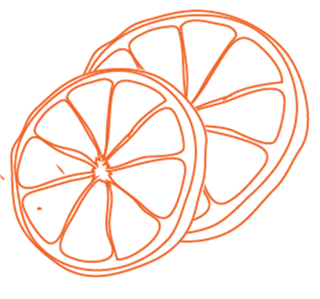
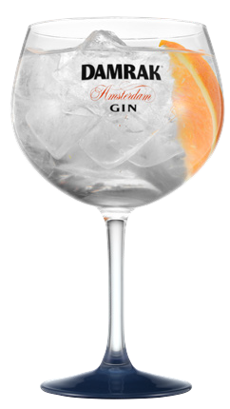
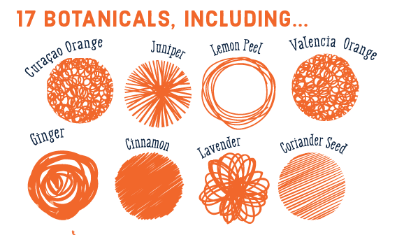
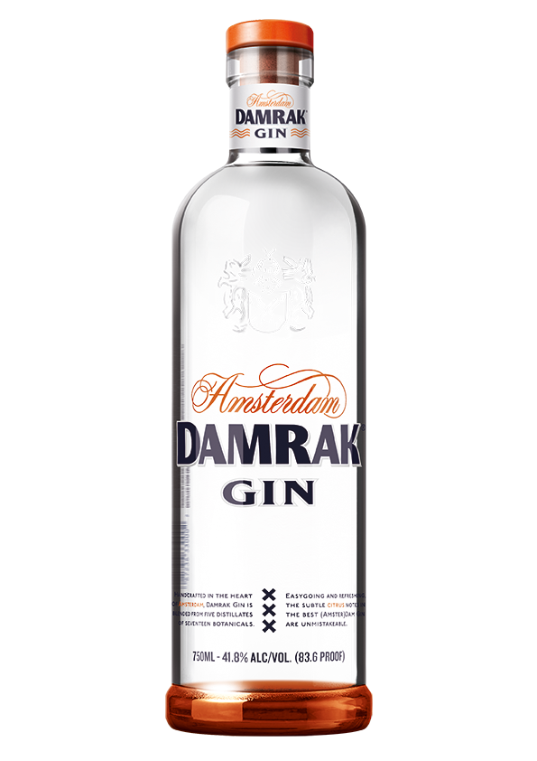
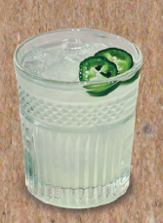
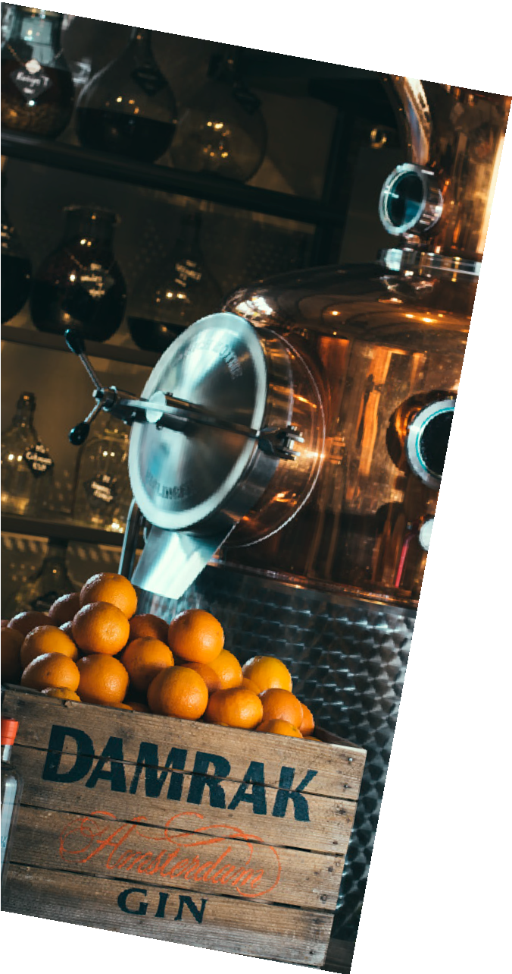
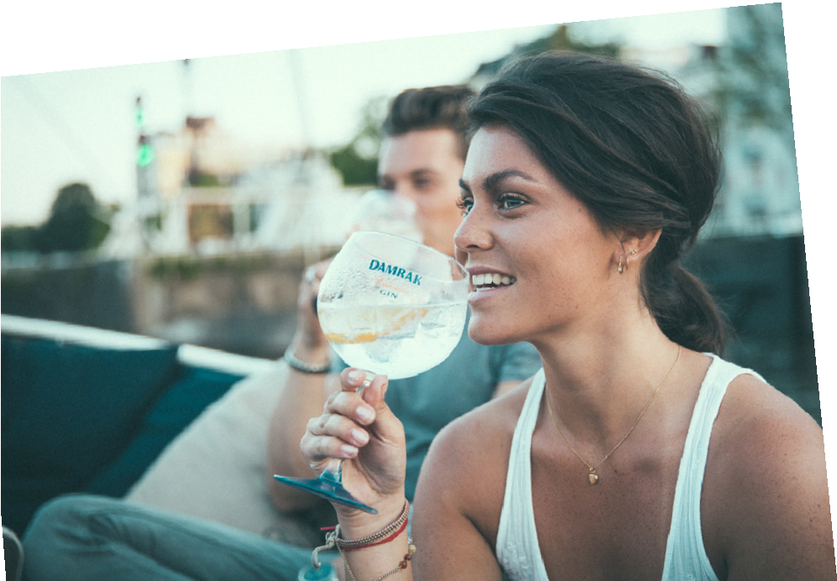
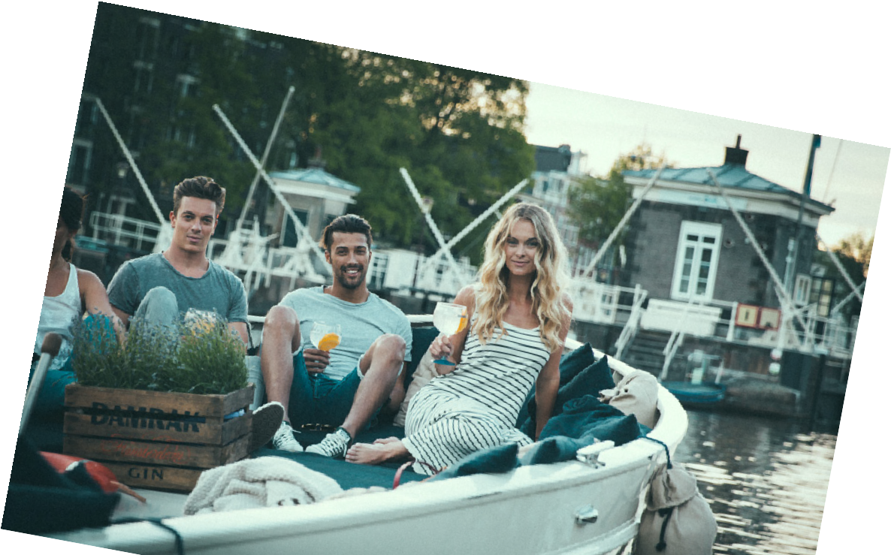





The best dam G&T
The first global gin brand to offer alcoholic & non-alcoholic alternatives
1 part Damrak Gin 3 parts Tonic Water
1-2 Orange Slices
WHAT’S WITH THE NAME?
In the mid 16th century Amsterdam was establishing itself as the center of world trade. The bustling inner harbor known as the Damrak became a critical mooring place for merchant ships bringing herbs and spices. Today Damrak Gin is distilled just steps away from the Damrak, right in the heart of Amsterdam, using the traditional craftsmanship the city is known for.
FLAVOR NOTES
Damrak has a unique flavor profile balancing the traditional juniper notes of a quality gin with fresh citrus notes, which makes it easily approachable for non-gin drinkers.
On the nose Damrak starts off with an aroma of sweet oranges. Shortly after a subtle spiciness of the gin botanicals breaks through, completed by a touch of sweetness of the juniper.
On the palate, the character of citrus withholds, to be
complemented by juniper, coriander and a floral touch of lavender. Warm, earthy tones of ginger and cinnamon initiate the smooth and sweet finish.
Elderflower collins
1.5 part Damrak Gin
1 part Elderflower liqueur
0.5 part Fresh Lemon Juice
Top with Soda Water
DISTILLATION
Five different distillates from five pot stills all blended together and allowed to rest (marry) for over 2 weeks after which it is filtered and bottled at 41.8% ABV.
94
Points
Wine
Enthusiast
Amsterdam green
1.5 oz Damrak Gin
0.5 oz Elderflower liqueur
0.5 oz simple syrup
0.75 oz lime juice
2 slices of cucumber and 1 slice of jalapeño muddled
Pricing & special offers:
F

Slide 2
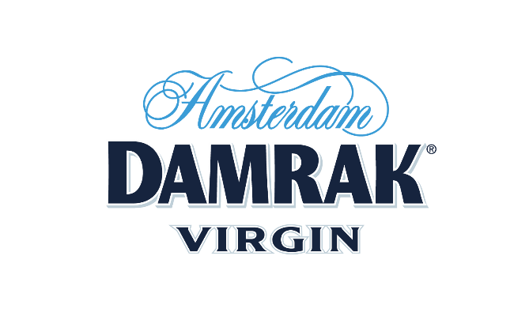


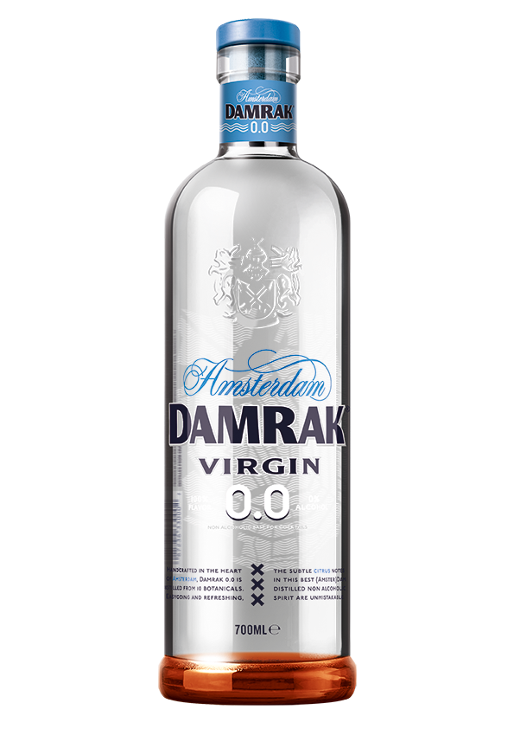
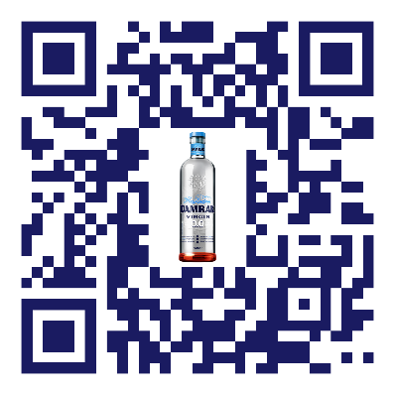
0% alcohol 100% flavor
The best dam
Virgin & Tonic
virgin?
For the sober curious, fit boys and girls, designated drivers and everyone else amongst us interested in an alcohol-free cocktail – meet Damrak VirGin.
It is everything Damrak is, simply (but in truth, very complexly) reformulated to eliminate the alcohol.
Still made in the heart of Amsterdam by our crafty distilling team by carefully extracting flavors from a collection of 10 botanicals.
FLAVOR NOTES
Citrus-forward classic gin-inspired flavor with pronounced orange and refreshing lemon.
Creating a high-quality non-alcoholic drink without compromising on flavor is not easy. But we wouldn’t be a real Amsterdammer if we stopped trying. And after 2 years of mixing, blending and perfecting the recipe, we did it. And boy are we proud! Without losing the unique Damrak taste, even at 0% alcohol, you can now enjoy a cocktail when you don’t want the buzz.
1 part Damrak Virgin
3 parts Tonic Water
1-2 Orange Slices
F
No ginlet
claim they ARE MAKING EFFORTS TO REDUCE ALCOHOL CONSUMPTION- nIELSEN
2 parts Damrak Virgin
½ part Lime Juice
½ part Simple Syrup
66% of millennials
Virgin mule
1 part Damrak Virgin
¼ part Lemon juice
3 parts Ginger Beer
Pricing & special offers:
F

