Slide 1


Slide 2

https://www.instahttps://www.instagram.com/reel/DQeeWUZDS1u/?utm_source=ig_web_copy_link&igsh=MzRlODBiNWFlZA==gram.com/p/C82IT8aNgoO/?utm_source=ig_web_copy_link&igsh=MzRlODBiNWFlZA%3D%3D
https://www.damrakgin.com/cocktail/no-ginlet/
https://www.instagram.com/reel/DRMwPRTDX1F/?utm_source=ig_web_copy_link&igsh=MzRlODBiNWFlZA==
https://www.instagram.com/reel/DLXjYvJtFNC/?utm_source=ig_web_copy_link&igsh=MWN3YzBkNG5vOTliMg%3D%3D
https://www.instagram.com/reel/DKhnS9wxjWS/?utm_source=ig_web_copy_link&igsh=MWdteDlkbXBienEybg%3D%3D
https://www.instagram.com/reel/DFN53bHMoEy/?igsh=MzRlODBiNWFlZA%3D%3D
https://www.instagram.com/reel/DEPWnnTsDXT/?utm_source=ig_web_copy_link&igsh=eGprOTJ3OTlmZzJy
https://us.bols.com/products/bloody-mary
https://www.instagram.com/reel/DAahmvfMj4-/?utm_source=ig_web_copy_link&igsh=NW1penVhOGZqYXIy
https://www.instagram.com/reel/DFnV5ZYMyrh/?utm_source=ig_web_copy_link&igsh=MW1wajB5c2djeGNxdA%3D%3D
https://www.instagram.com/reel/DMi2p_zseEV/?utm_source=ig_web_copy_link&igsh=Y29pYXlzeXB1Ymh
https://www.instagram.com/muffliquorco/p/CYCQUstsTW2/
https://www.instagram.com/reel/DC6xhNCMUta/

Slide 3

https://www.instagram.com/p/CQQNJ8dCkXU/?img_index=2
https://www.instagram.com/reel/DFdTcp4sRe_/?utm_source=ig_web_copy_link&igsh=cmRsNXRoNm0wc2V6
https://www.instagram.com/reel/C9KaXJnMMQ0/?igsh=MzRlODBiNWFlZA%3D%3D
https://www.instagram.com/reel/DGC09koMpmX/
https://www.instagram.com/p/C2dT202JmYM/
https://www.instagram.com/reel/DGC1J_Ds7yh/?igsh=OTVmdW1pbGpqanp5
https://www.instagram.com/reel/DGvHYAbM9B4/?utm_source=ig_web_copy_link&igsh=MWh2eTF1cWIxMWN3dg%3D%3D
https://us.bols.com/products/watermelon-margarita
https://www.instagram.com/reel/DITaO6Tsi-M/?utm_source=ig_web_copy_link&igsh=ZjU1NjlyYndkN3l1
https://www.instagram.com/reels/DRkBzv1jUs4/
https://www.instagram.com/reel/C_-8WpYshhK/?utm_source=ig_web_copy_link&igsh=czRmdWMxaG1xNDRv
https://www.instagram.com/p/DEAUFeQMoqm/?utm_source=ig_web_copy_link&igsh=NmN5dnN0cGZwaDF0
https://www.instagram.com/reel/C-XtUrosb81/
https://www.instagram.com/reel/DFdL_JKuhqi/?utm_source=ig_web_copy_link&igsh=eG41M3NvOTJ1c2s%3D

Slide 4

https://www.instagram.com/reel/C8aL38Nstm9/?igsh=MzRlODBiNWFlZA%3D%3D
https://www.instagram.com/reel/DHvxNYys5Py/?utm_source=ig_web_copy_link&igsh=a2FzNDByZXEwcnNm
https://themuffliquorco.com/blogs/cocktails/bold-beautiful-old-fashioned
https://www.instagram.com/reel/DHLd-gnMjPw/?igsh=MTN3b3c2ZTF2dm05MA%3D%3D
https://www.instagram.com/reel/C_gSegYMgQ8/?utm_source=ig_web_copy_link&igsh=NzI2bnF1OTdhcDVh
https://www.instagram.com/reel/DHTXEAfs7Mr/
https://www.instagram.com/p/DJuKFNsTICT/?img_index=2
https://www.instagram.com/reel/DBL4YOLMTxB/?igsh=MzRlODBiNWFlZA%3D%3D
https://www.instagram.com/reel/DJ7DkBMMi4k/?utm_source=ig_web_copy_link&igsh=aWY4eG92ZjZvNDQ3
https://www.instagram.com/reel/DGOWpv9OaIt/?utm_source=ig_web_copy_link&igsh=dHJzbnJkdGk5MGRv
https://www.instagram.com/reel/DAlm_C1sNnx/?utm_source=ig_web_copy_link&igsh=MXZsYzNrczdxcmhjMQ==
https://www.instagram.com/reel/DHk_sXisEm_/

Slide 5

https://limoncellopallini.com/cocktails/limoncello-martini/
https://us.bols.com/products/ginger-mule
https://www.instagram.com/reel/DEzjEtPJQFg/?utm_source=ig_web_copy_link&igsh=bGduOTE1enRwMTl1
https://www.instagram.com/reel/DCo7ziIsvJO/?utm_source=ig_web_copy_link&igsh=Z3AzZjIwMzk2Z3pt
https://www.instagram.com/p/CjLUIoRMxcV/?utm_source=ig_web_copy_link&igsh=MXczMTZ6eWJ2bmJteQ%3D%3D
https://www.instagram.com/reel/DJ7DkBMMi4k/?utm_source=ig_web_copy_link&igsh=aWY4eG92ZjZvNDQ3
https://www.instagram.com/p/DC2gyArukj-/?utm_source=ig_web_copy_link&igsh=MWd6M3U3NnQxYzlsNw==
https://www.instagram.com/reel/C-65-D-MF3Q/?utm_source=ig_web_copy_link&igsh=cXJqMGk4a2h5NDhy
https://www.instagram.com/reel/DBBOe_UMdPo/?utm_source=ig_web_copy_link&igsh=MzRlODBiNWFlZA%3D%3D
https://us.bols.com/products/long-island-iced-tea
https://www.instagram.com/reel/DKZ1-QFs4pi/?utm_source=ig_web_copy_link&igsh=MXBkMm9ybGtxaTc0bg%3D%3D

Slide 6

https://www.instagram.com/reel/DHbQAUCMdvv/
https://www.instagram.com/reel/DJC3WGksO6i/?utm_source=ig_web_copy_link&igsh=OXZubHVyNncwczNs
https://www.instagram.com/reel/DJJoDR-scVr/
https://www.instagram.com/reel/DJSOPa2s5S-/?utm_source=ig_web_copy_link&igsh=dTl5Ym91aHJjeG5t
https://www.instagram.com/reel/DJZsTI3M-WH/
https://www.instagram.com/reel/DHDhunEMc_n/?utm_source=ig_web_copy_link&igsh=MWd3d3h5ZGFzNHJzZQ==
https://www.instagram.com/reel/Cb-VMeYA0AD/
https://www.instagram.com/reel/DJZYLQPI8Ot/?utm_source=ig_web_copy_link&igsh=MzRlODBiNWFlZA==
https://www.instagram.com/reel/DE5FSR7MYNh/
https://www.instagram.com/reel/C_ODcXSsSR6/
https://www.instagram.com/bolscocktails/reel/DEpJ588MzVT/
https://www.instagram.com/reel/CqWRRISDkpF/?utm_source=ig_web_copy_link&igsh=bnd1amh5YWJ2Yjdo
https://www.instagram.com/reel/C9rV6SwMJB3/?igsh=MzRlODBiNWFlZA%3D%3D
https://www.instagram.com/reel/C-Sw0dPMps4/?utm_source=ig_web_copy_link&igsh=MXY3djlwb3NnMmNxNg%3D%3D
https://www.instagram.com/reel/CyIcuOMs2af/

Slide 7

https://www.instagram.com/p/DEcxYLjs2JK/
https://www.instagram.com/reel/DBhJL4tsmup/?utm_source=ig_web_copy_link&igsh=MzRlODBiNWFlZA==
https://www.instagram.com/reel/C71y6GvsPdq/?utm_source=ig_web_copy_link
https://www.instagram.com/p/DC2gyArukj-/?utm_source=ig_web_copy_link&igsh=MWd6M3U3NnQxYzlsNw==
https://www.instagram.com/reel/DJhkFMrukUs/?utm_source=ig_web_copy_link&igsh=cTdyc2ZkZmxrZGti
https://www.instagram.com/reel/DLP30CRN3RT/?utm_source=ig_web_copy_link&igsh=amJ6NWlnNDhsdTJ2
https://www.instagram.com/reel/DIrNZrnsVb1/?utm_source=ig_web_copy_link&igsh=MWZ5bXFyZzU4dzc3dQ%3D%3D
https://www.instagram.com/reel/DK7avegMivC/?utm_source=ig_web_copy_link&igsh=c210bjcxcG9qNWJz
https://themuffliquorco.com/blogs/cocktails/dry-muff-martini
https://www.instagram.com/reel/DLSovfSsWbU/?utm_source=ig_web_copy_link&igsh=MTRhbHJycTg4enZrOQ%3D%3D
https://www.instagram.com/reel/DKR92zttA4o/?utm_source=ig_web_copy_link&igsh=ODh2ZXRtbm0xMTZl
https://www.instagram.com/reel/C1kzpYZpZkI/?utm_source=ig_web_copy_link&igsh=NnBxaGZ4OXoxbTlu
https://www.instagram.com/reel/DLiENzcsudi/?utm_source=ig_web_copy_link&igsh=MTEwMWQ1eWhneDJubg%3D%3D
https://www.instagram.com/reel/DJW1fRRssL1/?utm_source=ig_web_copy_link&igsh=Y2ppM3IxeDdtNnQw
https://www.instagram.com/reel/DIogSzWM1q8/?utm_source=ig_web_copy_link&igsh=enhrbDc1MHpzZHN3

Slide 8
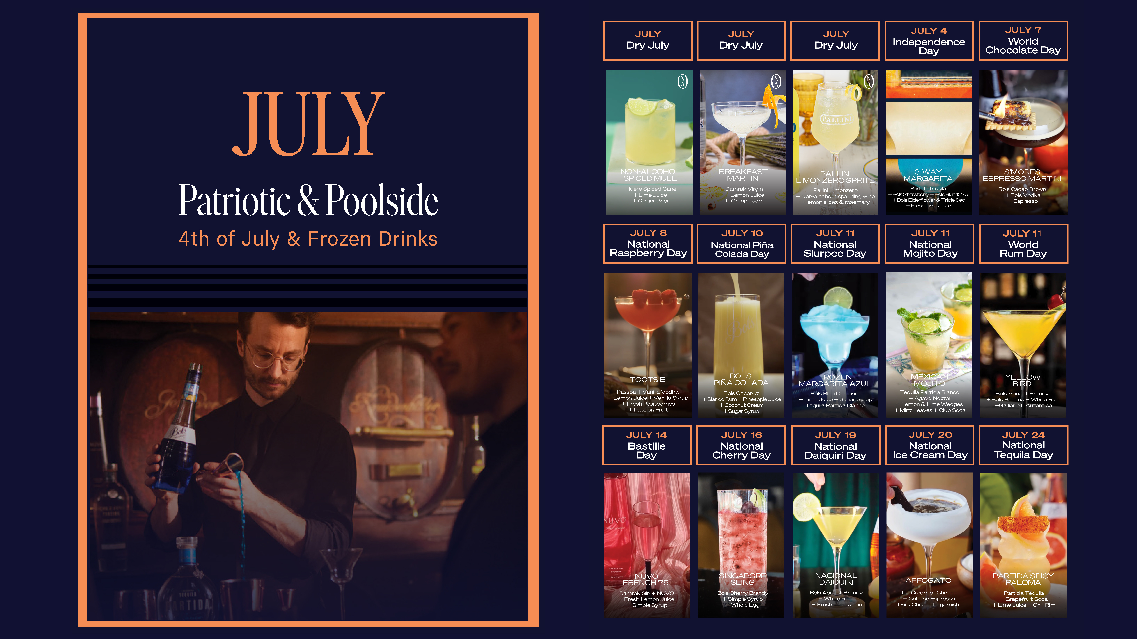
https://www.instagram.com/reel/DJPjADFOZBU/?igsh=OW90Z3NqNDBidjdt
https://www.damrakgin.com/cocktail/breakfast-martini/
https://www.instagram.com/reel/DKhnS9wxjWS/?utm_source=ig_web_copy_link&igsh=MWdteDlkbXBienEybg%3D%3D
https://www.instagram.com/reel/DLpnHBEsudg/?utm_source=ig_web_copy_link
https://www.instagram.com/reel/DCtpIofM214/
https://www.instagram.com/reel/C_vZUrpi_E_/?utm_source=ig_web_copy_link&igsh=cmRzemZoYXF4eW0w
https://www.instagram.com/reel/DL2TCTmMdDG/?igsh=MzRlODBiNWFlZA%3D%3D
https://www.instagram.com/reel/C-xttlrMTg3/
https://www.instagram.com/reel/CukW_aGr3n0/
https://www.instagram.com/p/DA59f5IszLn/?utm_source=ig_web_copy_link&igsh=MWZpcmpmaGpocjJzYw==
https://www.instagram.com/reel/C0fD_PPJ0BH/?utm_source=ig_web_copy_link&igsh=Z3drMWFpNmFudzlh
https://www.instagram.com/p/DAd5sJQM4nc/?img_index=1
https://www.instagram.com/p/C_vqfx6ss_u/
https://www.instagram.com/reel/DH0T5IdM6zW/
https://www.instagram.com/reel/DJ9ml_iMlBm/

Slide 9
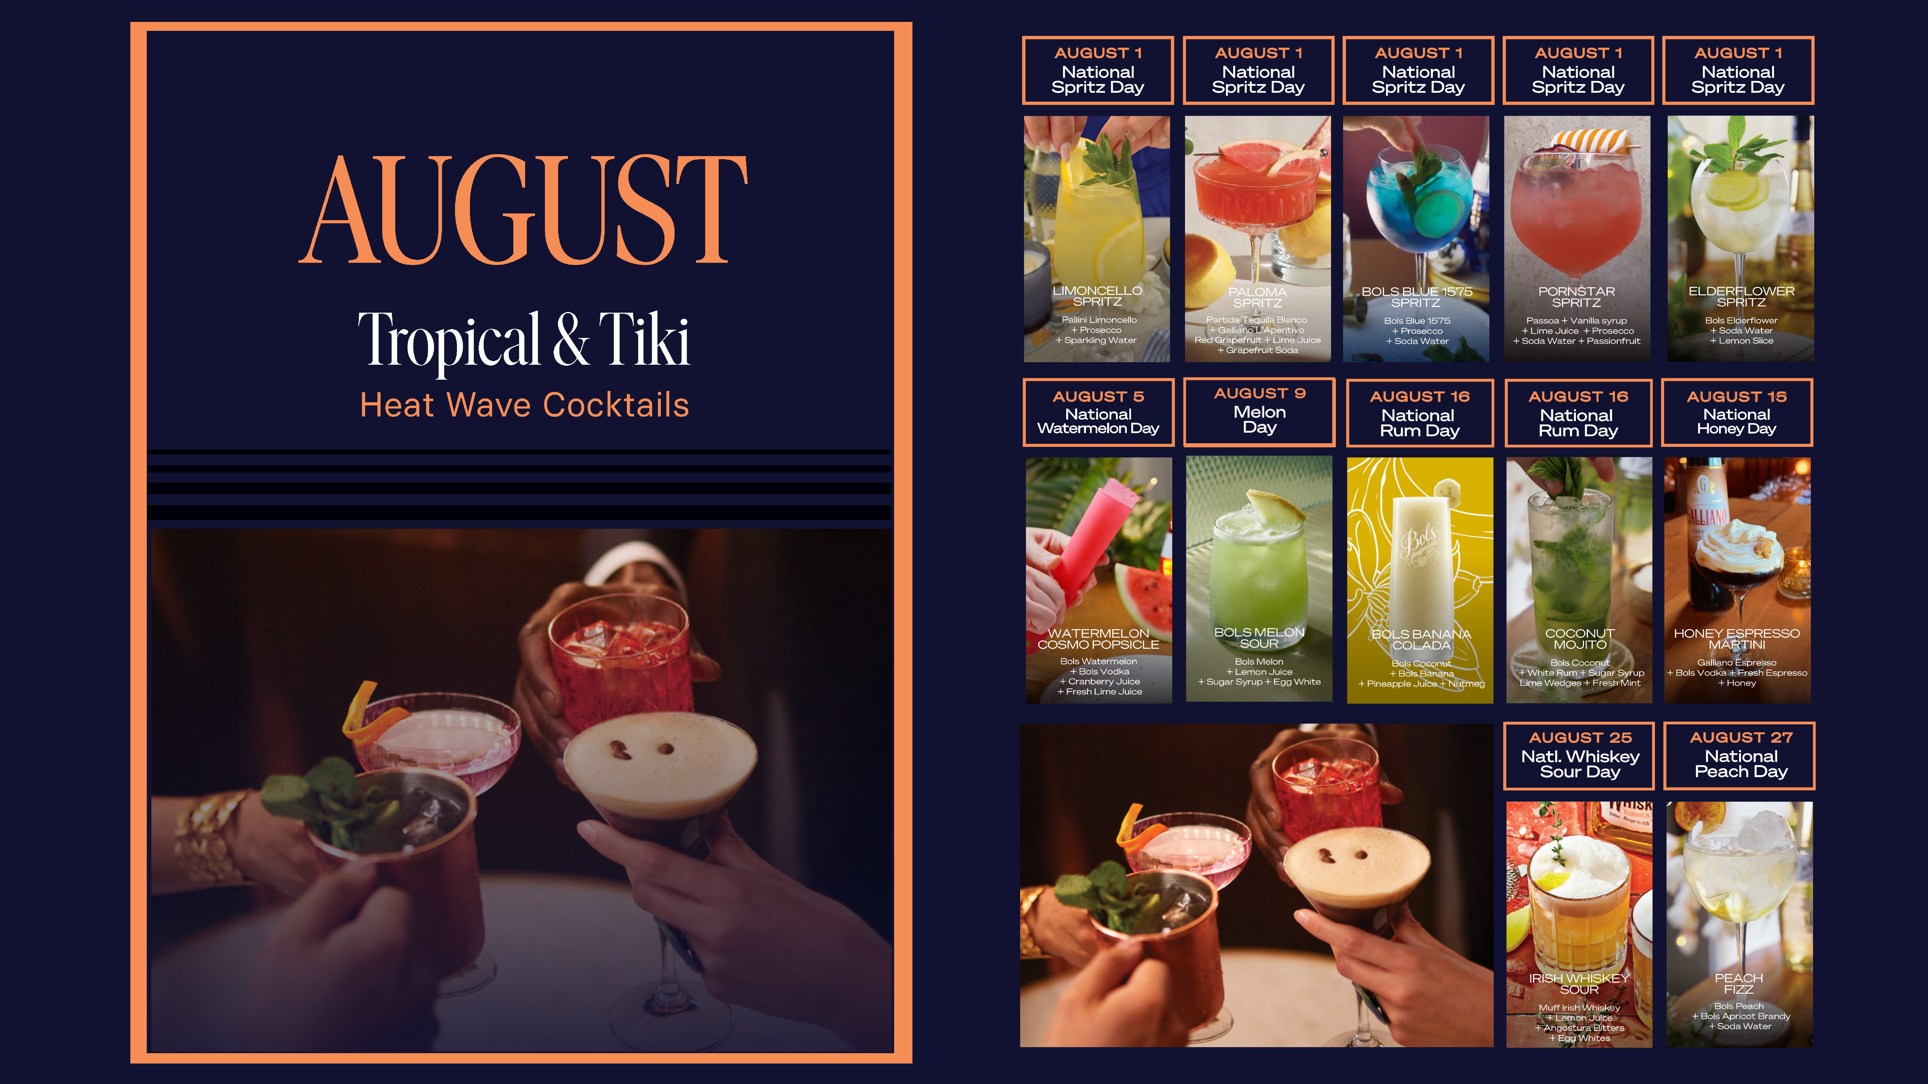
https://www.instagram.com/reel/DKw9tcDp2S8/?utm_source=ig_web_copy_link&igsh=MWY5NzJkMzV2eW05aA%3D%3D
https://www.instagram.com/reel/C5J6ytlvWEl/
https://www.instagram.com/reel/DFnV5ZYMyrh/?utm_source=ig_web_copy_link&igsh=MW1wajB5c2djeGNxdA%3D%3D
https://www.instagram.com/reel/DIMcMwQtHMc/?utm_source=ig_web_copy_link&igsh=d3gwN3l4MjljYzh1
https://www.instagram.com/reel/C71y6GvsPdq/?utm_source=ig_web_copy_link&igsh=MXFocnYyMGR2bnRrYQ%3D%3D
https://www.instagram.com/reel/DMIG9VQM7_K/?igsh=Z3NmcHk5MHFtMHlv
https://us.bols.com/products/melon-sour
https://us.bols.com/products/banana-colada
https://www.instagram.com/reel/DJ4cV-hMisO/?utm_source=ig_web_copy_link&igsh=MzRlODBiNWFlZA%3D%3D
https://www.instagram.com/reel/DJ4erxiOmZF/?igsh=MXBpaG41anB0dHVrMw%3D%3D
https://www.instagram.com/p/CwXa6s_IwLW/
https://www.instagram.com/reel/DKHhV25MBo5/

Slide 10
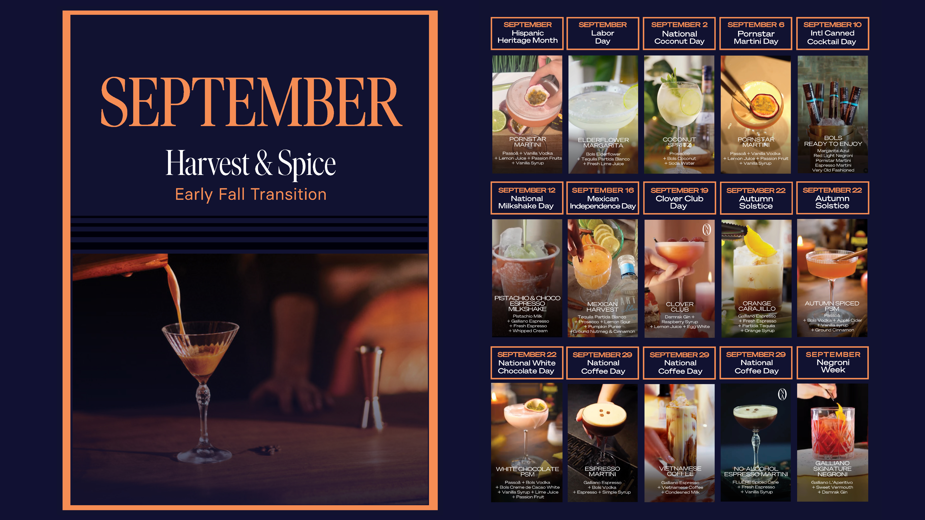
https://www.instagram.com/reel/DA9noS2RDof/?utm_source=ig_web_copy_link&igsh=MjRncGhqM2IwNnJ2
https://www.instagram.com/reel/DITaO6Tsi-M/?utm_source=ig_web_copy_link&igsh=ZjU1NjlyYndkN3l1
https://www.instagram.com/reel/DJwif-dsAWf/
https://www.instagram.com/reel/DKfEm0WsEdm
https://www.instagram.com/p/DFLPS3MM-Qr/
https://www.instagram.com/reel/DGVk-z-sw91/?utm_source=ig_web_copy_link&igsh=MXhoajVkMGt0dGVmOQ%3D%3D
https://www.instagram.com/reel/CzKPajCLhYn/?utm_source=ig_web_copy_link&igsh=eTJ3eWtkdmNjY3B0
https://www.instagram.com/reel/DGC09koMpmX/
https://www.instagram.com/reel/DImGMR-MOvJ/?utm_source=ig_web_copy_link&igsh=YWRjNGMxeHJ4MHh6
https://www.instagram.com/reel/DA8p1-au60t/?utm_source=ig_web_copy_link&igsh=MW1uaWh2OG0wY24xbA%3D%3D
https://www.instagram.com/reel/DAi5ryDuRo9/?utm_source=ig_web_copy_link&igsh=ZDliYzhidTB4NHdh
https://www.instagram.com/reel/DHLd-gnMjPw/
https://www.instagram.com/reel/DLzt80UM_Nz/
https://www.instagram.com/reel/DLXjYvJtFNC/?utm_source=ig_web_copy_link&igsh=MWN3YzBkNG5vOTliMg%3D%3D
https://www.instagram.com/reels/C_-8WpYshhK/

Slide 11

https://www.instagram.com/reel/DKhnS9wxjWS/?utm_source=ig_web_copy_link&igsh=MWdteDlkbXBienEybg%3D%3D
https://www.instagram.com/reel/DE2nhg4Mh_6
https://www.instagram.com/p/DEcxYLjs2JK/
https://www.instagram.com/reel/DE2nhg4Mh_6
https://www.instagram.com/p/DIogSzWM1q8/
https://limoncellopallini.com/cocktails/autumn-spritz/
https://www.damrakgin.com/cocktail/damrak-gin-tonic/
https://themuffliquorco.com/blogs/cocktails/the-perfect-muff-gin-tonic
https://www.instagram.com/reel/DMQF7EYoICn/?utm_source=ig_web_copy_link
https://www.instagram.com/p/COIDfThjGsR/
https://www.instagram.com/p/DCMmPngsvje/
https://www.instagram.com/p/C1Agvcmvdet/?utm_source=ig_web_copy_link&igsh=MW14NTE4dGF1bDJhNA%3D%3D&img_index=1
https://www.instagram.com/reel/CzG4JWCr38D/?utm_source=ig_web_copy_link&igsh=eGRjY2FpZ3ZpaTA1
https://www.instagram.com/reel/DByvGfLszkN/?utm_source=ig_web_copy_link&igsh=MXRlNTgzOGd3ZXJkNw==
https://www.instagram.com/reel/DIrNZrnsVb1/

Slide 12
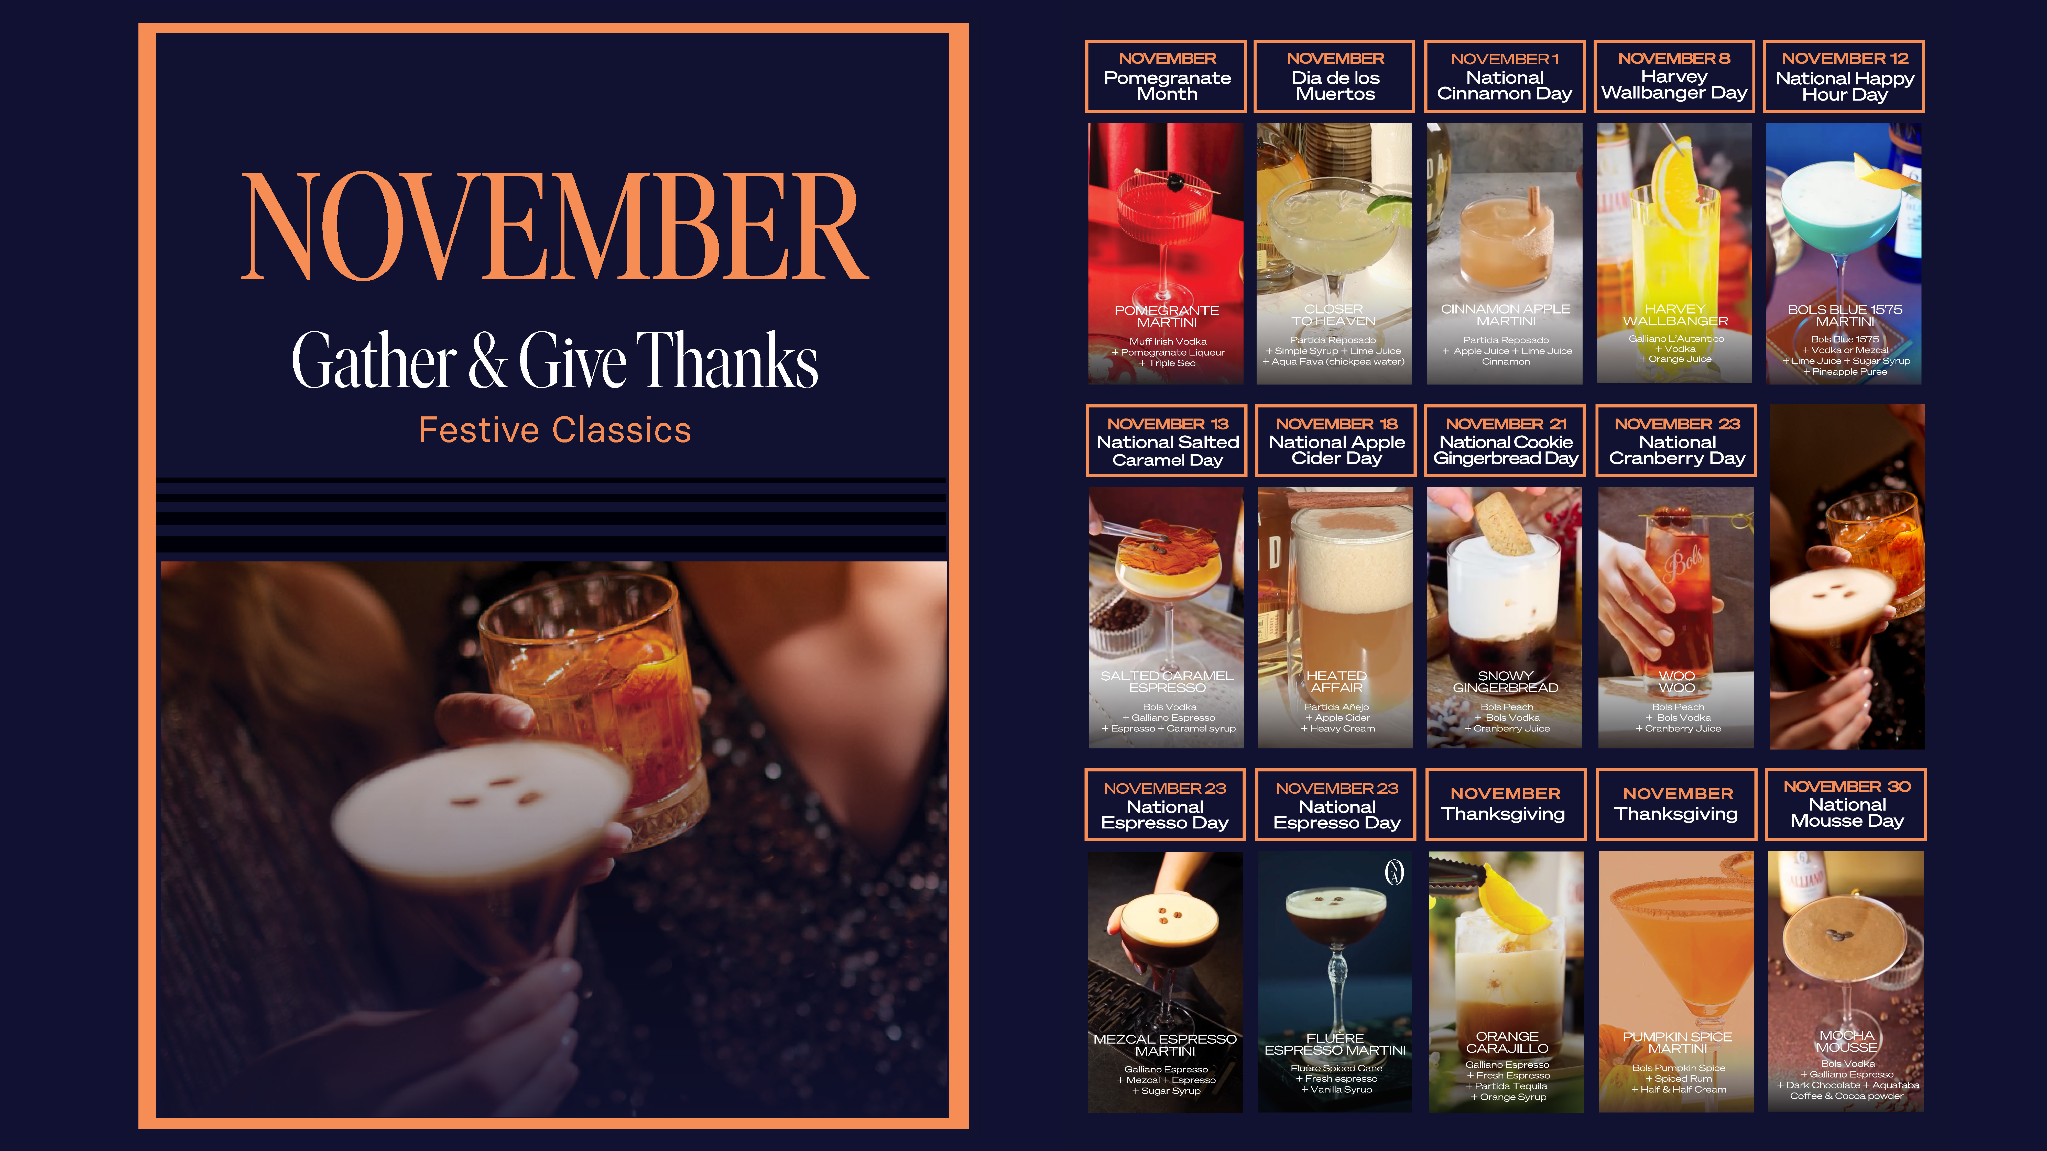
https://themuffliquorco.com/blogs/cocktails/pomegranate-mufftini
https://www.instagram.com/reel/CzuJdTRPn0Q/?utm_source=ig_web_copy_link&igsh=MWhpYnVwa2F5dWlwYg%3D%3D
https://www.instagram.com/reel/DBfCSYIShlq/?utm_source=ig_web_copy_link&igsh=MTJuOXZlaXVsYW5rOQ%3D%3D
https://www.instagram.com/reel/DCHcjccsPVn/?utm_source=ig_web_copy_link&igsh=NXA0aXY2Njlwc2Y5
https://www.instagram.com/reel/DFN53bHMoEy/?utm_source=ig_web_copy_link
https://www.instagram.com/reel/DEzjEtPJQFg/?utm_source=ig_web_copy_link&igsh=bGduOTE1enRwMTl1
https://www.instagram.com/reel/C17GmGiLyN_/?utm_source=ig_web_copy_link&igsh=em13emxoeXJ4dTFt
https://www.instagram.com/reel/DDCUuXdMJrp/?igsh=b3B0eHdhd2NqOG9l
https://www.instagram.com/reel/DJrMVRGMGrP/?utm_source=ig_web_copy_link&igsh=dGV2ejZtc3c4YWtw
https://www.instagram.com/p/DJRmDaDMJLw/?utm_source=ig_web_copy_link&igsh=MXZ5a3NlZ3d3c2RyZw%3D%3D&img_index=1
https://www.instagram.com/reel/DLXjYvJtFNC/
https://www.instagram.com/reel/DImGMR-MOvJ/?utm_source=ig_web_copy_link&igsh=YWRjNGMxeHJ4MHh6
https://www.instagram.com/bolscocktailsusa/p/CxjBJksPEbV/?img_index=1
https://www.instagram.com/reel/DEemnJWM8MT/?utm_source=ig_web_copy_link&igsh=czc0aDRicXdyMGpp

Slide 13

https://www.instagram.com/reel/DD9xO5bs_fr/?utm_source=ig_web_copy_link&igsh=MzRlODBiNWFlZA%3D%3D
https://www.instagram.com/reel/DAjAyFaMotp/?utm_source=ig_web_copy_link&igsh=MWF0dmdmb2FiN21jcg%3D%3D
https://www.instagram.com/reel/DIOvE8TsjiL/?utm_source=ig_web_copy_link&igsh=MXR6eTE3YTlycnEzeA%3D%3D
https://www.instagram.com/reel/DDCUuXdMJrp/?utm_source=ig_web_copy_link&igsh=b3B0eHdhd2NqOG9l
https://www.instagram.com/p/DHMI1CisnXO/
https://www.instagram.com/p/DCEZG1WsQbc/
https://www.passoa.com/en-us/cocktail/passoa-sangria
https://www.instagram.com/reel/DDj7_LDs9Dy/?utm_source=ig_web_copy_link&igsh=cm1zNHQxbzBzMTJl
https://www.instagram.com/reel/DDQOOjbPKb2/?utm_source=ig_web_copy_link
https://www.instagram.com/reel/DDZoRqPs40n/?utm_source=ig_web_copy_link&igsh=ZHZna2VkZTJldWJ2
https://www.instagram.com/reel/DEATSgTsCt_/
https://www.instagram.com/reel/C1aKLJrPyro/?utm_source=ig_web_copy_link&igsh=eHk2eWdqMTBsZmI0

