Slide 1
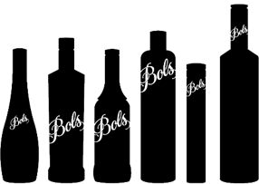
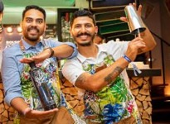
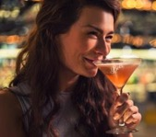
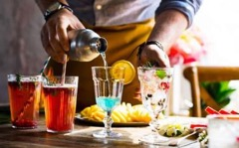
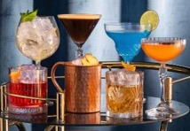
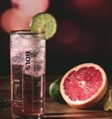
THE WORLDS
FIRST COCKTAIL BRAND
ORIGINAL
SOPHISTICATED
The original spirit of Amsterdam
Cocktails is a lifestyle
PURPOSE:
REASON TO BELIEVE:
For Bartenders & Consumers:
BOLS cocktails is here to inspire you to explore the world of cocktails and create magic
Born and raised in Amsterdam since 1575, 450 years of experience in the art of distilling creating flavor and innovating cocktails.
An extensive range of flavor experiences and products.
Crafted with all natural botanicals and an accessible taste profile.
UNIVERSAL INSIGHT:
The Creation of the Cocktail is as important as drinking it.

Slide 2
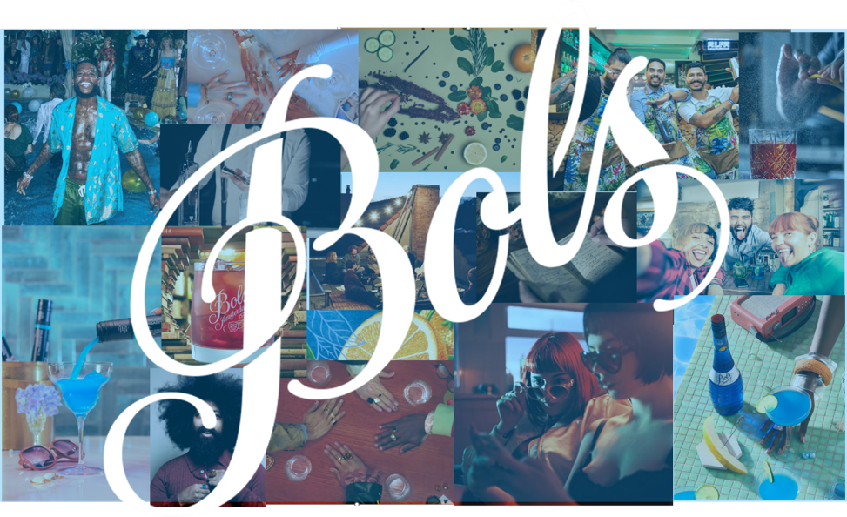

Slide 3
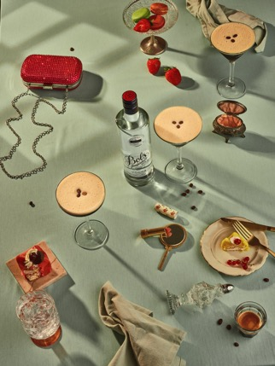
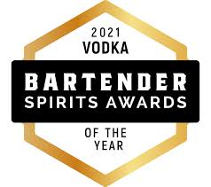
BOLS VODKA
Tapping into our Lucas Bols craftsmanship and distillation expertise (450 years), Bols Vodka was developed to create the best mixable vodka. Its natural wheat distillate base and charcoal filters result in an extraordinary high level of purity, making it perfect for cocktails.

Slide 4
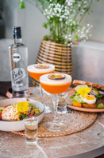
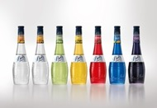

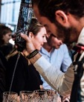




PORTFOLIO STRATEGY & ROLE
The flavored Liqueurs act as the cocktail enabler
Genever stands for credibility and your original cocktail mixer
Vodka to support the trade as an all-round cocktail focus
Ready to Enjoy cocktails to build consumer brand name and bring cocktails at home *
Delivers revenue
On premise focus first, retail only supportive
Build credibility as cocktail flavor ingredient
On premise product with focus on bartender scene
Builds credibility through heritage and quality
Build BOLS consumer cocktail brand
Off premise focus first, blurring into On trade with big Serve cocktail bottle
* Launch only with approved business case + Media Communication plan
On premise focus
Service product as the perfect mixable vodka

Slide 5


PORTFOLIO STRATEGY & ROLE
The flavoured Liqueurs act as the cocktail enabler
Genever stands for credibility and your original cocktail mixer
Vodka to support the trade as an all-round cocktail focus
Ready to Enjoy cocktails to build consumer brand name and bring cocktails at home *
Delivers revenue
On premise focus first, retail only supportive
Build credibility as cocktail flavour ingredient
On premise product with focus on bartender scene
Builds credibility through heritage and quality
Build BOLS consumer cocktail brand
Off premise focus first, blurring into On trade with big Serve cocktail bottle
* Launch only with approved business case + Media Communication plan
On premise focus
Service product as the perfect mixable vodka

Slide 6
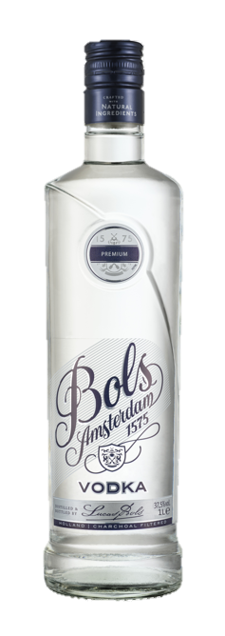









BRAND POSITIONING & PRICING
Bols Vodka can be positioned as an Imported vodka. Competing in the upper mainstream segment as your perfect mixable vodka. At home or in a bar.
LOW Perceived Quality HIGH
Super to hyper premium brands
Imported Holland
Scandinavian style brands
Russian
Flavoured Vodka
YOUNG Consumer OLD

Slide 7
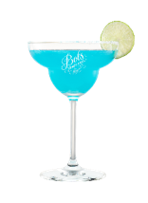
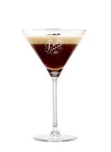

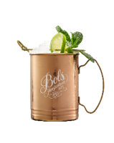
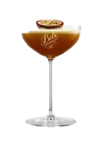
How do BOLS Signature Cocktail fit your consumers?
Below are the 7 BOLS Signature cocktails, designed to match the global favourite cocktails, to HERO a Bols product, with all the details in the table. Each market can take inspiration from our global signature drinks and should decide which signature drink is locally relevant.
# 1
Name: | Bols Elderflower Spritz | Bols Amsterdam Mule | Bols Margarita Azul | Bols Pornstar Martini | Bols Espresso Martini | Bols Negroni | Bols Very Old Fashioned
BOLS Hero | Elderflower liqueur | Original Genever | Blue Curaçao liqueur | Vodka | Vodka | Original Genever | Barrel Aged Genever
Ingredients | Bols Elderflower liqueur, Prosecco, Soda | Bols Original Genever or Bols Vodka, Lime juice, angostura bitters, ginger beer | Tequila, Bols Blue Curacao, lime juice, sugar syrup | Bols Vodka, Passoa (passion fruit liqueur), Bols Vanilla liqueur, passionfruit puree, lime juice | Bols Vodka, Bols Coffee liqueur, Coffee, sugar syrup | Bols Original Genever, Sweet vermouth, Italian bitter liqueur | Bols Barrel aged Genever, sugar syrup, angostura bitters
Occasion | Aperitivo, At Home or At the park with friends or family | Aperitivo, At Home or At the park with friends or family | Hanging out with friends. Or Party or special celebration at home | Hanging out with friends. Or Party or special celebration at home | Pre Dinner, After Diner, Indulgence moments | Pre Diner appetizer, Autumn and Winter, with a friends or Alone | Pre Diner appetizer, Autumn and Winter, with a friends or Alone
Complexity | O | OO | OO | OO | OOO | OOOO | OOOO
ABV | LOW | LOW – MEDIUM | MEDIUM | MEDIUM | MEDIUM | HIGH | HIGH
Preparation | O | OO | OOO | OOOO | OOOO | OOO | OOO

Slide 8



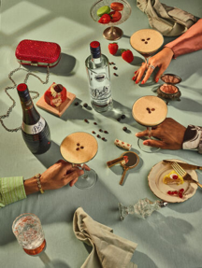
Distilled and filtered through charcoal filters, resulting in an extraordinary high level of purity
100% Grain vodka crafted with natural ingredients
Significant international presence, over 1 million cases worldwide
DEVELOPED IN ORDER TO CREATE THE BEST MIXABLE VODKA
Mixologist’s Choice
Popular Choice
Easy Mix

Slide 9
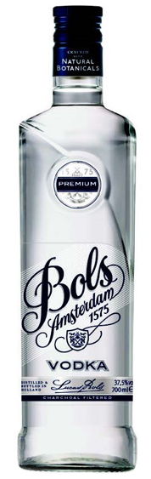
signature cocktails
bols vodka
PORN STAR MARTINI
1 ½ OZ BOLS VODKA
1 OZ PASSOA LIQUEUR
¼ OZ LIME JUICE
¼ OZ SIMPLE SYRUP*
½ OZ PASSION FRUIT PUREE
Shake all ingredients with ice.
Fine strain in a pre-chilled martini or coupe glass.
Garnish with half passion fruit and a sidekick of Prosecco. *Vanilla

Slide 10
signature cocktails
Bols vodka
ESPRESSO MARTINI
1 ½ OZ BOLS VODKA
½ OZ COFFEE LIQUEUR
Dash SIMPLE SYRUP
1 SHOT OF ESPRESSO Shake all ingredients with ice.
Strain in a pre-chilled martini or coupe glass.
Garnish with coffee beans.

Slide 11
signature cocktails
BOLS VODKA
RASPBERRY MULE
1 ½ OZ BOLS VODKA
½ OZ RASPBERRY LIQUEUR
¼ OZ FRESH LIME JUICE
TOP WITH GINGER BEER Build in a mule cup.
Garnish with lemon twist and raspberry.

Slide 12
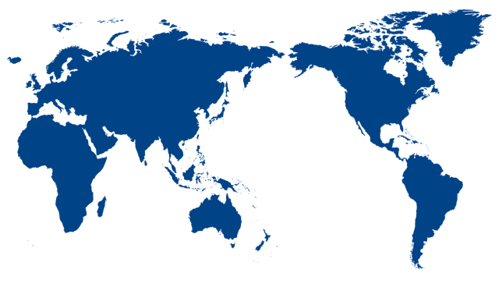
INTERNATIONAL SUCCES
Bols Vodka has a significant international presence selling over 1 million (9L) cases annually and has leading positions or presence in Poland, Argentina Sweden, Canada, the Netherlands, Launching in the USA 2022

Slide 13
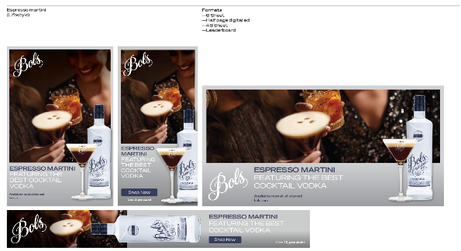
PROVI and Trade Media Ads

Slide 14
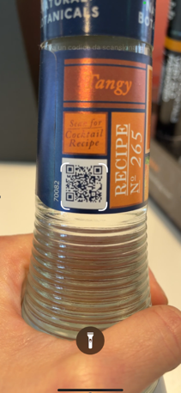
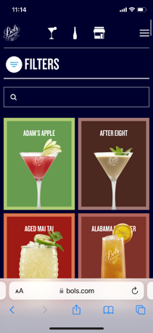
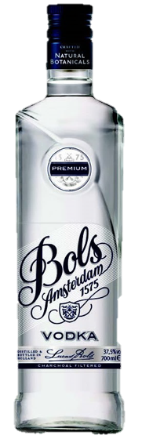


ONLINE COCKTAIL GALLERY
Displays the diverse cocktails that can be made with our liqueurs, accessible directly via our website, or buy scanning the QR code on the bottle.
Target group:
Sales teams, wholesale, bartenders,
bar managers & consumers
You can find inspiration about:
Cocktails
Natural botanicals
Craftmanship
Flavors
Tasting notes
Cocktail Recipes |
Create cocktails at home (bols.com)

