Slide 1


MEDIA COVERAGE
2024-2025

Slide 2

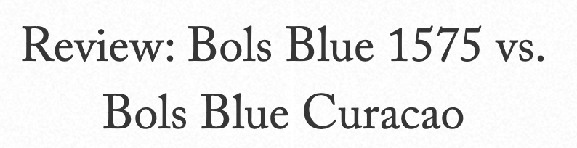
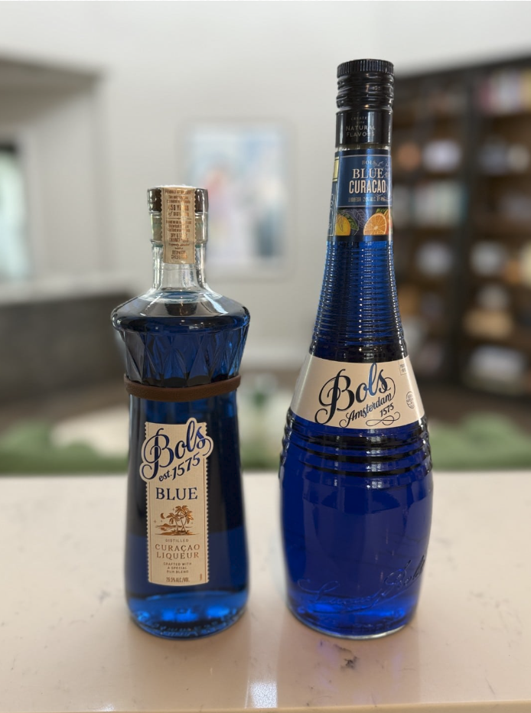
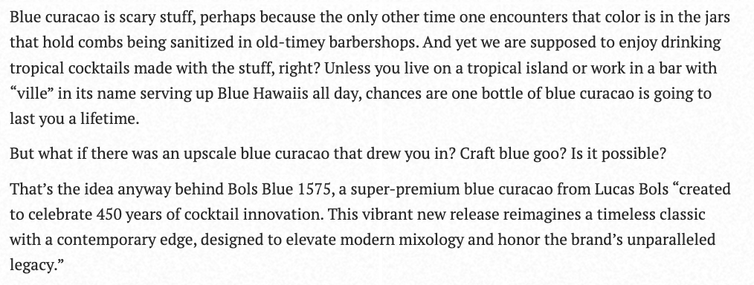
Date: 8/25/2025
Online Visits: 43,898
Click to view article

Slide 3
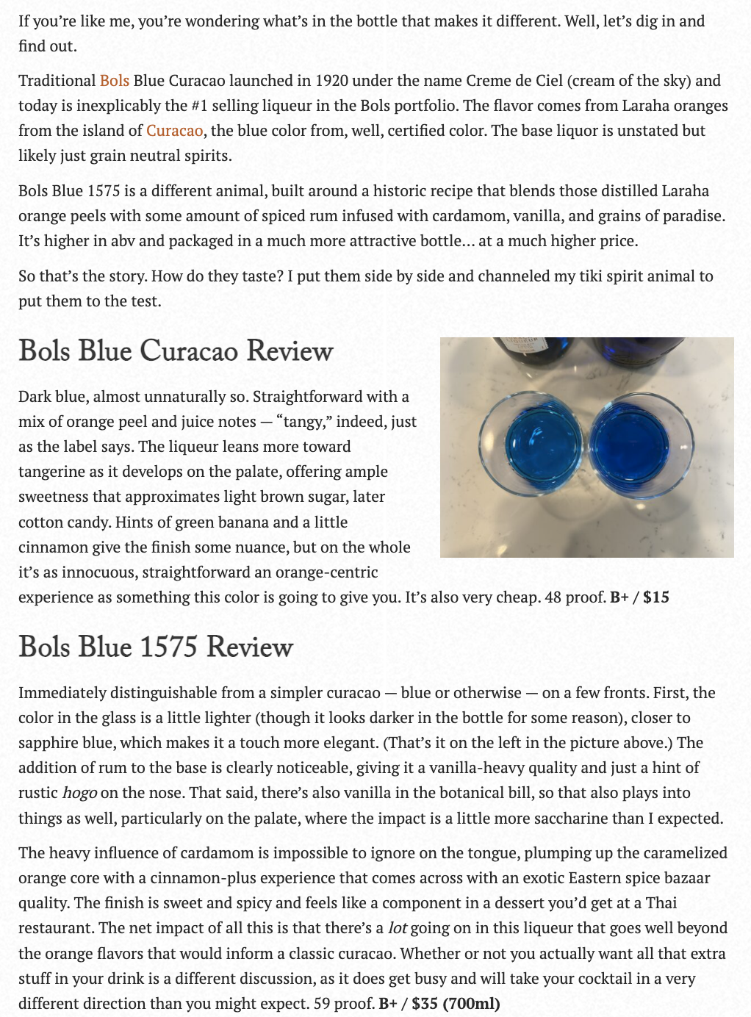


Slide 4


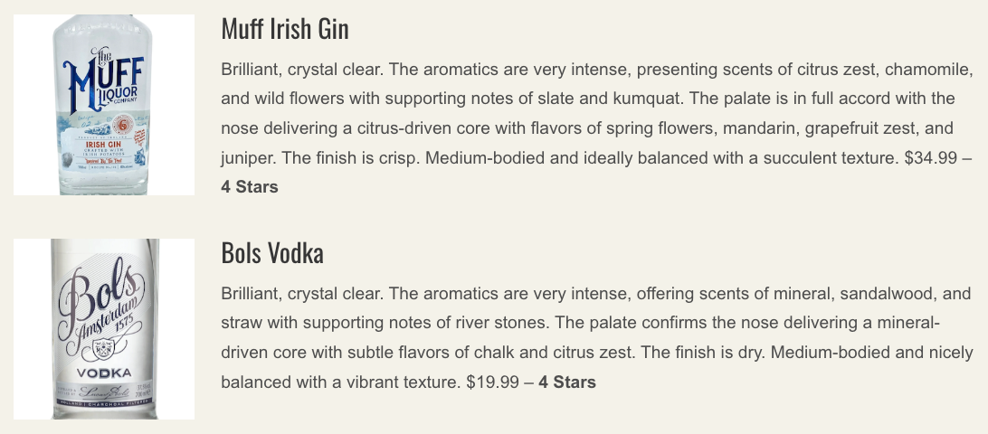
Date: 8/20/2025
Online Visits: 5,000
Click to view article

Slide 5

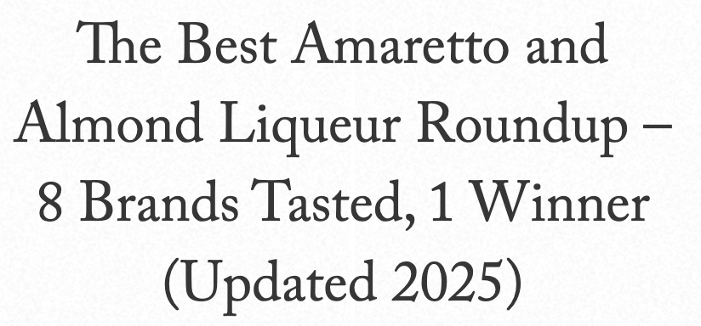
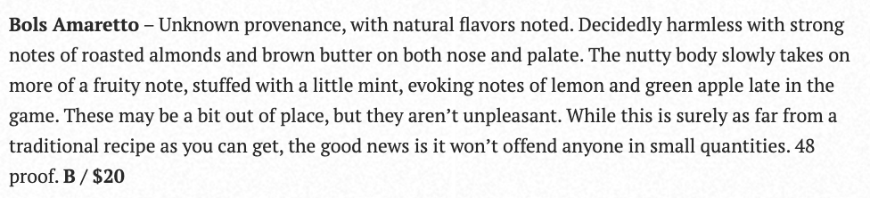
Date: 8/17/2025
Online Visits: 43,898
Click to view article

Slide 6

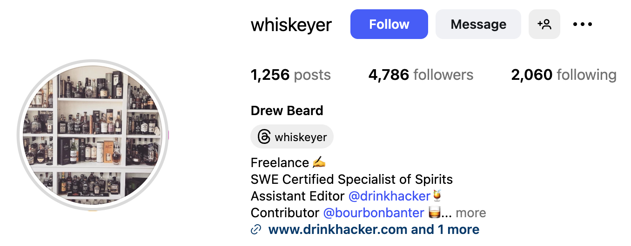

Date: 8/3/2025
Followers: 4,786
Click to view post

Slide 7


Date: 7/9/2025
Online Visits: 5,000
Click to view article

Slide 8


Slide 9


Date: 7/9/2025
Online Visits: 5,000
Click to view article

Slide 10


Slide 11
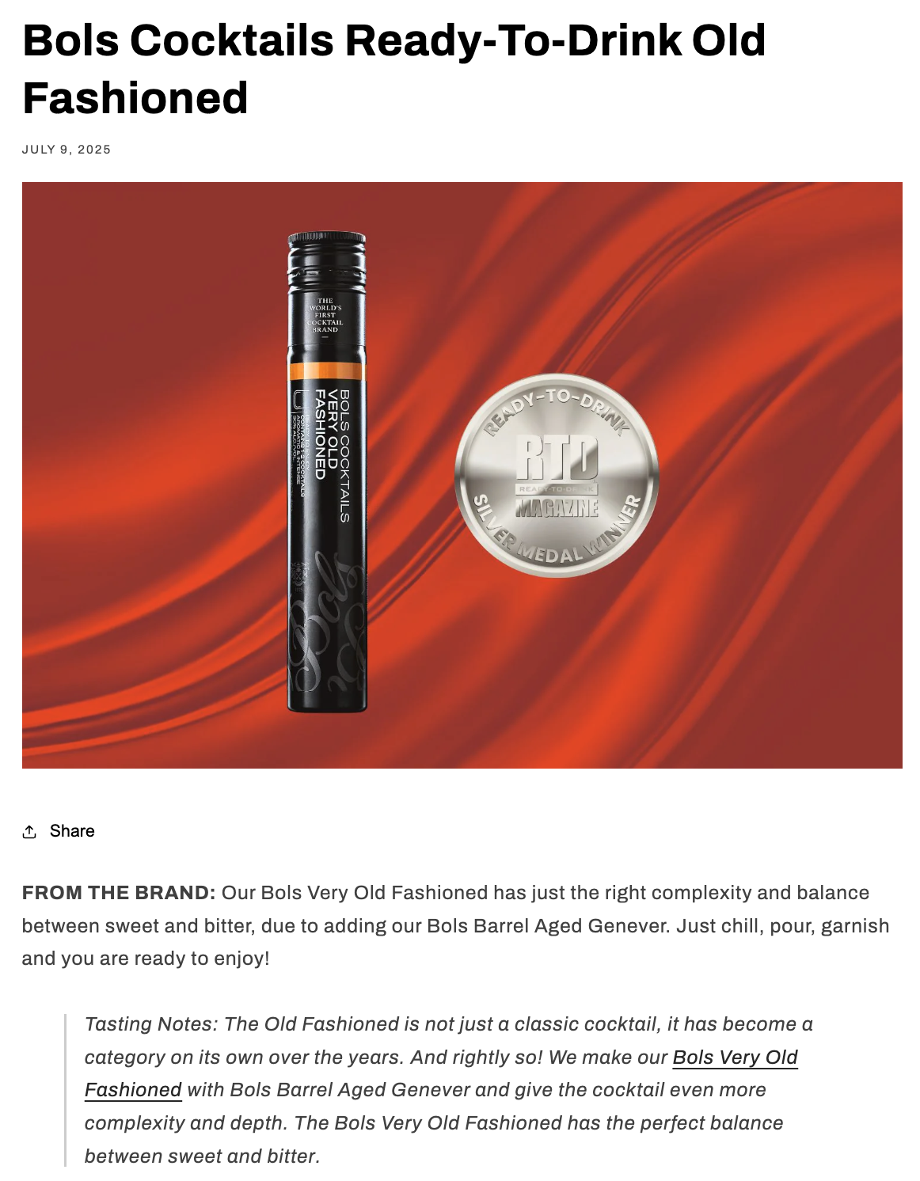
Date: 7/9/2025
Online Visits: 5,000
Click to view article

Slide 12


Slide 13
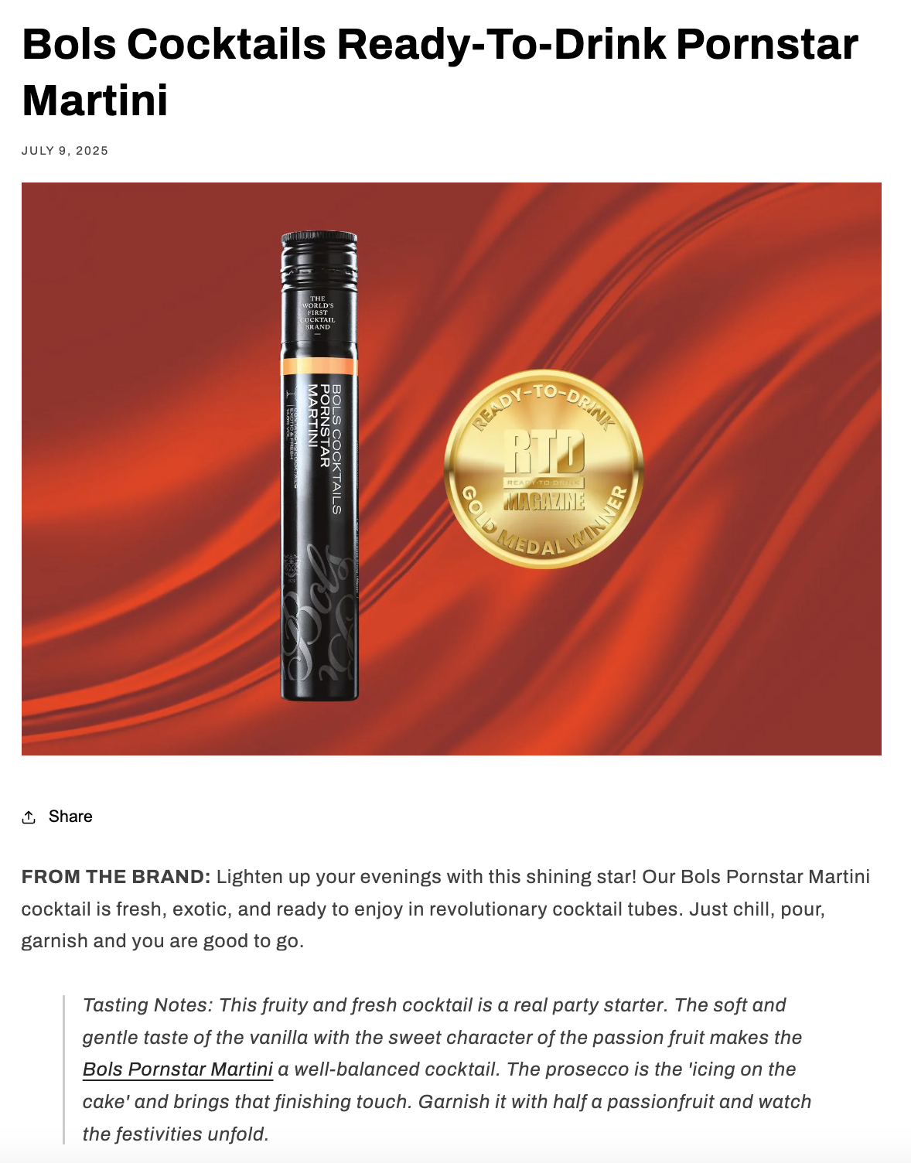
Date: 7/9/2025
Online Visits: 5,000
Click to view article

Slide 14


Slide 15

Date: 7/9/2025
Online Visits: 5,000
Click to view article

Slide 16


Slide 17


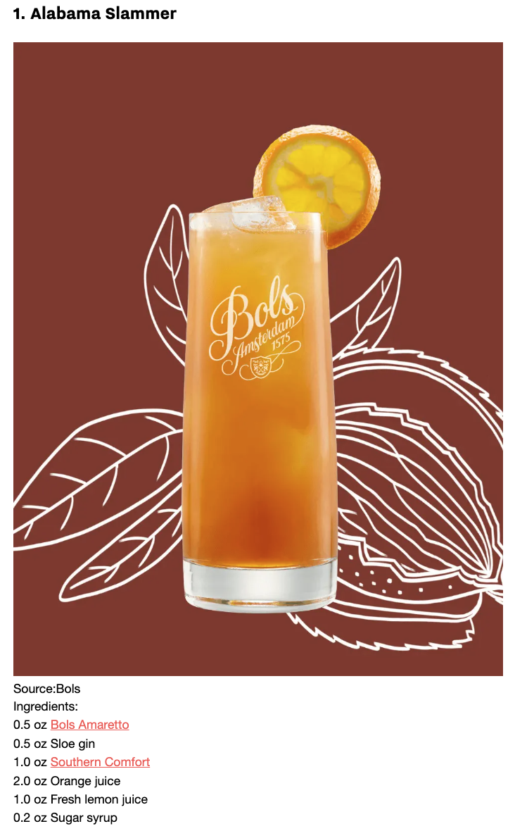
Date: 7/4/2025
Online Visits: 32,310
Click to view article

Slide 18
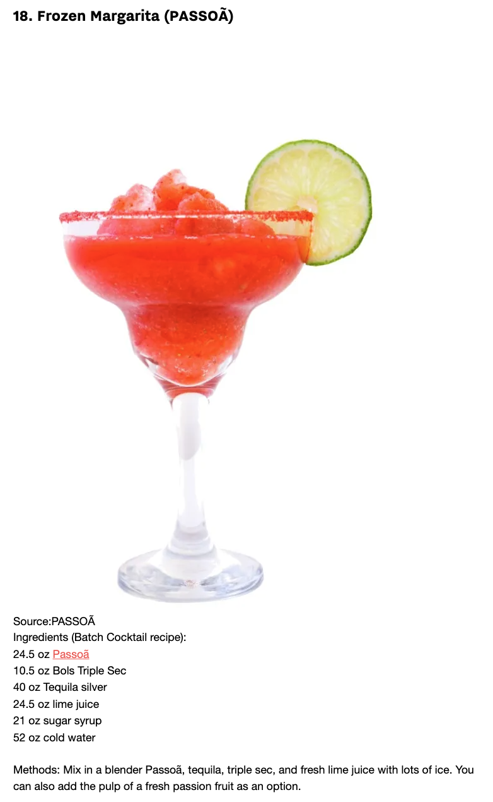

Slide 19


Slide 20




 | Date: 7/4/2025 Online Visits: 61,192 Click to view article
 | Date: 7/4/2025 Online Visits: 5,448 Click to view article
 | Date: 7/4/2025 Online Visits: 78,704 Click to view article
 | Date: 7/4/2025 Online Visits: ​​5,000 Click to view article
Syndications from Cassius

Slide 21



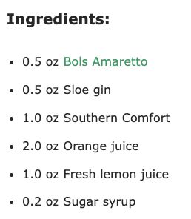
Date: 7/3/2025
Online Visits: 16,549
Click to view article

Slide 22

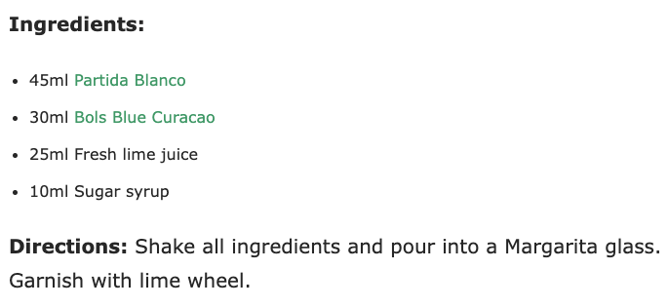

Slide 23

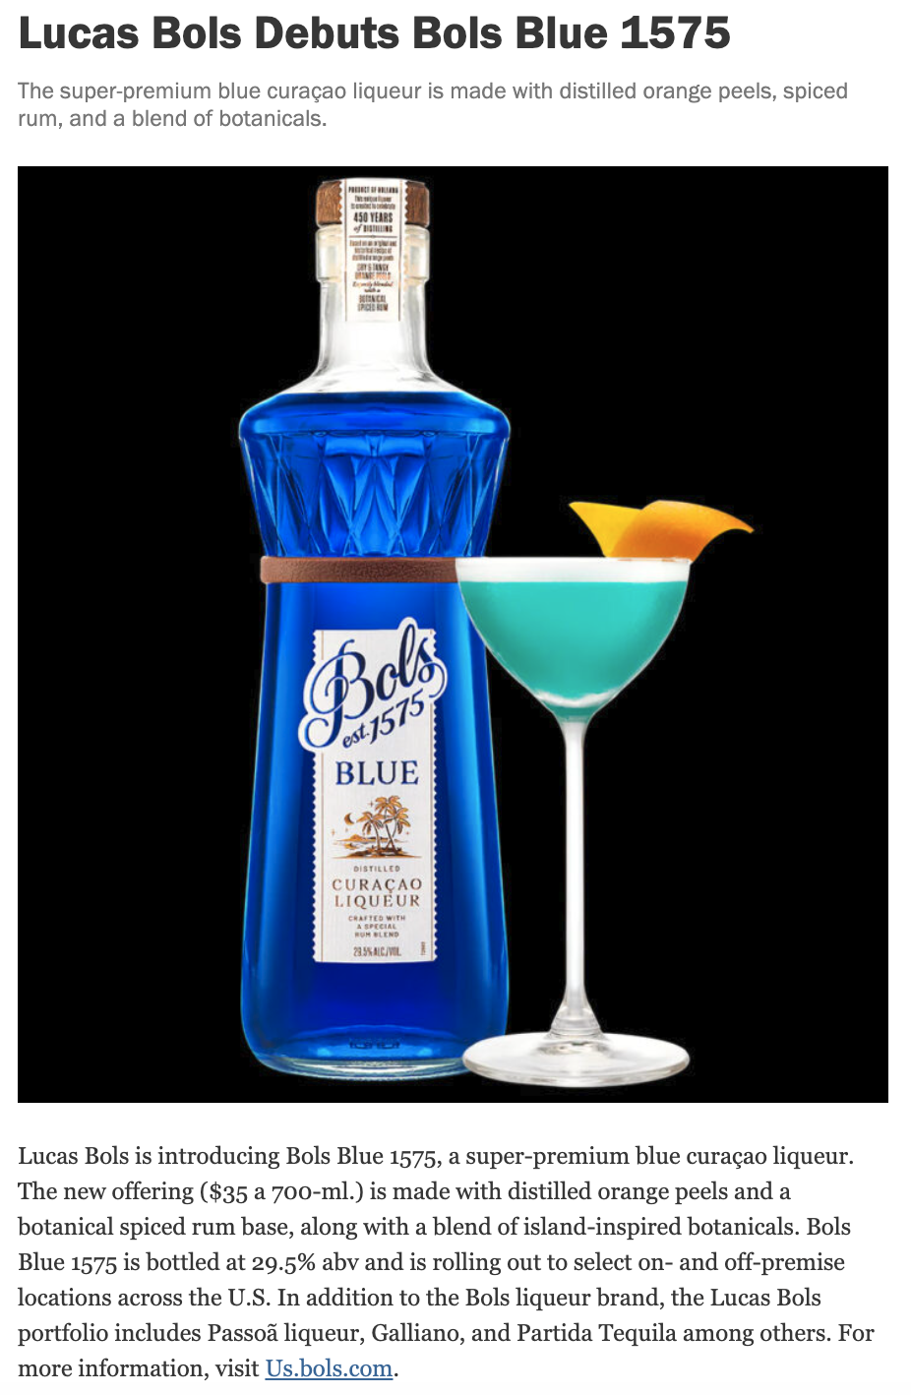
Date: 7/3/2025
Online Visits: 5,000
Click to view article

Slide 24


Date: 7/1/2025
Online Visits: 9,643
Click to view article

Slide 25
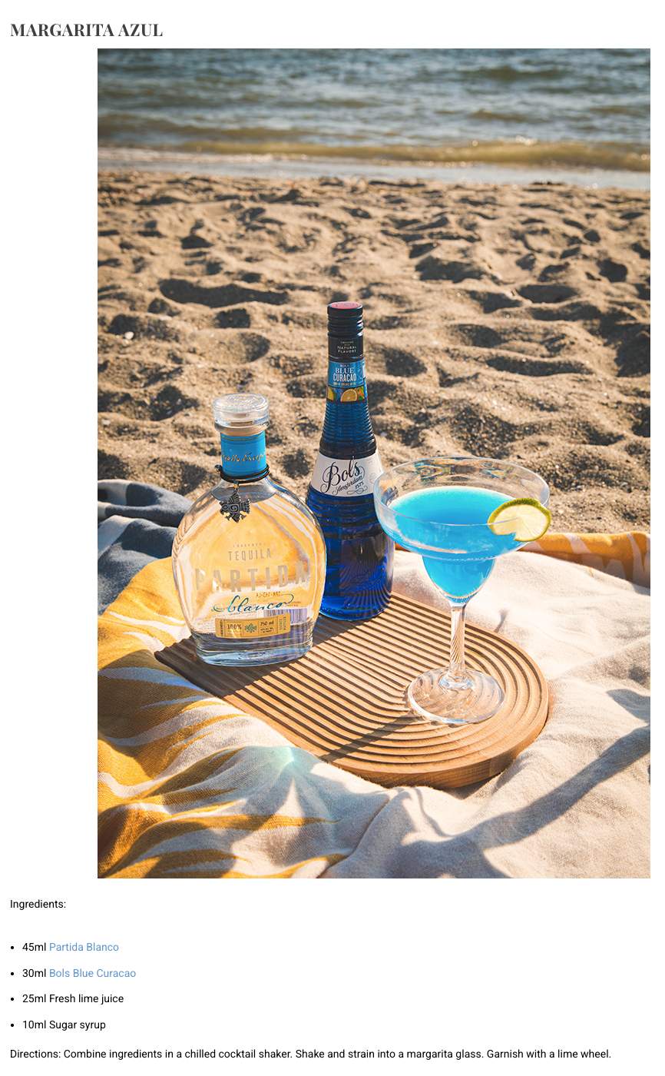

Slide 26



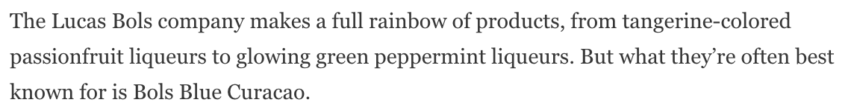
Date: 6/26/2025
Online Visits: 78,108,059
Click to view article

Slide 27
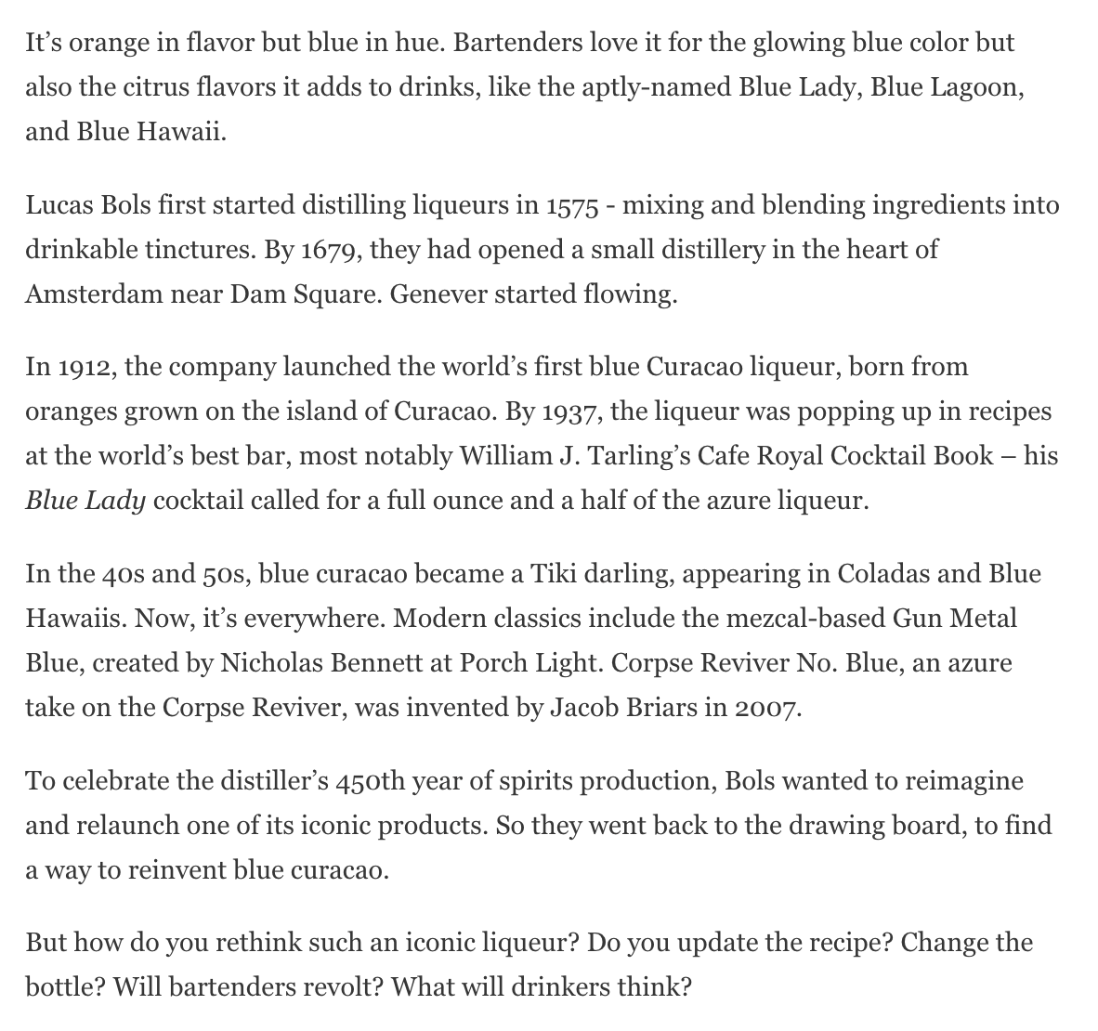
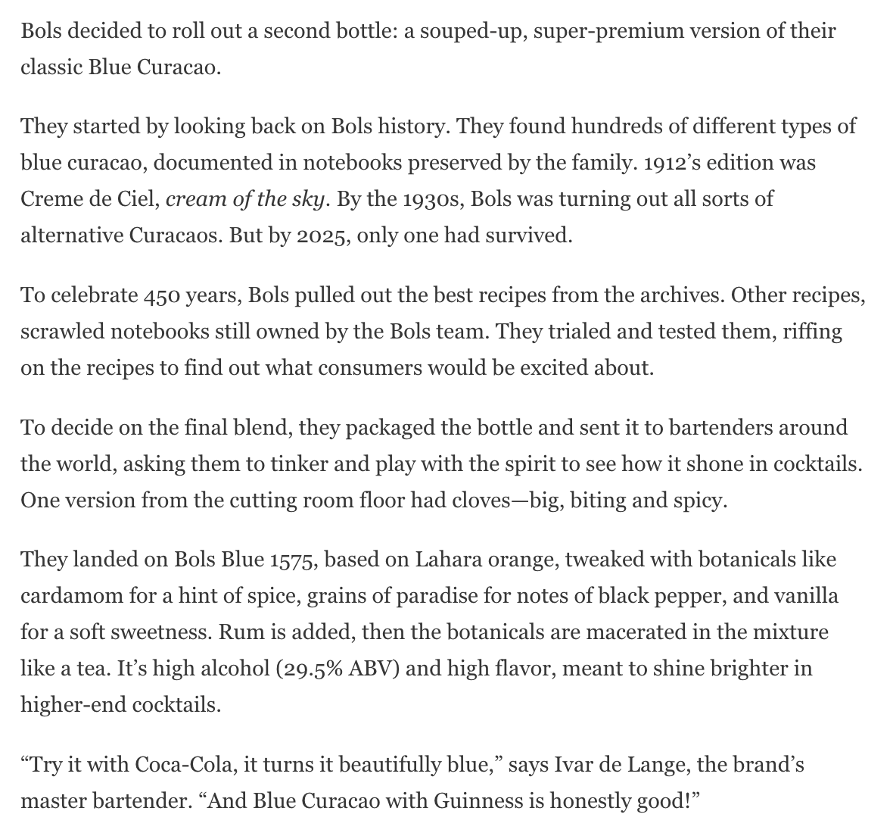

Slide 28
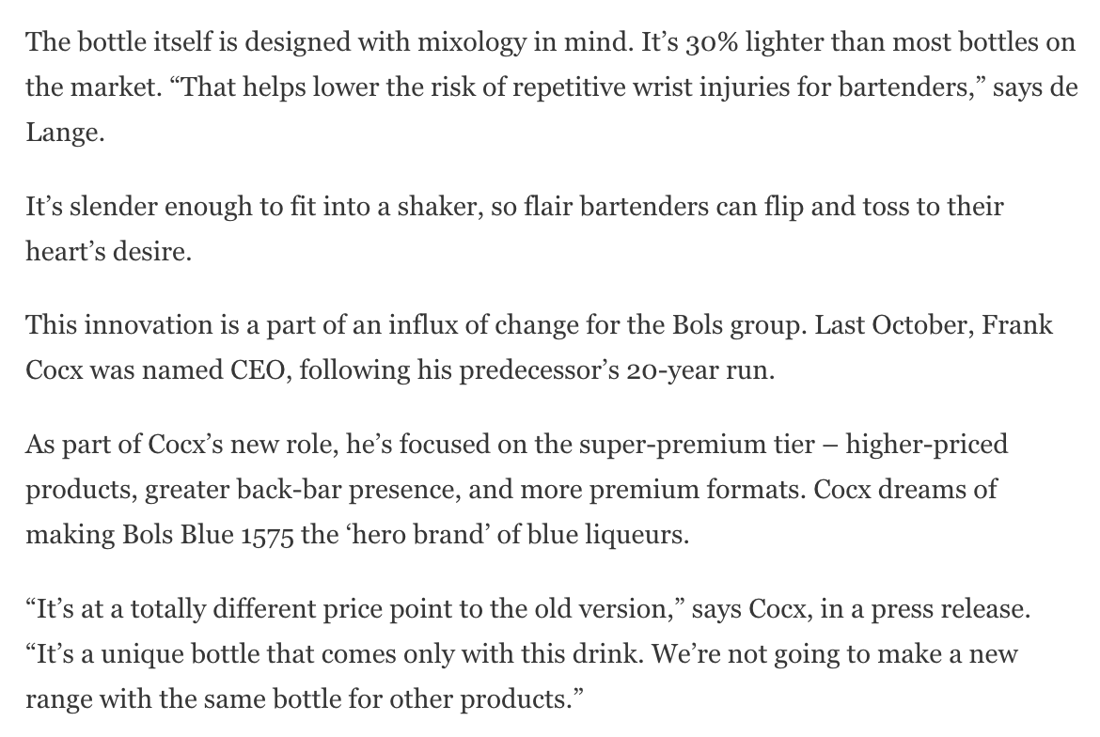

Slide 29

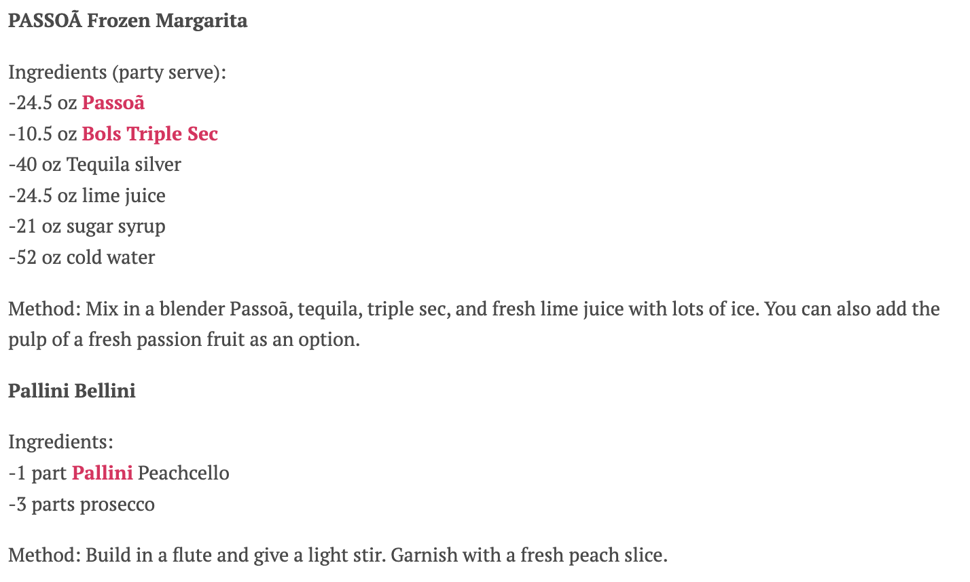
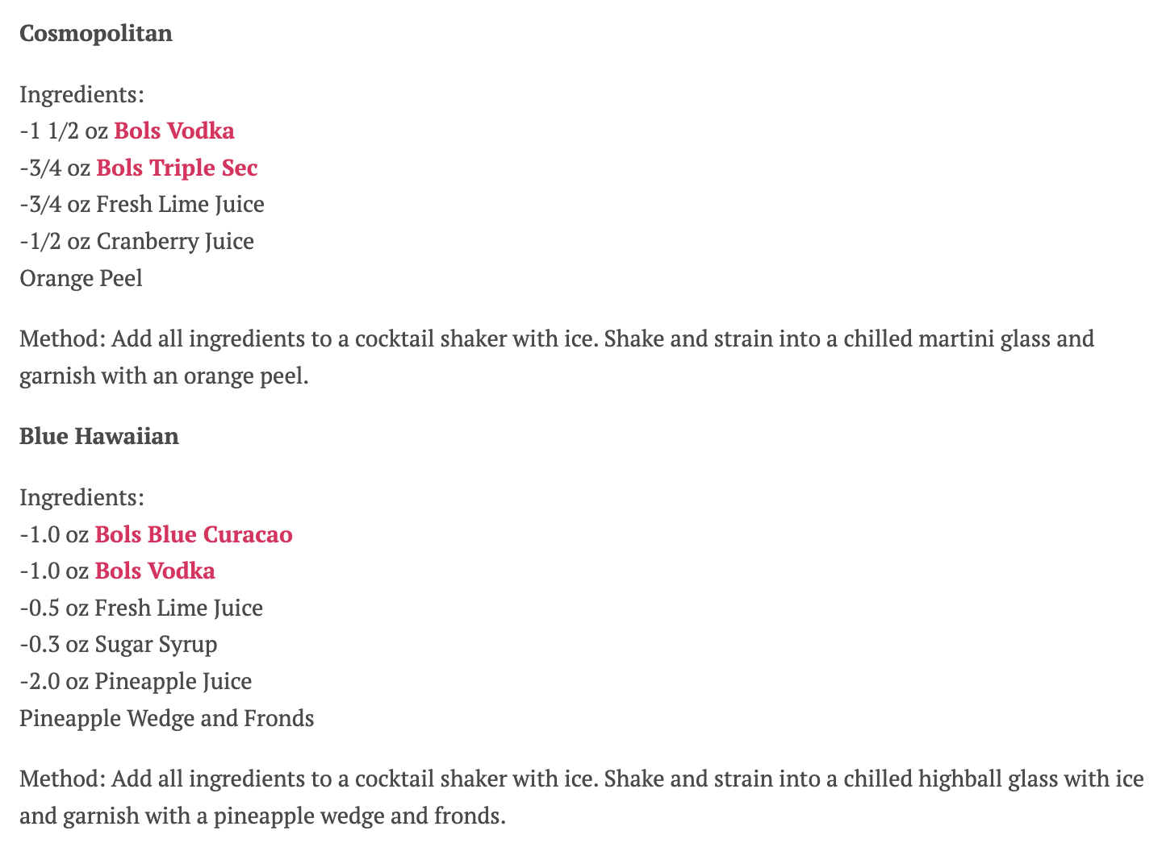
Date: 6/22/2025
Online Visits: 13,903
Click to view article

Slide 31

 | Date: 6/22/2025 Online Visits: 26,975 Click to view article
Syndication from Woman Around Town

Slide 32


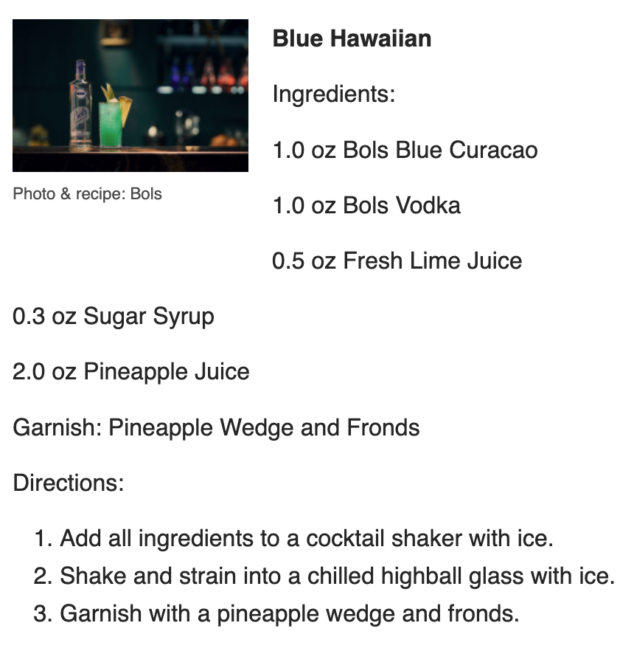
Date: 6/18/2025
Online Visits: 7,851
Click to view article

Slide 33


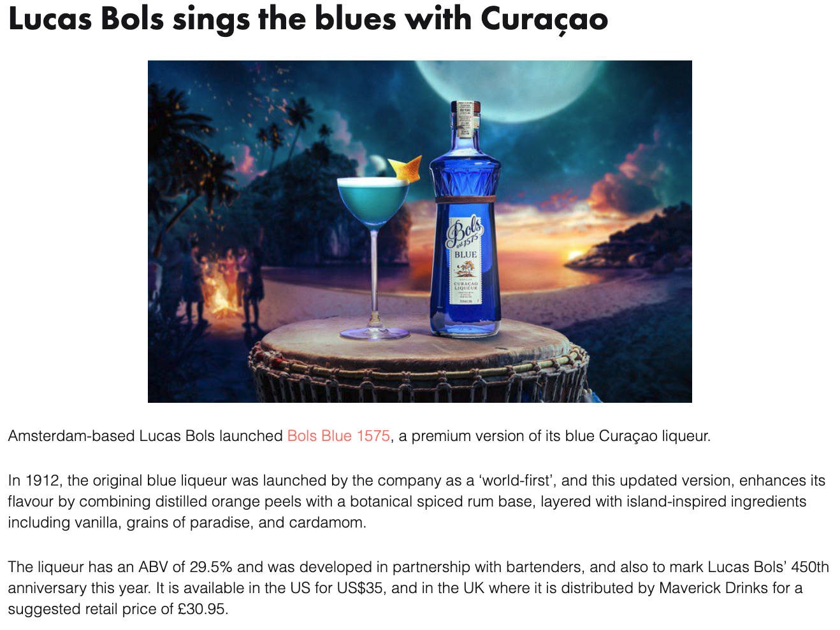
Date: 6/17/2025
Online Visits: 14,496
Click to view article

Slide 34

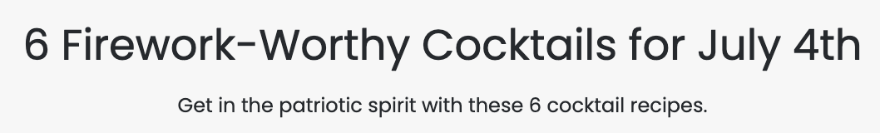

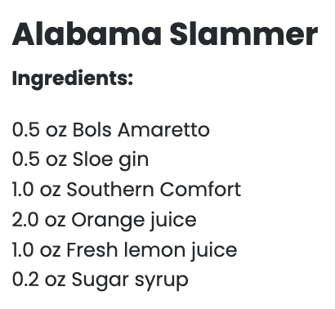

Date: 6/16/2025
Online Visits: 1,227,877
Click to view article

Slide 35


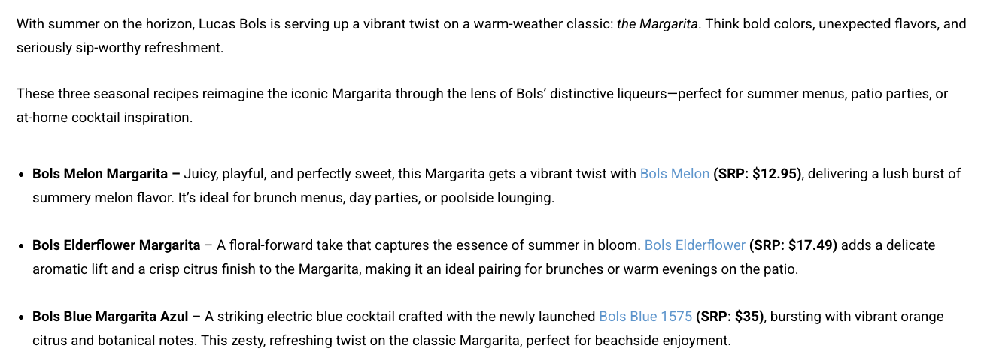
June 2, 2025
Online Visits: 9,643
Click to view article

Slide 36
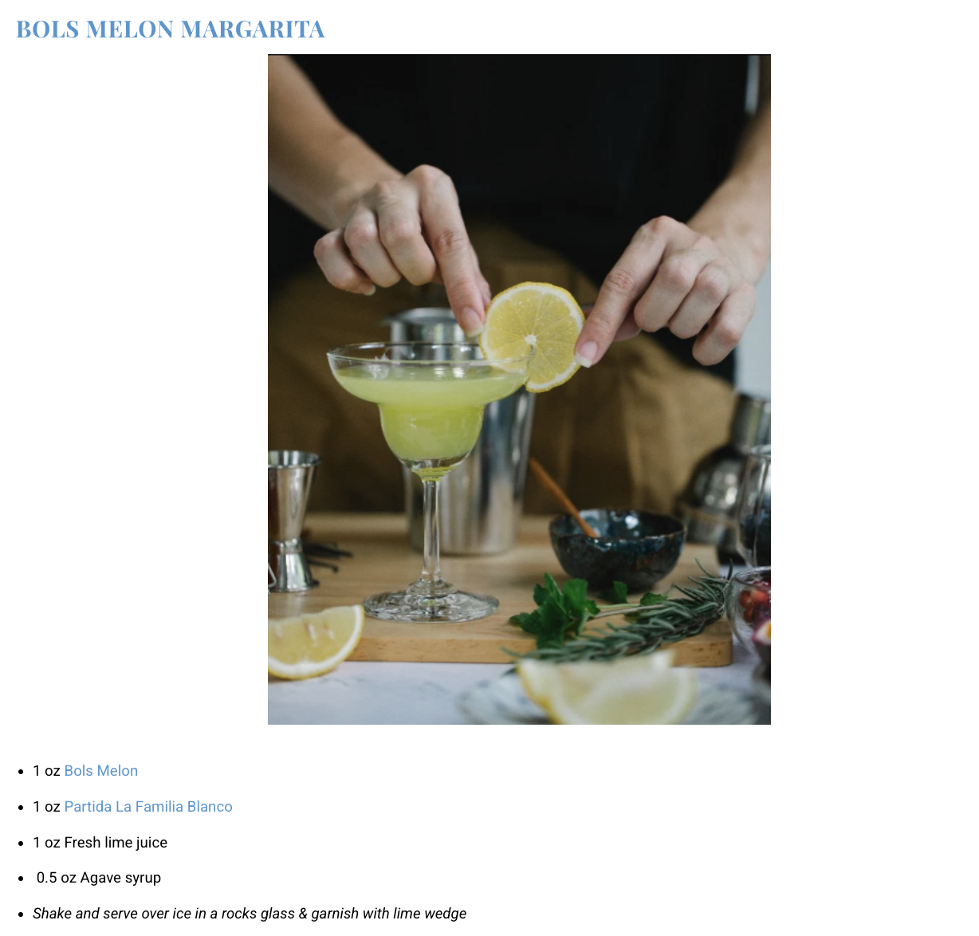


Slide 37


Slide 38

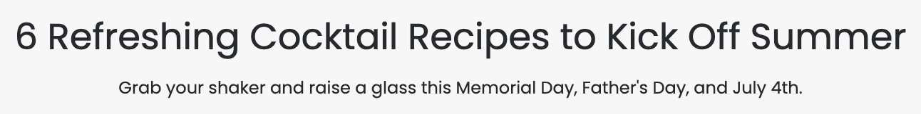

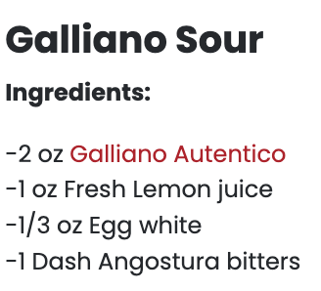
May 15, 2025
Online Visits: 1,227,877
Click to view article

Slide 39

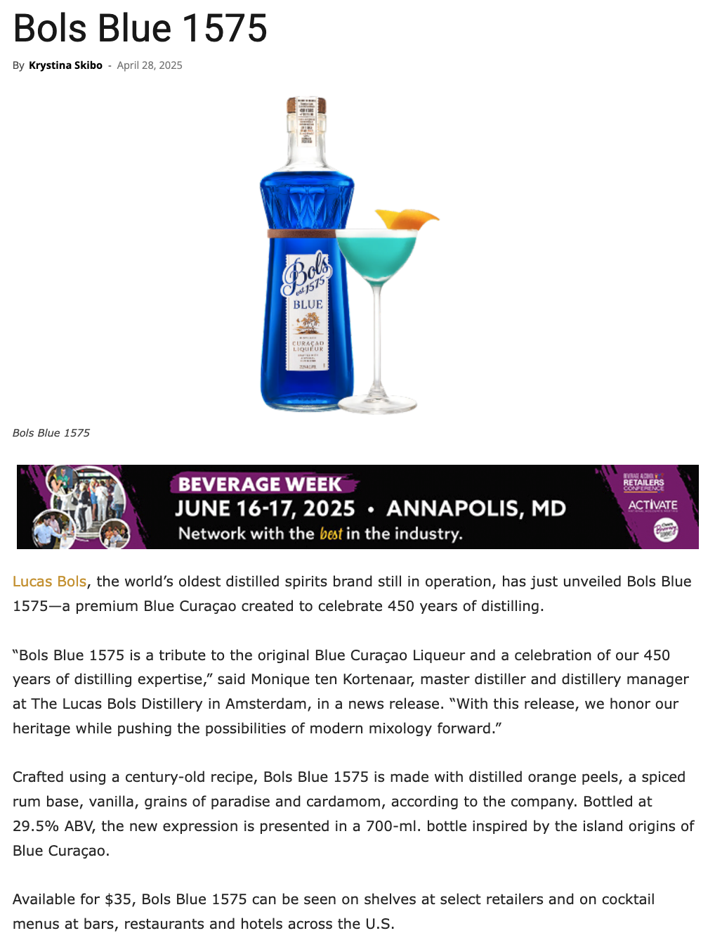
April 28, 2025
Online Visits: 5,000
Click to view article

Slide 40



April 25, 2025
Followers: 3,368
Click to view profile

Slide 41

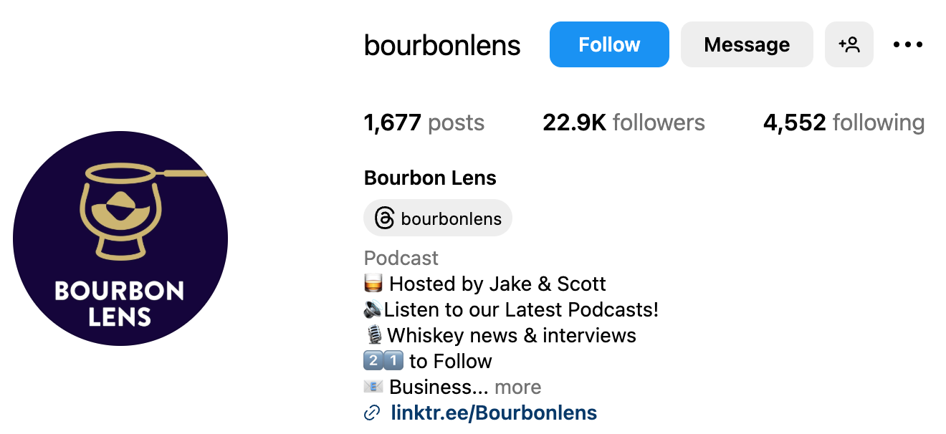
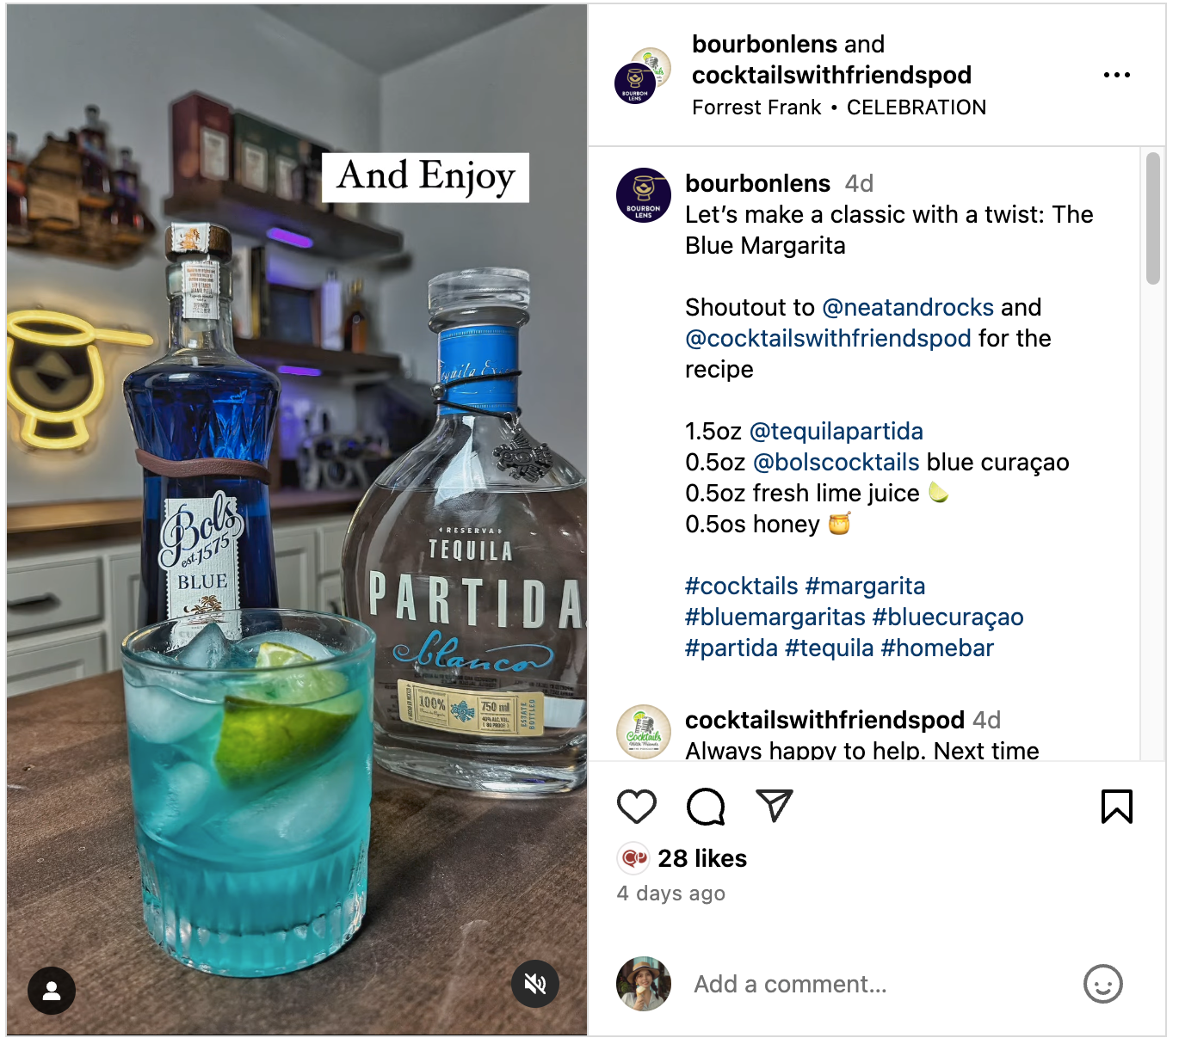
April 20, 2025
Followers: 22,900
Click to view post

Slide 42



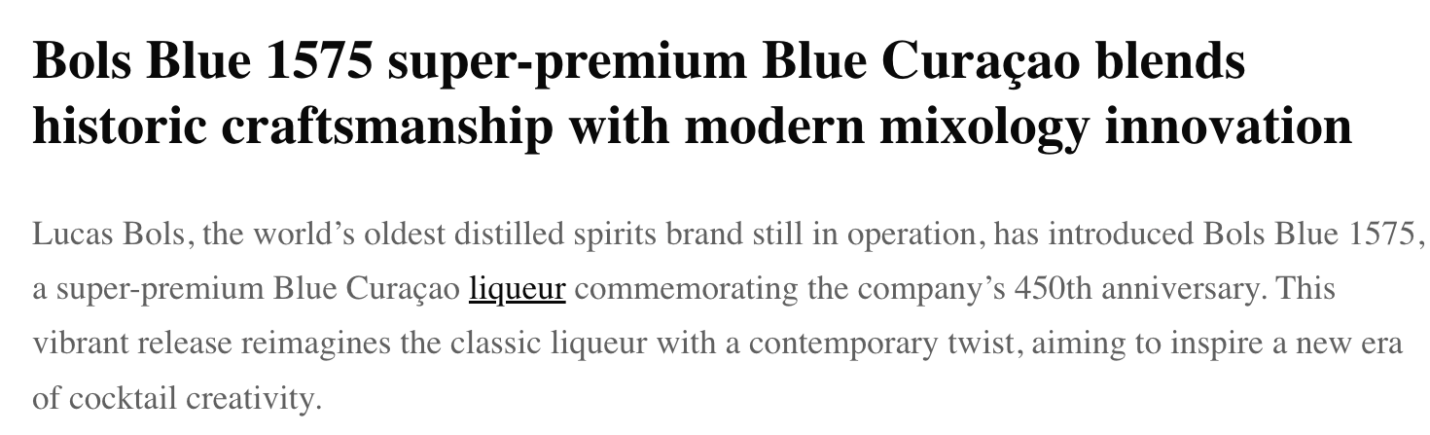
April 17, 2025
Online Visits: 5,000
Click to view article

Slide 43
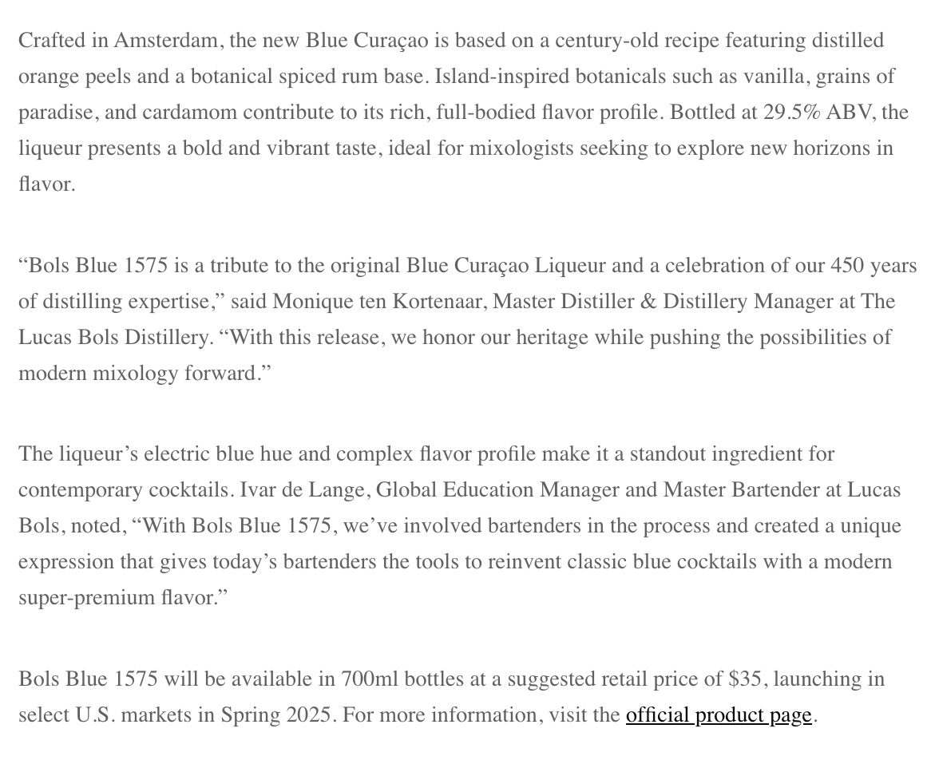

Slide 44

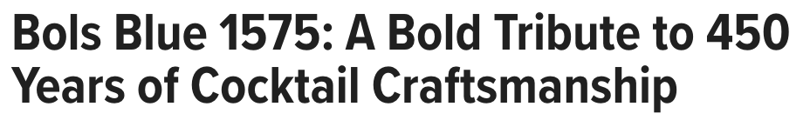


April 17, 2025
Online Visits: 81,942
Click to view article

Slide 45
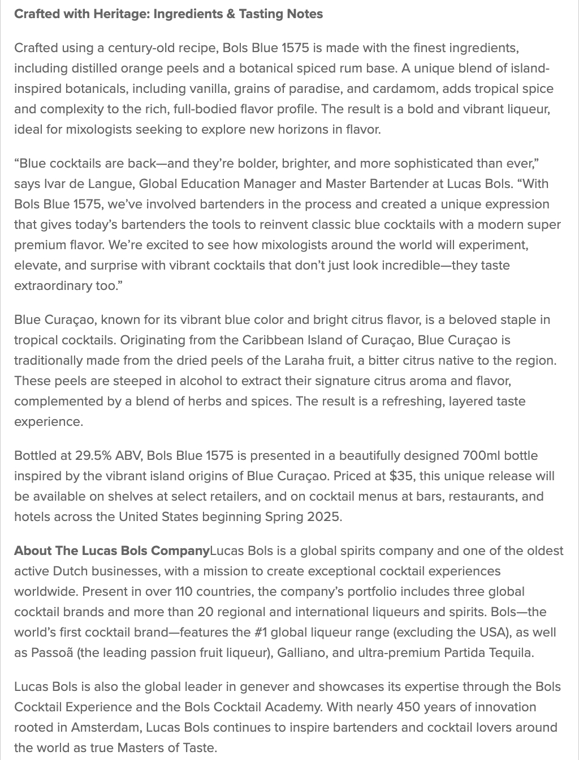

Slide 46



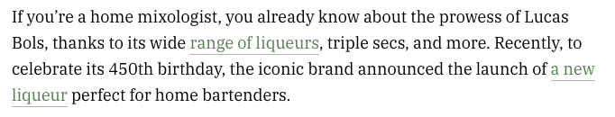
April 17, 2025
Online Visits: 629,659
Click to view article

Slide 47
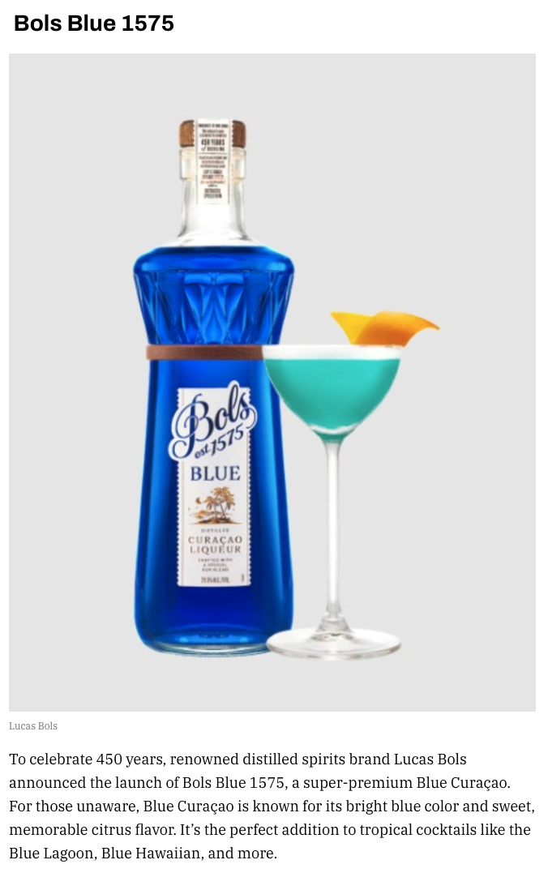
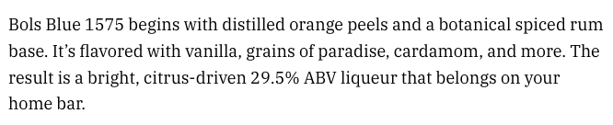

Slide 48



Slide 49

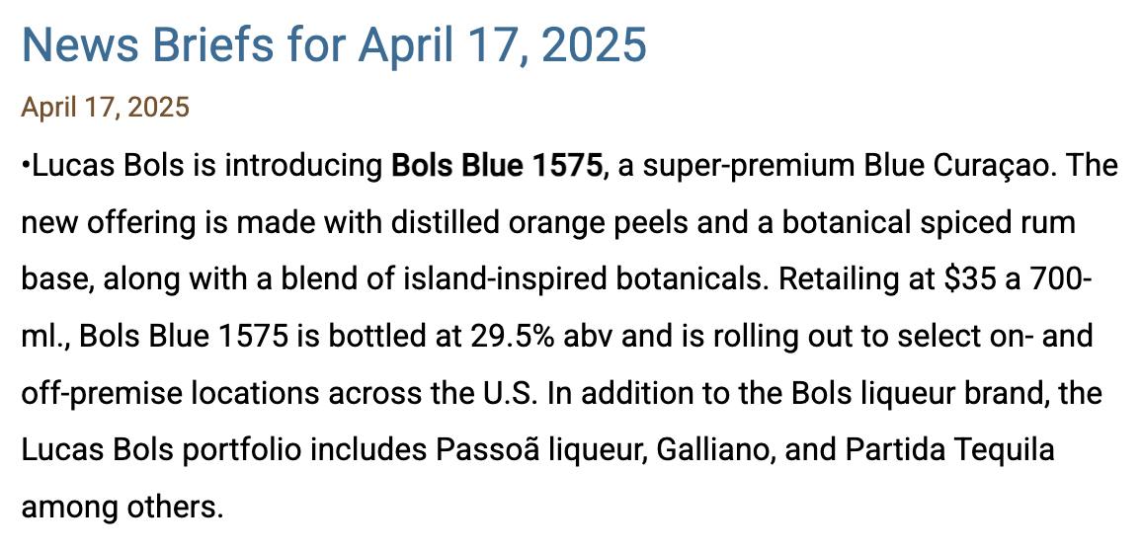
April 17, 2025
Online Visits: 5,247
Newsletter Subscriptions: 50,000
Click to view article

Slide 50

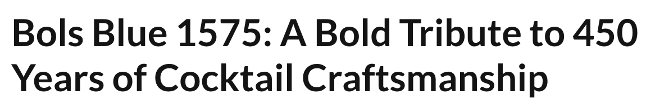
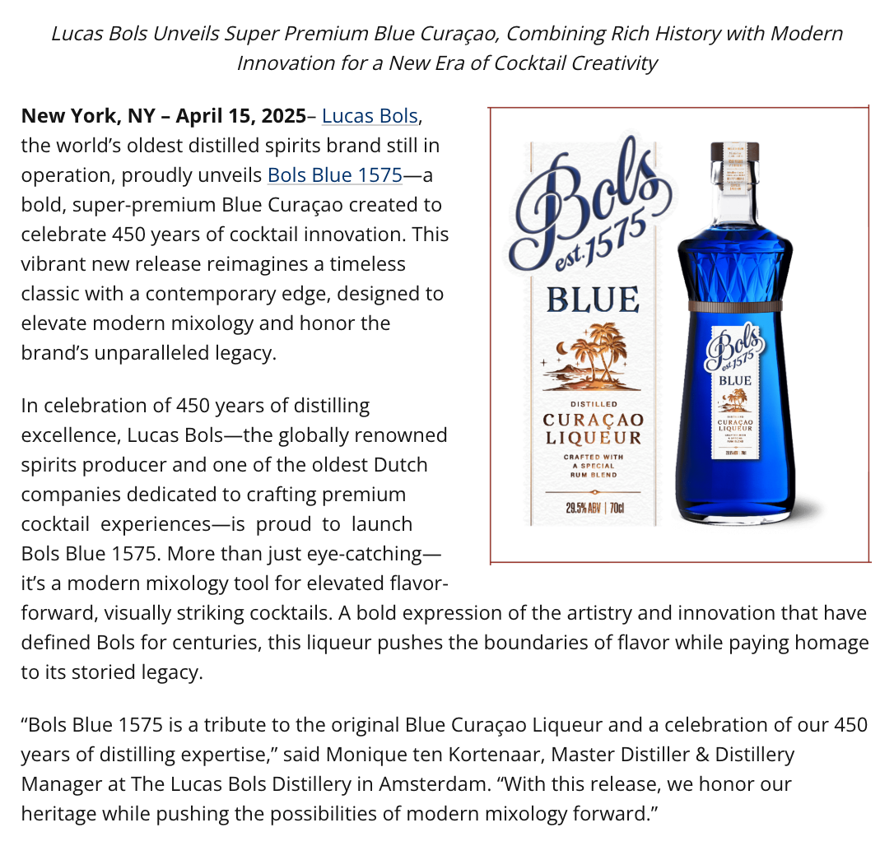
April 16, 2025
Online Visits: 15,763
Click to view article

Slide 51



Slide 52

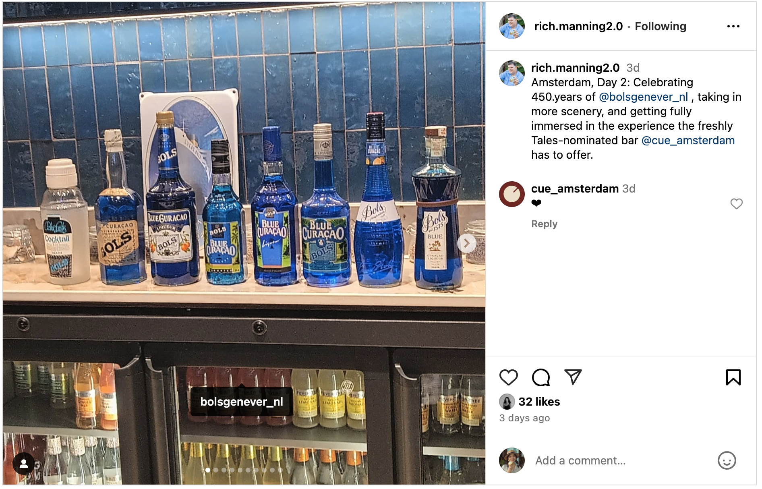
April 11, 2025
Followers: 1,631
Click to view post

Slide 53


April 10, 2025
Followers: 1,625
Click to view post

Slide 54


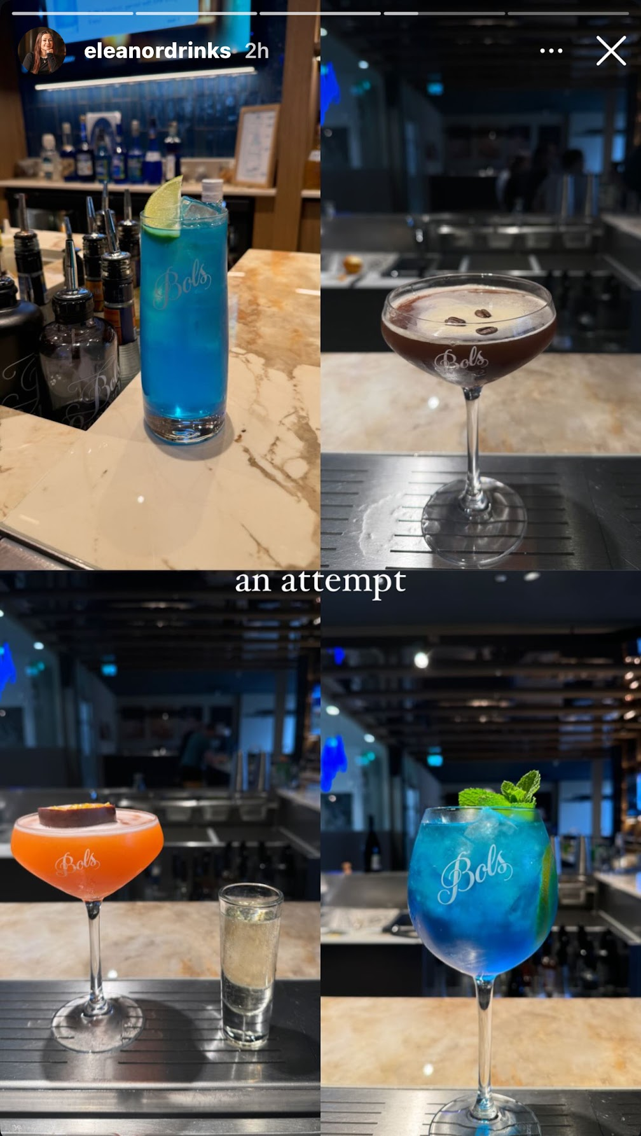

April 10, 2025
Followers: 414
Click to view profile

Slide 55


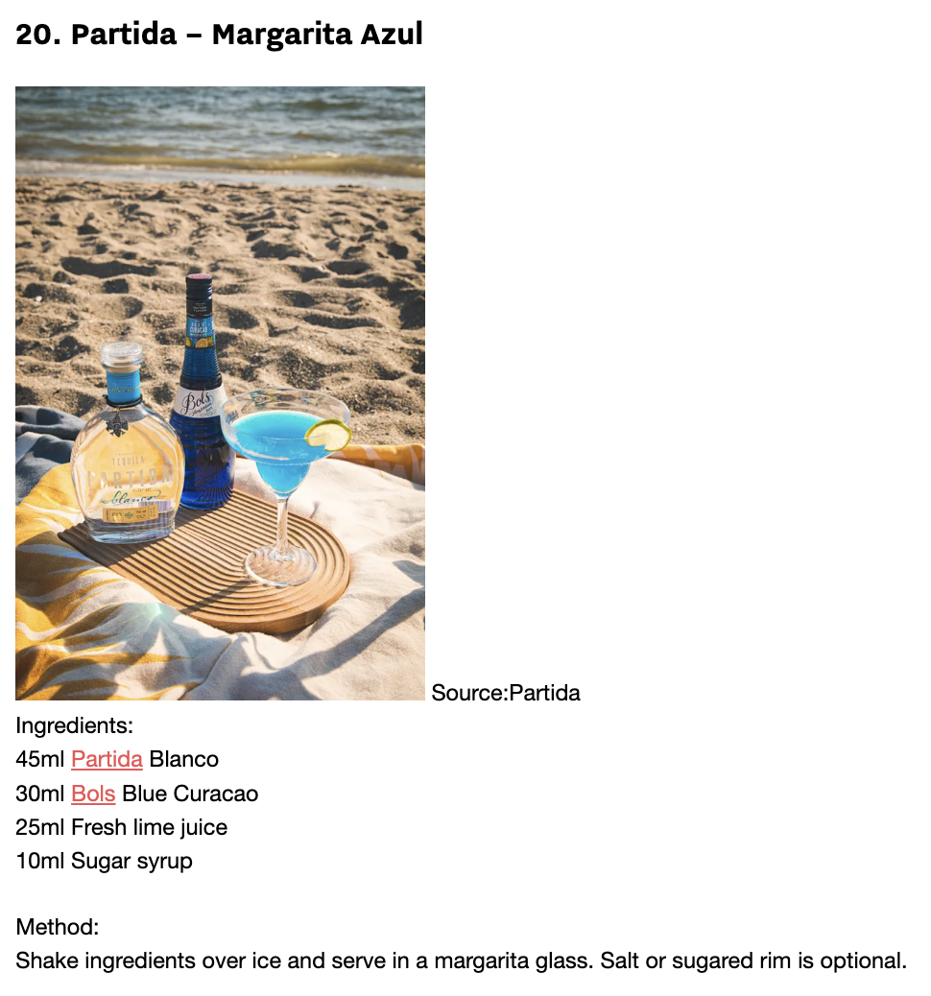
February 21, 2025
Online Visits: 42,949
Click to view article

Slide 56






 | February 21, 2025 Online Visits: 33,956 Click to view article
 | February 21, 2025 Online Visits: 5,000 Click to view article
 | February 21, 2025 Online Visits: 170,764 Click to view article
 | February 21, 2025 Online Visits: 5,000 Click to view article
 | February 21, 2025 Online Visits: 68,071 Click to view article
 | February 21, 2025 Online Visits: 50,623 Click to view article
Syndications from Cassius

Slide 57

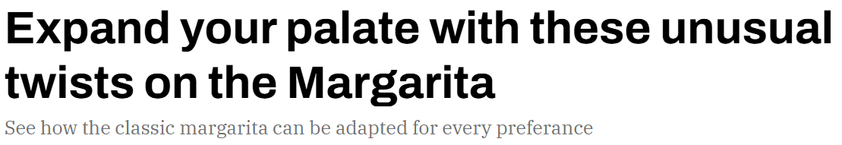
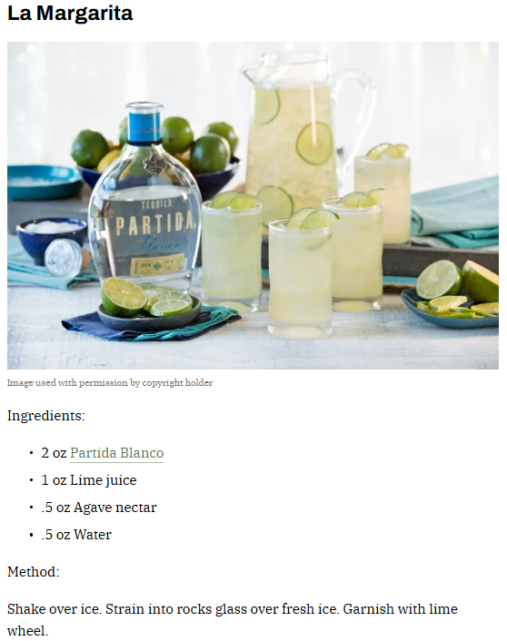
February 19, 2025
Online Visits: 953,553
Click to view article

Slide 58


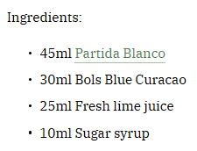

Slide 59

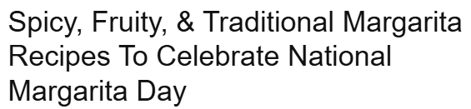

February 19, 2025
Online Visits: 13,967
Click to view article

Slide 60



February 12, 2025
Online Visits: 38,209
Click to view article

Slide 61


Slide 62




February 9, 2025
Online Visits: 5,000
Click to view article

Slide 63

 | February 9, 2025 Online Visits: 5,000 Click to view article
Syndication from Champaign Living

Slide 64





January 31, 2025
Online Visits: 1,308,616
Click to view article

Slide 65

 | February 19, 2025 Online Visits: 407,199,536 Click to view article
Syndication from The Manual

Slide 66



December 31, 2024
Online Views: 49,888
Click to view article

Slide 67


Slide 68




December 19, 2024
Online Views: 80,493
Click to view article

Slide 69


Slide 70


Slide 71


Slide 72




December 12, 2024
Online Views: 115,726
Click to view article

Slide 73




Slide 74




December 12, 2024
Online Views: 5,000
Click to view article

Slide 75


Slide 76





December 5, 2024
Online Views: 16,761
Click to view article

Slide 77



October 30, 2024
Online Visits: 5,000
Click to view article

Slide 78




October 28, 2024
Online Visits: 71,594
Click to view article

Slide 79




October 25, 2024
Online Visits: 28,747
Click to view article

Slide 80



October 16, 2024
Online Visits: 5,000
Click to view article

Slide 81




September 14, 2024
Online Visits: 1,244,138
Click to view article

Slide 82




Slide 83


Slide 84



