Slide 1

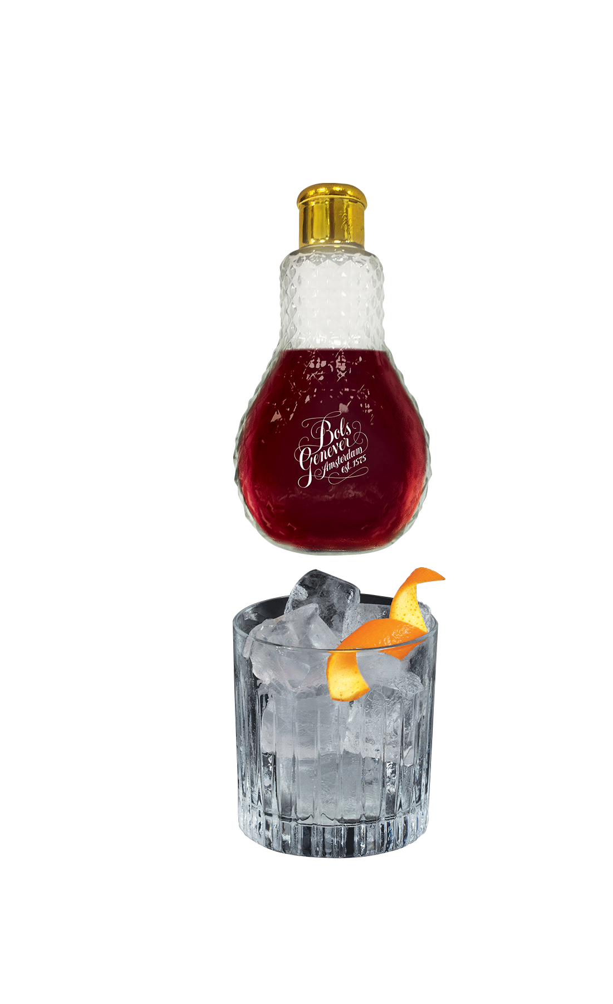
THE
PERFECT
PITCH
BOLS GENEVER
ORIGINAL
PERFECT PITCH
Bols Genever is The Original Spirit of Amsterdam.
Born in 1575. Over 400 years’ experience in mastering Bols Genever.
Bols Genever Original, an incomparable triple grain malt spirit with 22 unique botanicals, delivers an exceptionally smooth and complex taste experience of malt, stone fruits and juniper that will bring your tongue to life!
Bols Genever is the ideal spirit for our signature cocktail, The Red Light Negroni:
Equal parts, Bols Genever Original, bitter Italian liqueur and sweet vermouth.
WHY Red Light Negroni:
A cheeky homage to our distillery location in the heart of the Red Light District in Amsterdam.
Provides guests with an added value experience (Theatrical serve). Take the lightbulb home with you.
Perfect for your Happy Hour menu
Served in our proprietary Lightbulb decanter.
@BolsGenever
www.BolsGenever.com

Slide 2

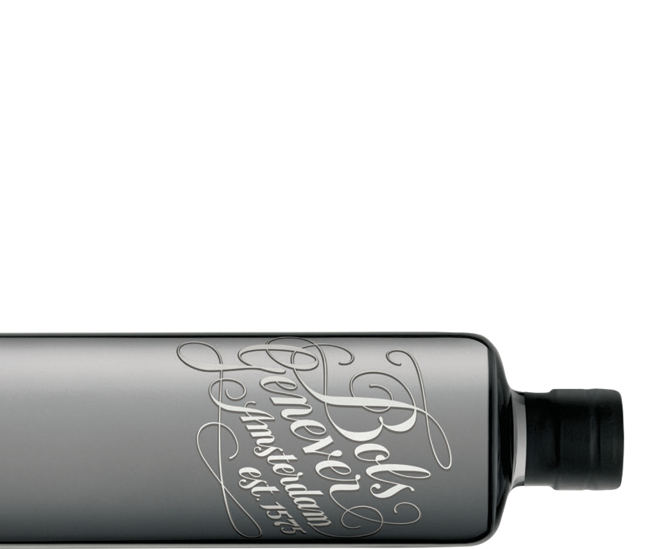
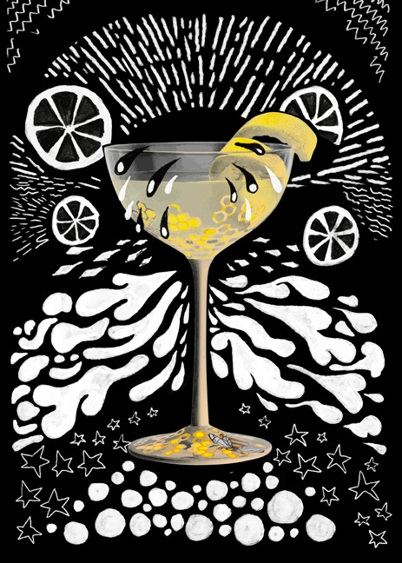
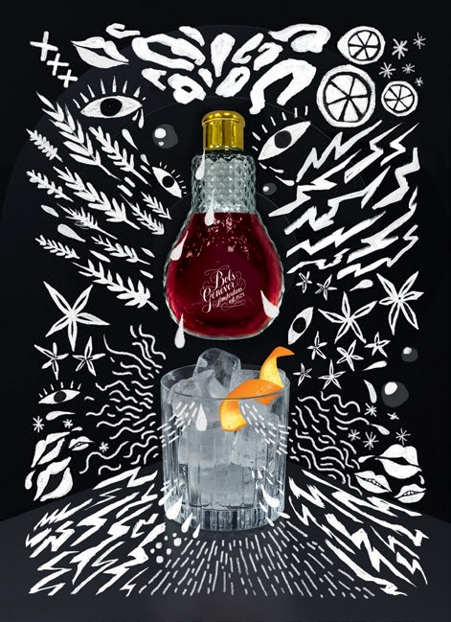
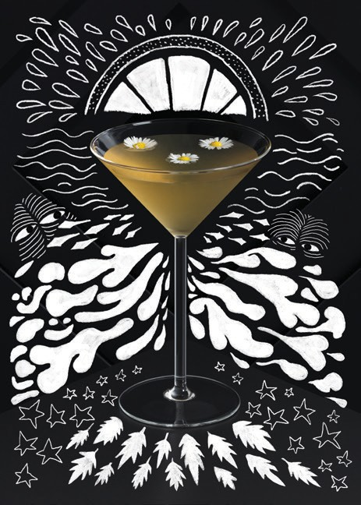


WHY THE PERFECT PITCH
To Do:
Use the pitch to present Bols Genever Original to your bartenders, buyers, and consumers.
We have purposely standardized this pitch to deliver the same message about Bols Genever Original to all accounts and to allow our audience to understand and feel comfortable with the spirit.
Do Not Do:
Stay away from overwhelming your audience with too much information on production methods/historical facts.
Instead, use our key terms to allow your audience to understand and digest the basic information about Bols Genever Original.
This will make them feel comfortable about Bols Genever Original in our unique terms.
Do not speak about Bols Genever Original in the general Genever terms, always refer back to Bols Genever Original and what makes us unique!
SIGNATURE COCKTAILS
CITRUS COCKTAILS
THE
RED
LIGHT
NEGRONI.
DAISY.
1 oz Bols Genever Original 1 oz sweet vermouth
1 oz Italian bitter liqueur
Combine the ingredients with ice into a mixing glass, and stir well.
Strain into the lightbulb glass.
Serve the lightbulb next to a rocks glass filled with ice and garnished with an orange twist.
2 oz Bols Genever Original
.5 oz Orange Curacao
.25 oz simple syrup
.25 oz lemon juice
Shake all ingredients and fine strain into a pre-chilled coupe glass.
Top with sparkling wine. Garnish with orange peel.
Easy 1-2-3 refreshing summer cocktail
BEE’S KNEES
2 oz Bols Genever Original
.75 oz lemon juice
.75 oz local honey
Shake and strain into a Nick & Nora glass
A must have for your classic cocktail menu section
@BolsGenever
www.BolsGenever.com

