Slide 1

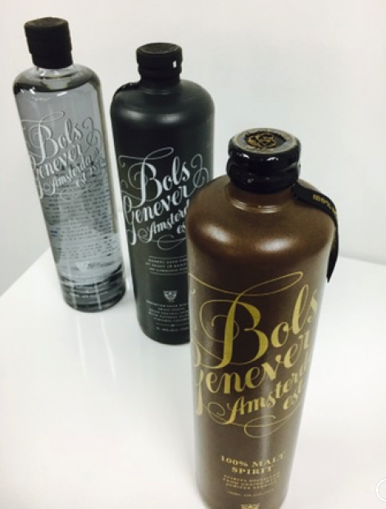
100% Malt Spirit Bols Genever
WHEN: January 1st (listed at distributors 1st december)
WHAT: 750ML
WHERE: NY/CA/IL/MA/CO/TX
HOW MANY: Special Item 33 cases (actual cases) per states 1 time PO
FOB: $200
Wholesale per case : IL: $288, NY: $282, CA: $282, MA: $282, CO: $282, TX: $282
NO CASE DEAL!!
SRP: SRP $69.99
PRESS: OCTOBER 1st begin the push
ASSETS: Sell sheet link Pack shot image link: Pack shot Link
Received samples for PR

Slide 2
PR, launch Ad and launch event
Launch Ad: in the #1 trade magazine, Imbibe (2 months January/February)
Press: December gift issues consumer and trade publication looking for 24 press clip from December to February
Launch event with Piet in January 2018:
- 1st event in mature market in NYC (with Boston guests joining)
- 2nd event in emerging market in Denver Colorado

Slide 3
Launch calendar
 | OCTOBER | NOVEMBER | DECEMBER | JANUARY | FEBRUARY | MARCH
Listed with MHW | DONE
listed with distributors |  |  | DONE
MARKET LAUNCH |  |  |  | January 15th
PR
PRESS CLIP
POS | DONE
IMBIBE ADS
PIET LAUNCH EVENT

Slide 4
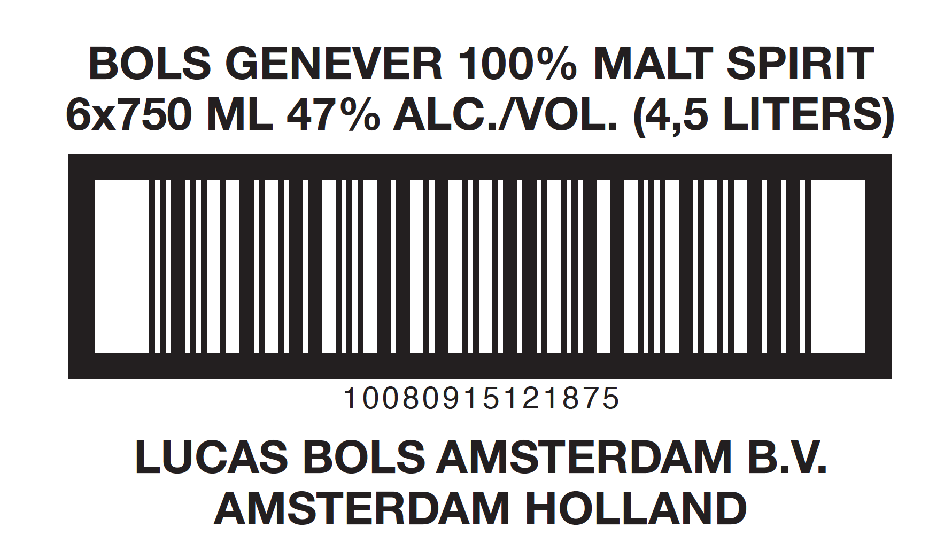
100% Malt Spirit Bols Genever
SPEC’s
Outer case picture:
Bottle UPC:
Case UPC:

Slide 5
Focus accounts
Top 50 (depending on states) On-P BA & SM’s RESPONSIBILITY
Top 10 Off-P (depending on states) SM’s RESPONSIBILITY

Slide 6
On-P
NY Acc’s
Off-P
50 top On-P and 12 top Off-P accounts
1 case max per accounts, hold for selected accounts
New account’s request please contact SM for authorization

Slide 7
IL Acc’s
On-P
50 top On-P (cannot do Off-P, the market is not ready we need to see more 1820 presence first)
1 case max per accounts, hold for selected accounts
New account’s request please contact SM for authorization

Slide 8
TX Acc’s
Chains Acc’s
On-P
Independent Acc’s
12 top Off-P Chains and 10 top Off-P accounts Independent
1 case max per Independent accounts, 2 cases per Chain accounts. hold for selected accounts
New account’s request please contact SM for authorization

Slide 9
On-P
CA South Acc’s
Off-P
50 top On-P and 7 top Off-P accounts
1 case max per accounts, hold for selected accounts
New account’s request please contact SM for authorization

Slide 10
On-P
CA North Acc’s
Off-P
50 top On-P and 7 top Off-P accounts
1 case max per accounts, hold for selected accounts
New account’s request please contact SM for authorization

Slide 11
CO Acc’s
On-P
Off-P
32 top On-P and 12 top Off-P accounts
1 case max per accounts, hold for selected accounts
New account’s request please contact SM for authorization

Slide 12
MA Acc’s
On-P
Off-P
50 top On-P and 6 top Off-P accounts
1 case max per accounts, hold for selected accounts
New account’s request please contact SM for authorization

