Slide 1

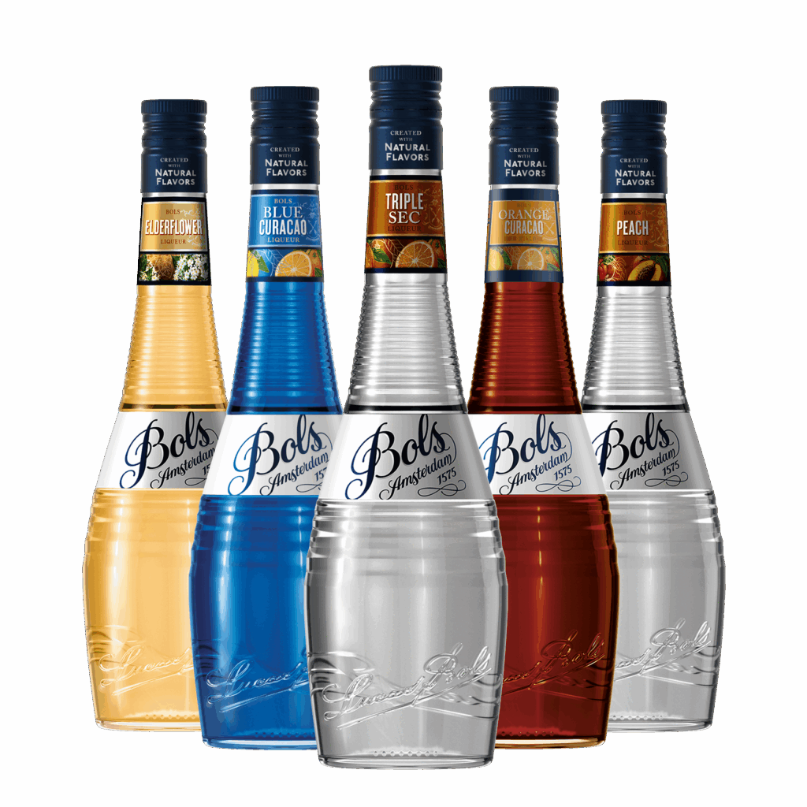
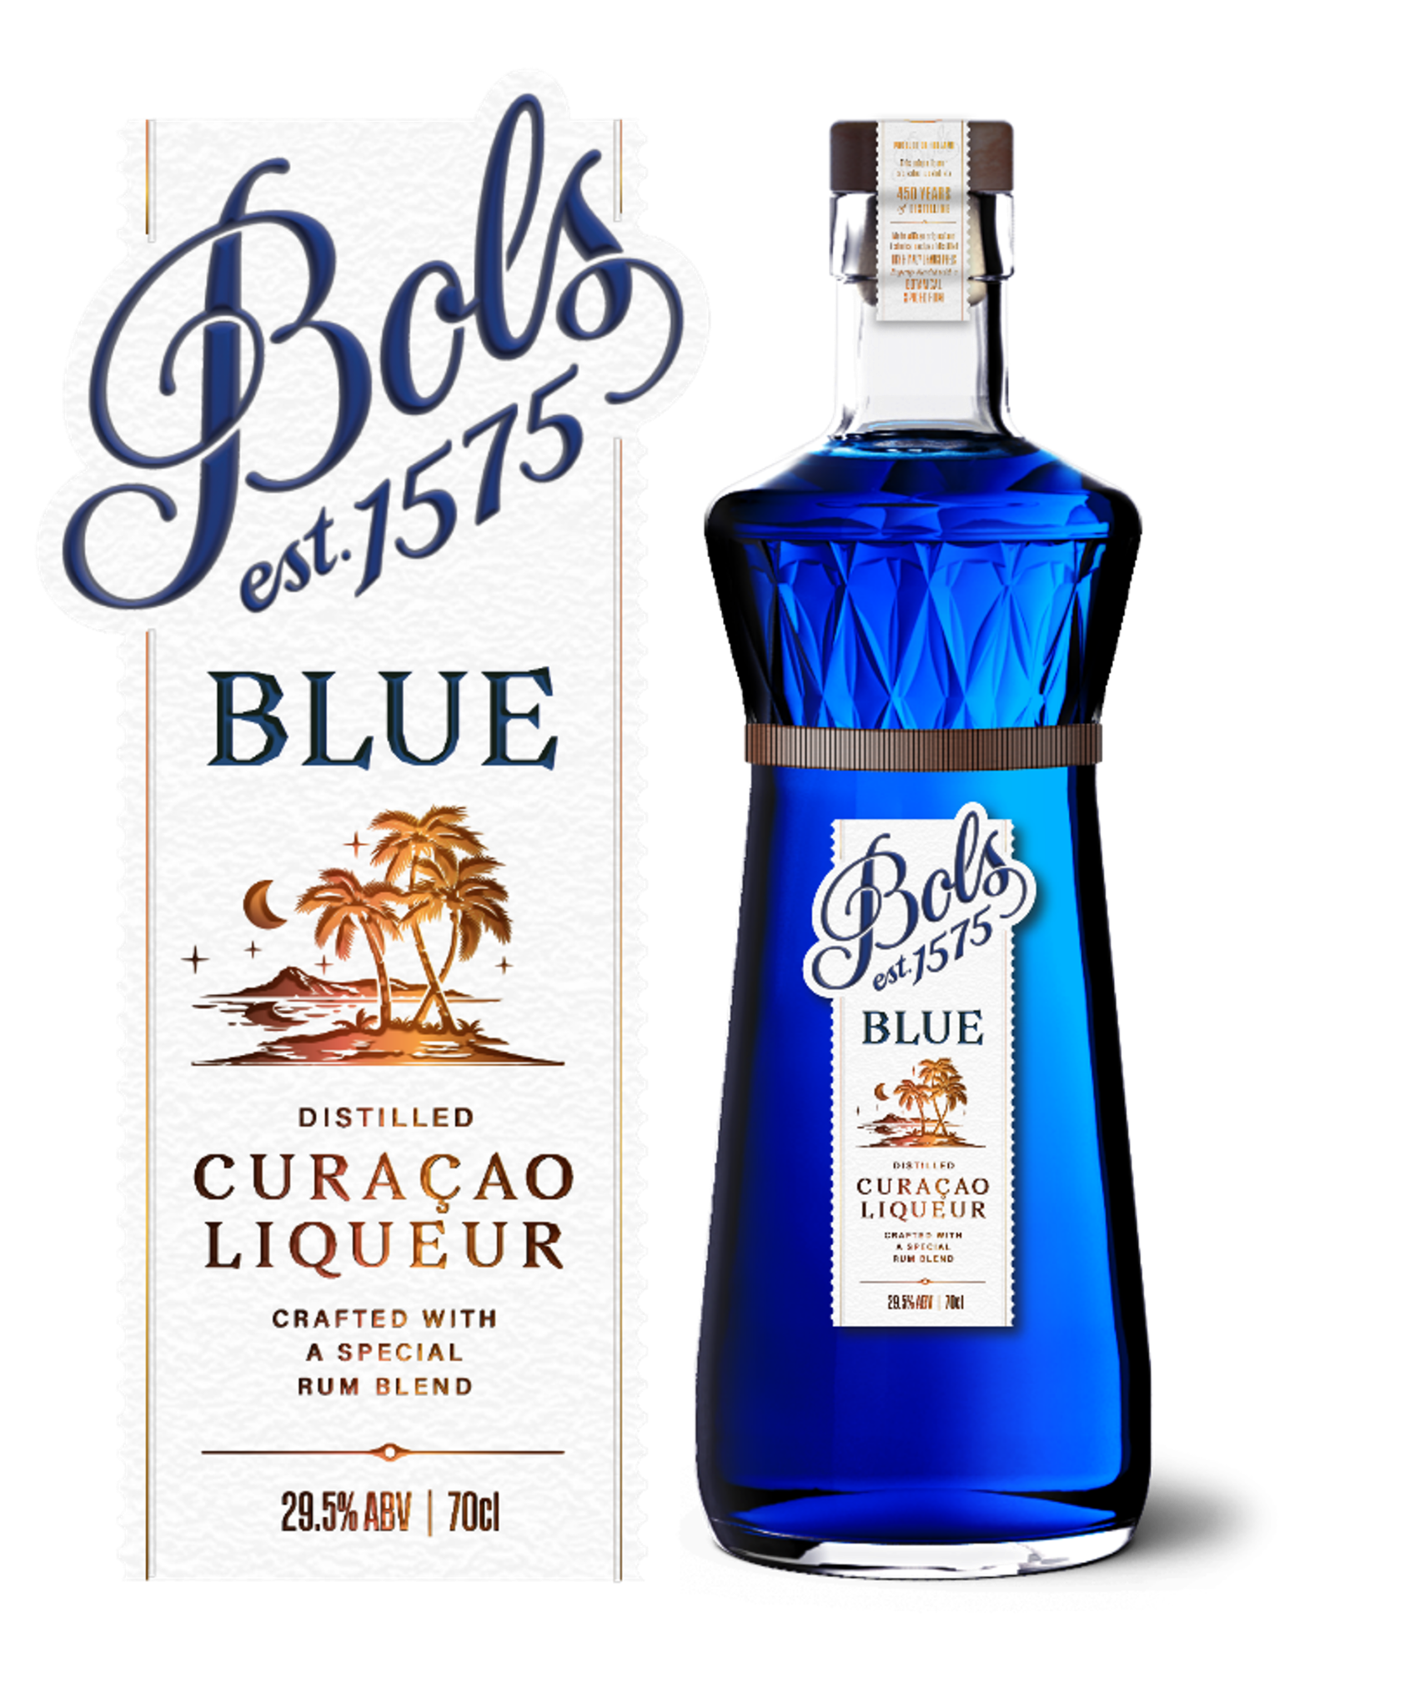
2025 Top Media
Hits Recap

Slide 2



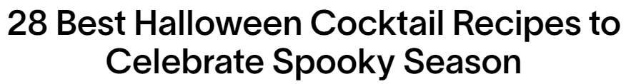
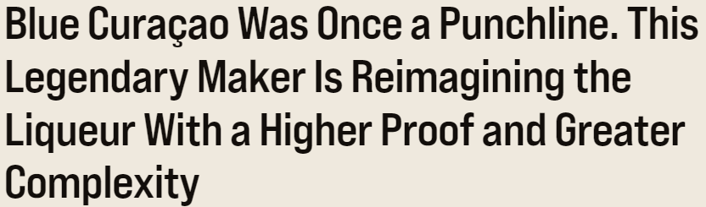
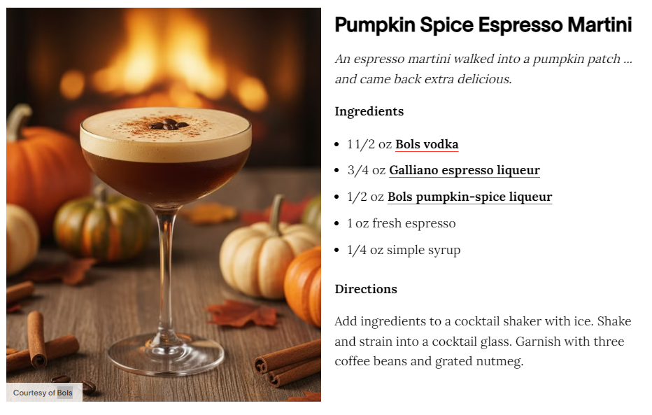
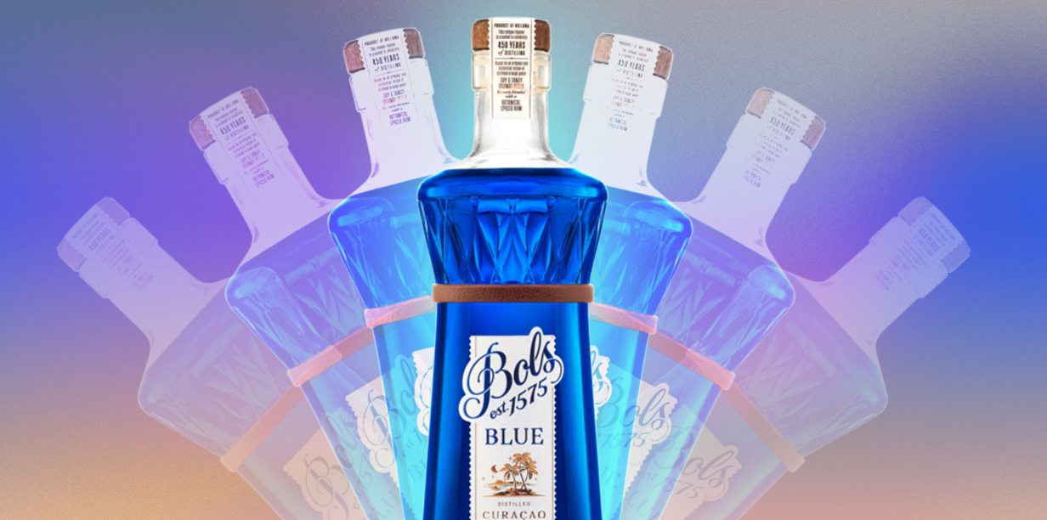
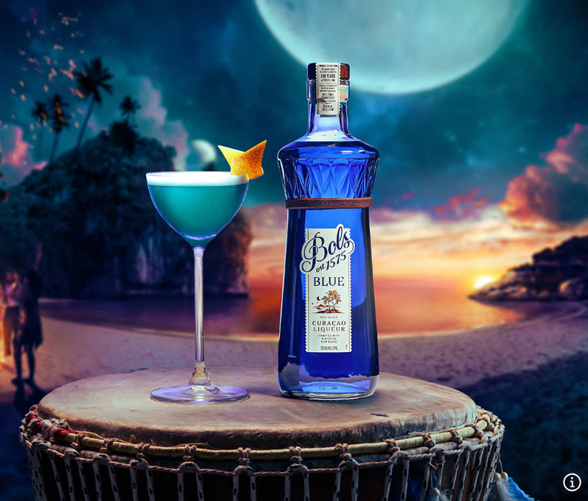

2025 - Top Media Highlights
Date: 11/25/2025
UVM: 829,906
Link
Date: 10/24/2025
UVM: 12,883,348
Link
Date: 9/30/2025
UVM: 15,082,382
Link

Slide 3




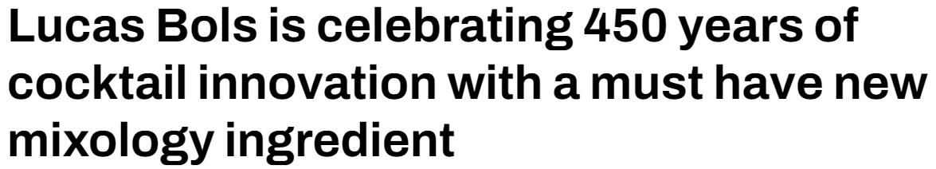
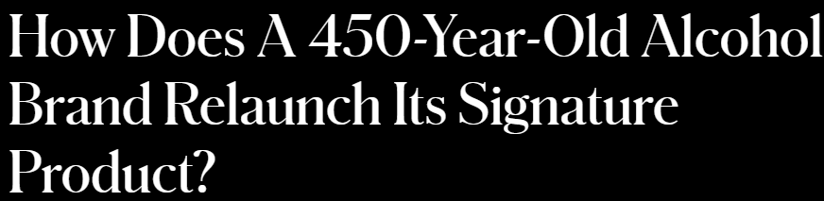
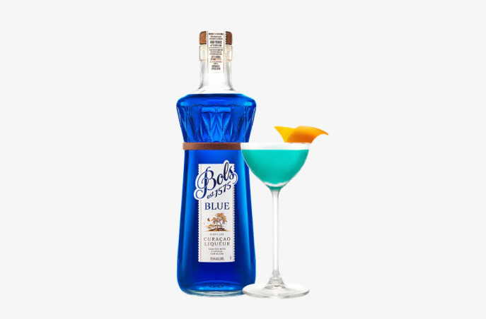
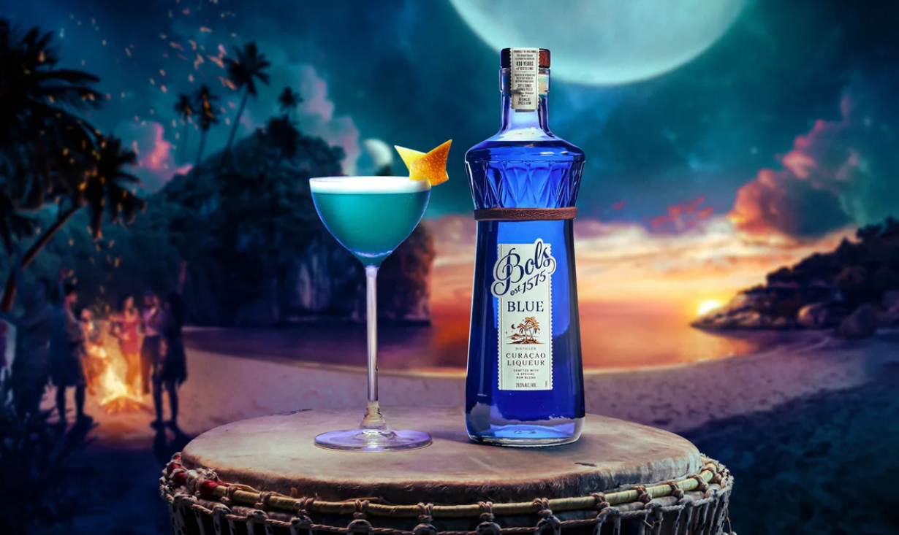
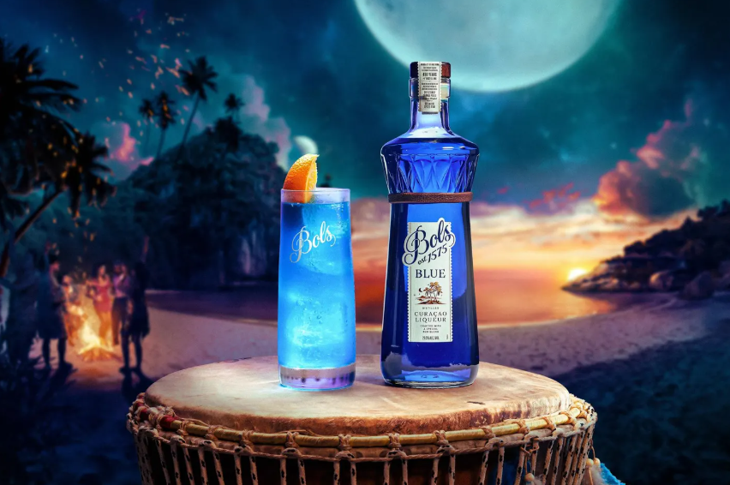
2025 - Top Media Highlights
Date: 10/15/2025
UVM: 785,423
Link
Date: 3/14/2025
UVM: 50,739,115
Link
Date: 4/17/2025
UVM: 350,825
Link
Notes:
https://www.insidehook.com/spirits/muff-liquor-company-gin-vodka-irish-whiskey-review
https://robbreport.com/food-drink/spirits/gallery/best-irish-whiskey-brands-1235509136/redbreast_15/
https://www.wineenthusiast.com/toplists/100-best-spirits-of-2025/?srsltid=AfmBOorO2sIB5ICAsSpSH8R0rSM6ojZibx92BKoWPOGcl7b1v1JXbVt9
https://www.forbes.com/sites/hudsonlindenberger/2025/12/05/the-relentless-rise-of-muff-liquor-and-the-founder-who-refused-to-quit/
https://www.drinkhacker.com/2025/04/10/review-the-muff-irish-vodka-gin-and-whiskey/
https://ftw.usatoday.com/story/entertainment/pop-culture/2025/03/14/best-irish-whiskeys-st-patricks-day-guide-jameson-natterjack/81960562007/#
https://www.themanual.com/food-and-drink/muff-liquor-company/#dt-heading-where-can-i-buy-them

Slide 4
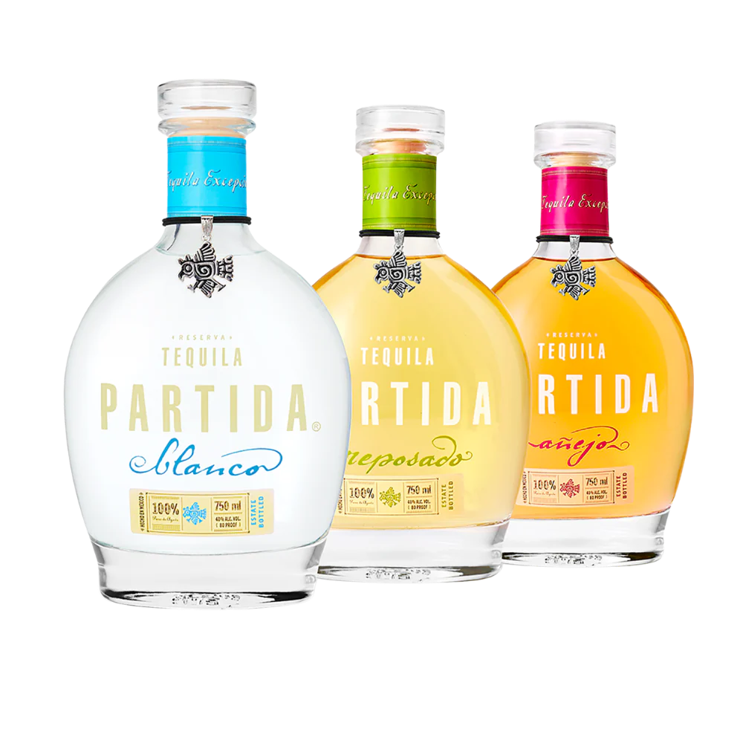

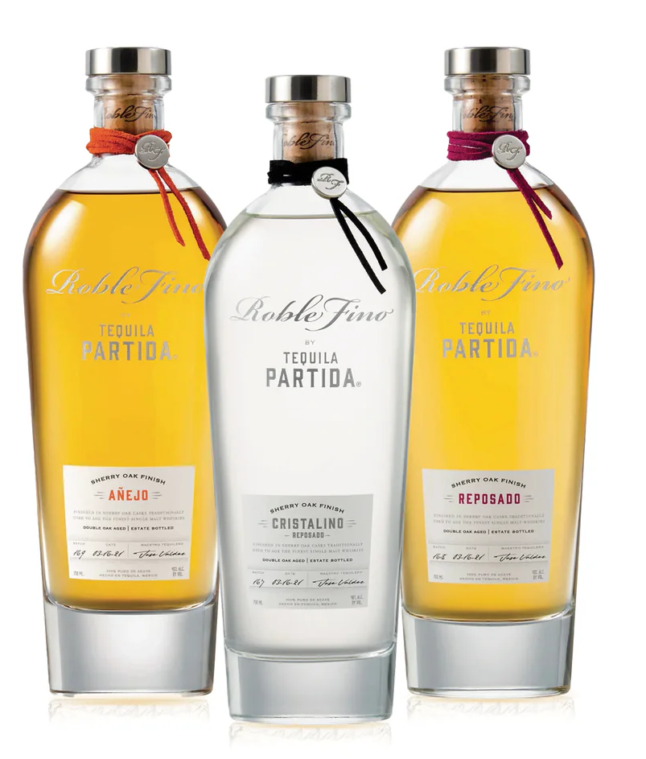
2025 Top Media
Hits Recap

Slide 5



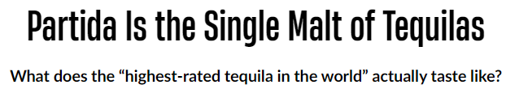

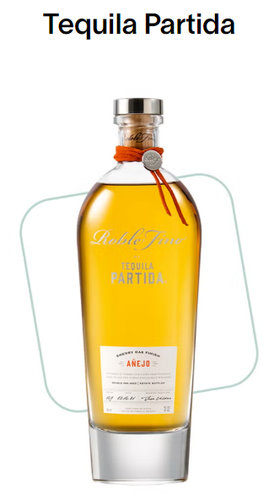


2025 - Top Media Highlights
Date: 3/21/2025
UVM: 12,883,348
Link
Date: 5/1/2025
UVM: 829,906
Link
Date: 4/30/2025
UVM: 785,423
Link

Slide 6



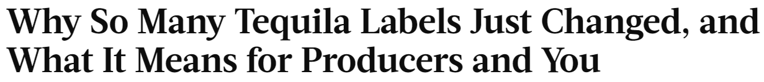

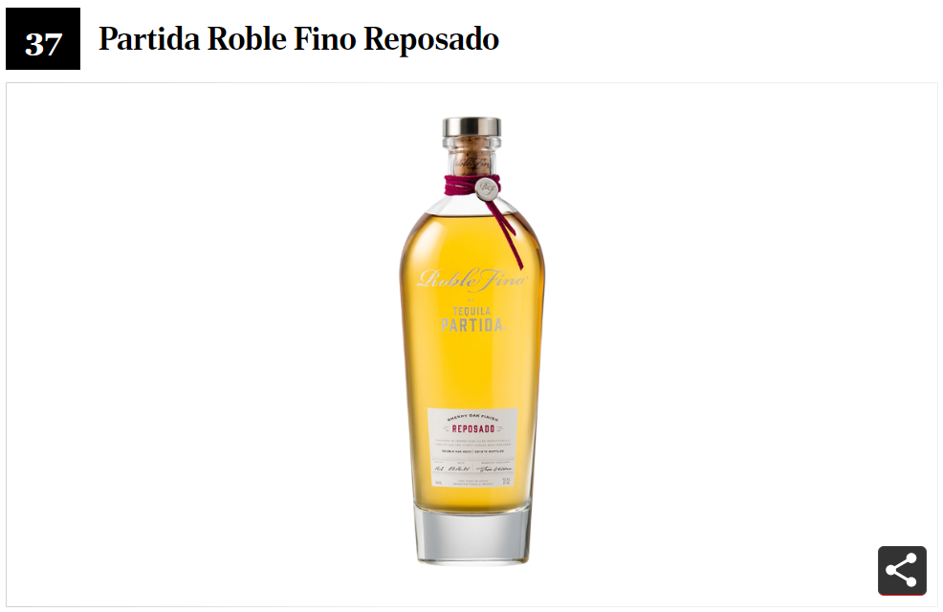
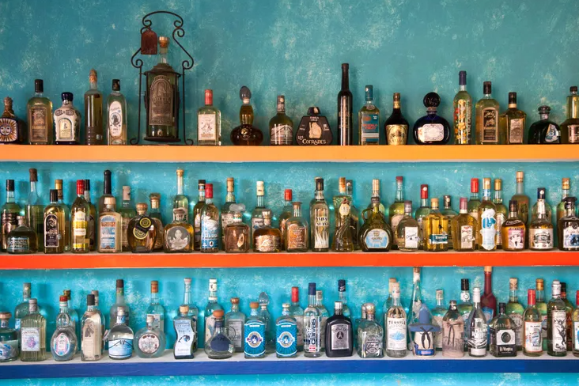
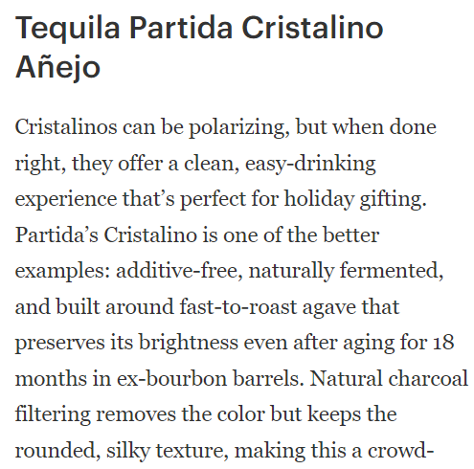
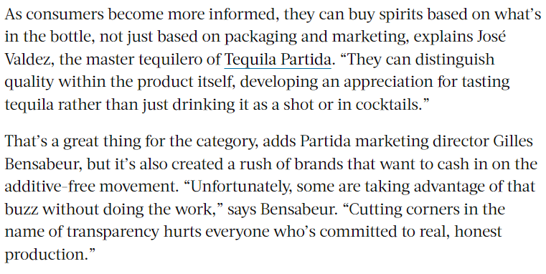
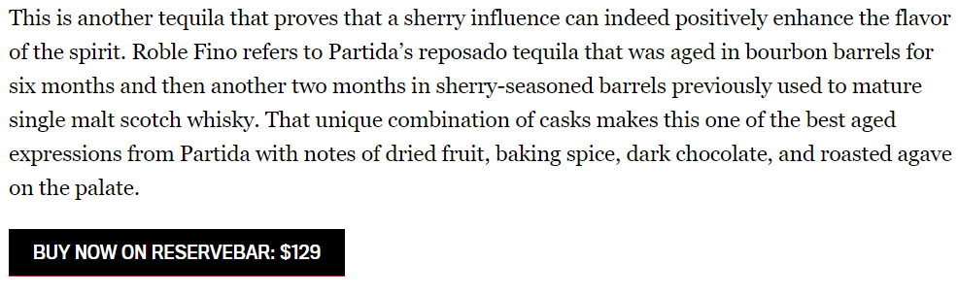
Top Media Highlights 2025
Date: 12/9/2025
UVM: 50,739,115
Link
Date: 4/29/2025
UVM: 1,861,181
Link
Date: 11/13/2025
UVM: 10,093,996
Link

Slide 7
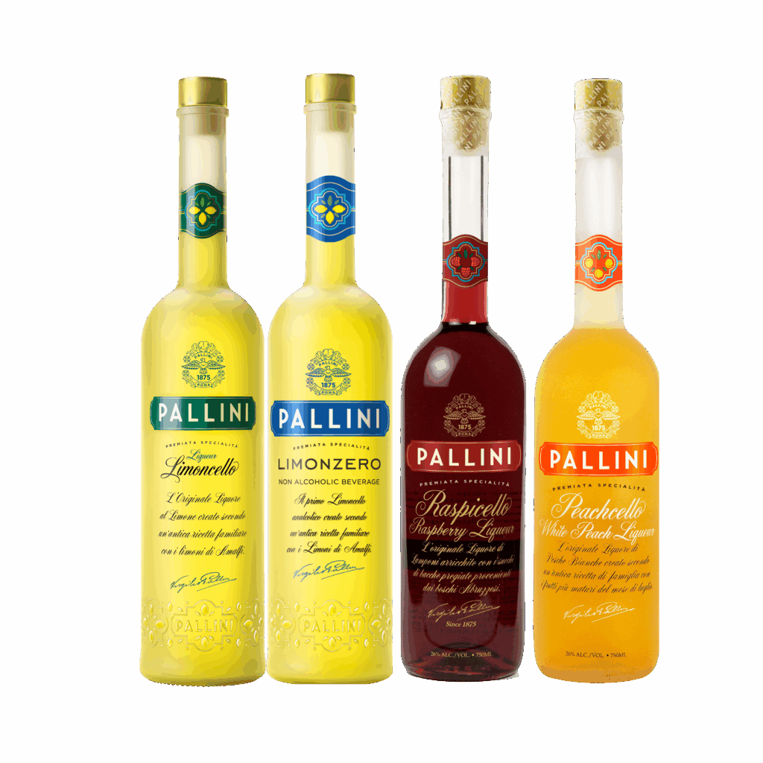
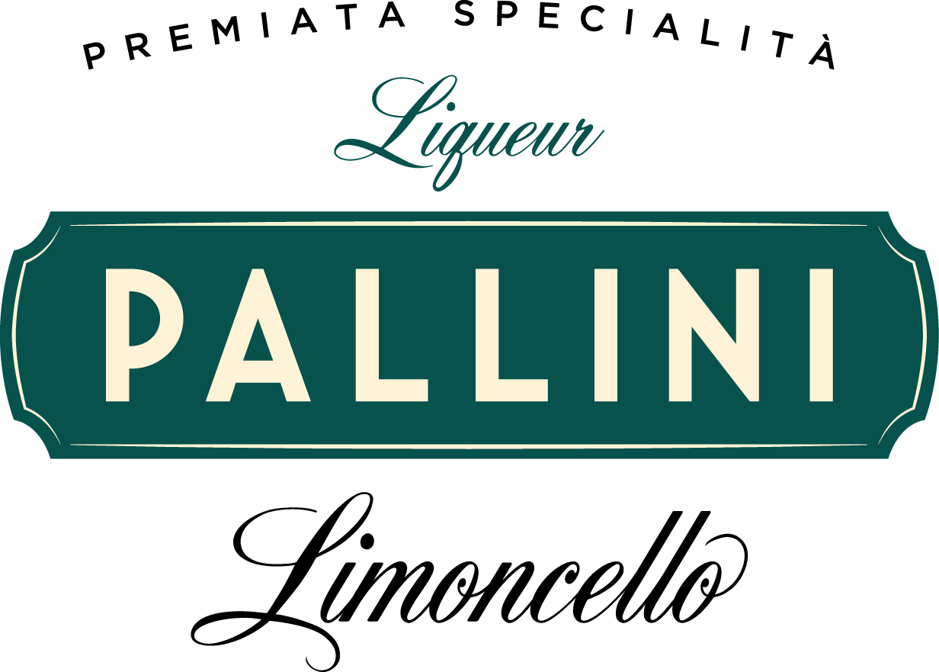
2025 Top Media
Hits Recap

Slide 8



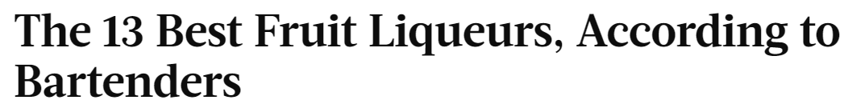
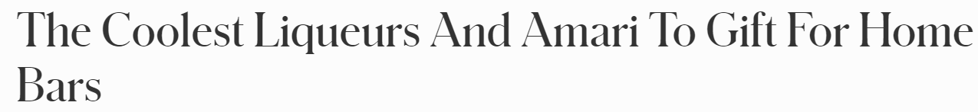

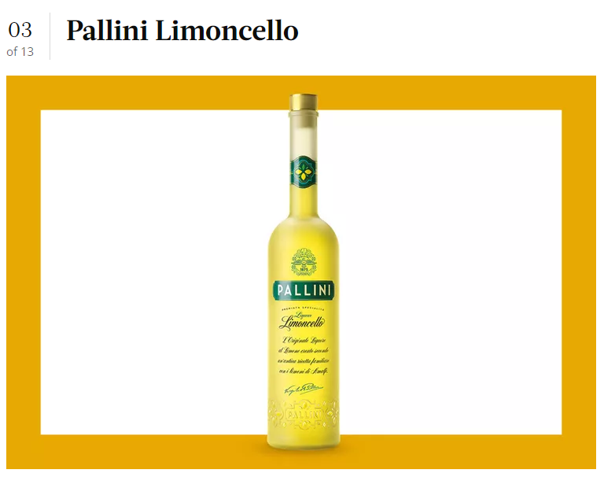
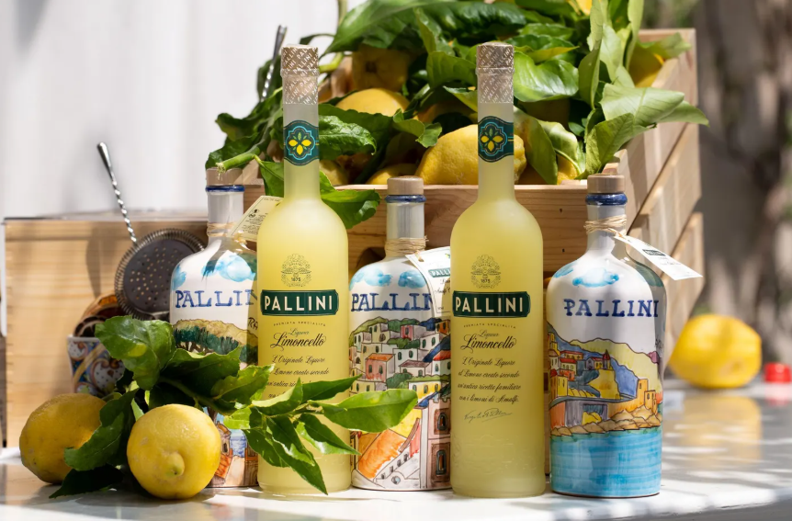
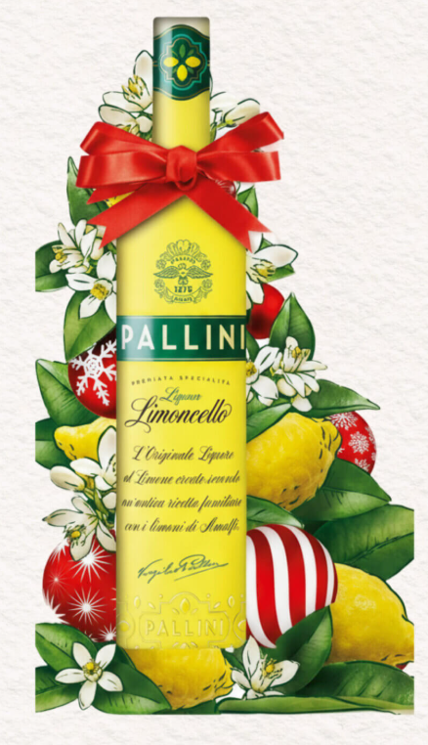
2025 - Top Media Highlights
Date: 11/23/2025
UVM: 50,739,115
Link
Date: 5/13/2025
UVM: 10,093,996
Link
Date: 12/20/2025
UVM: 44,306
Link

Slide 9


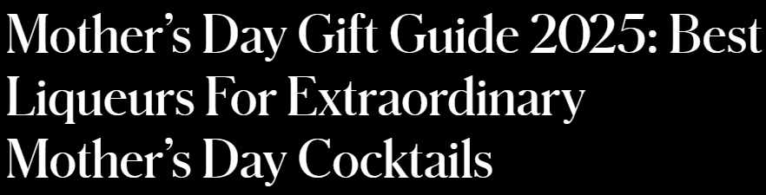
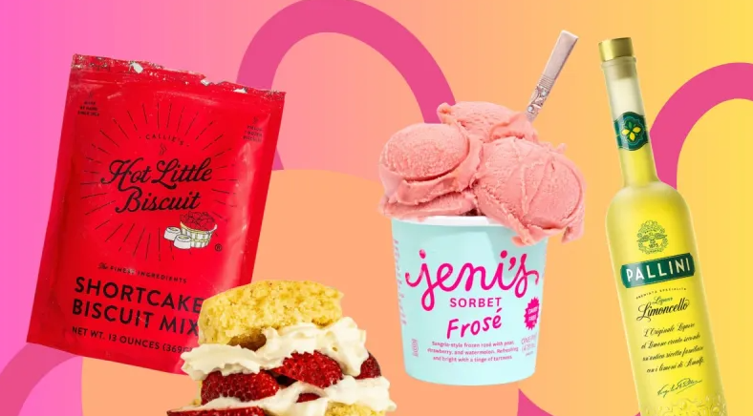
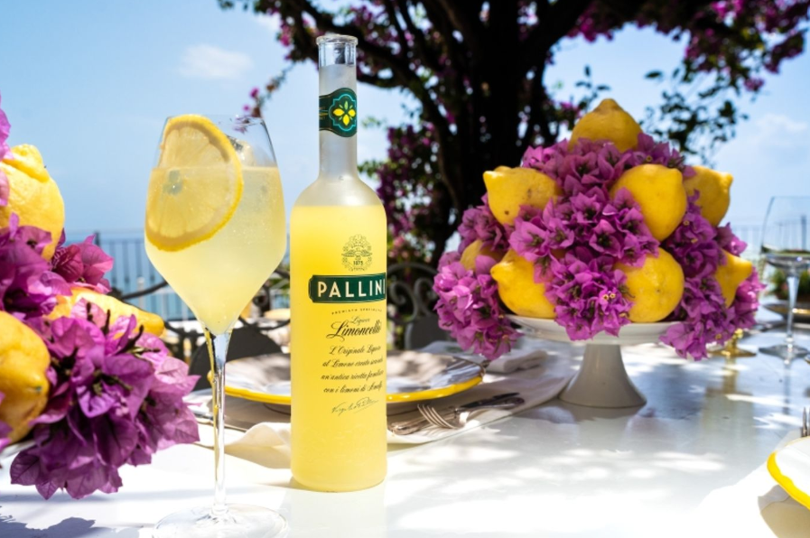
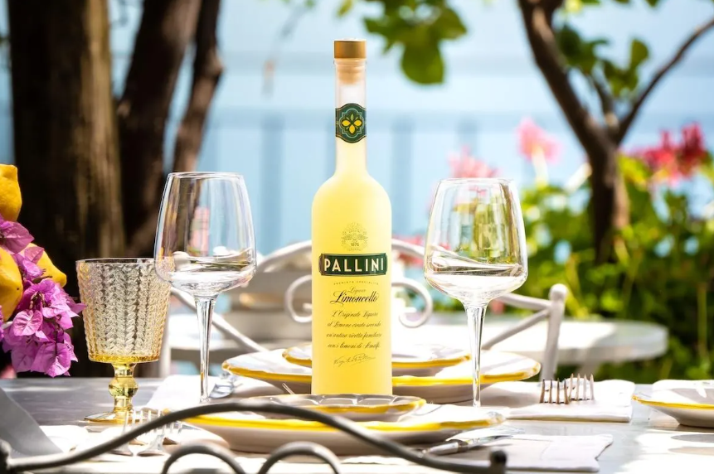
2025 - Top Media Highlights
Date: 5/6/2025
UVM: 57,473
Link
Date: 5/15/2025
UVM: 1,450,675
Link
Date: 4/16/2025
UVM: 50,739,115
Link

Slide 10
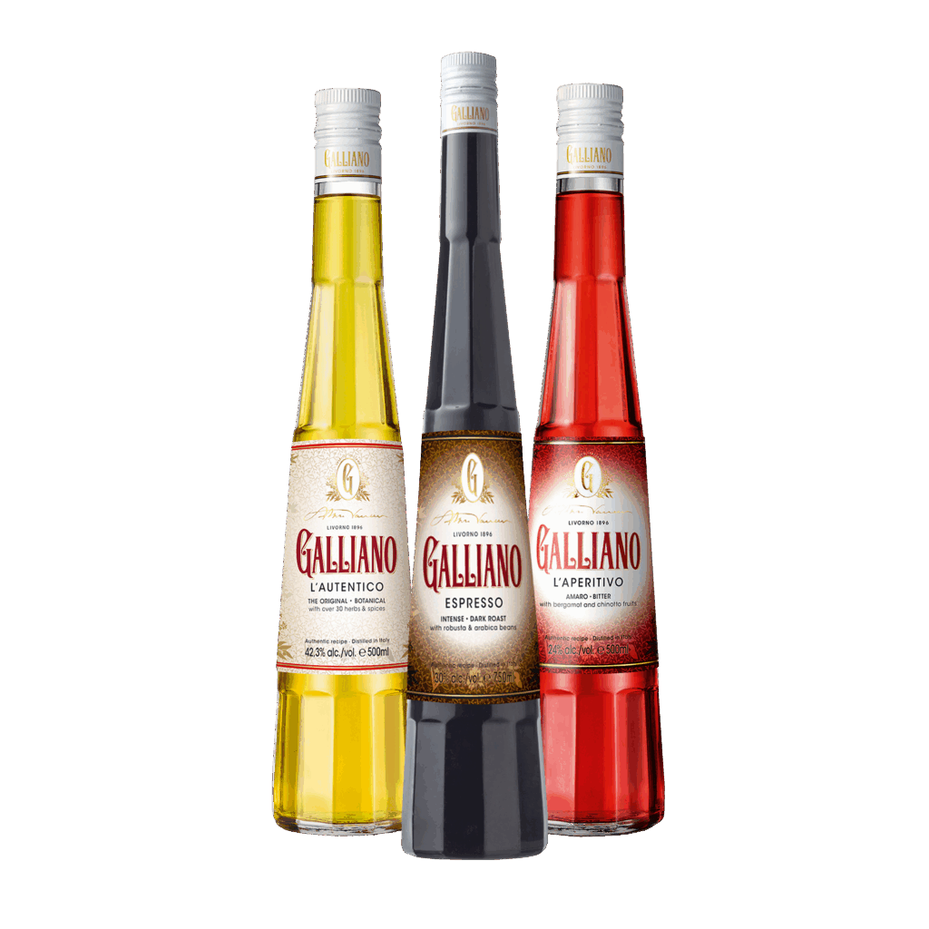
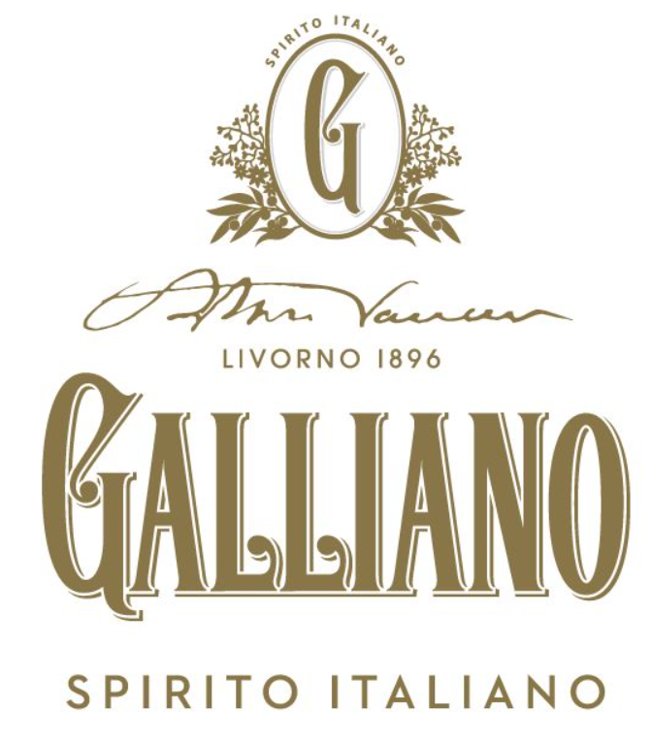
2025 Top Media
Hits Recap

Slide 11



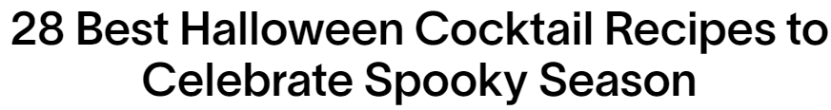

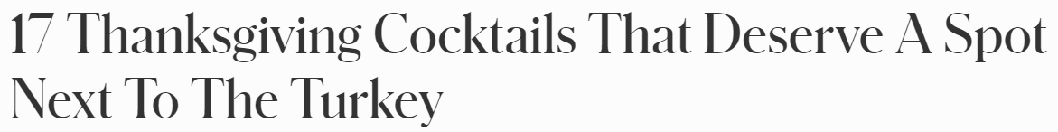
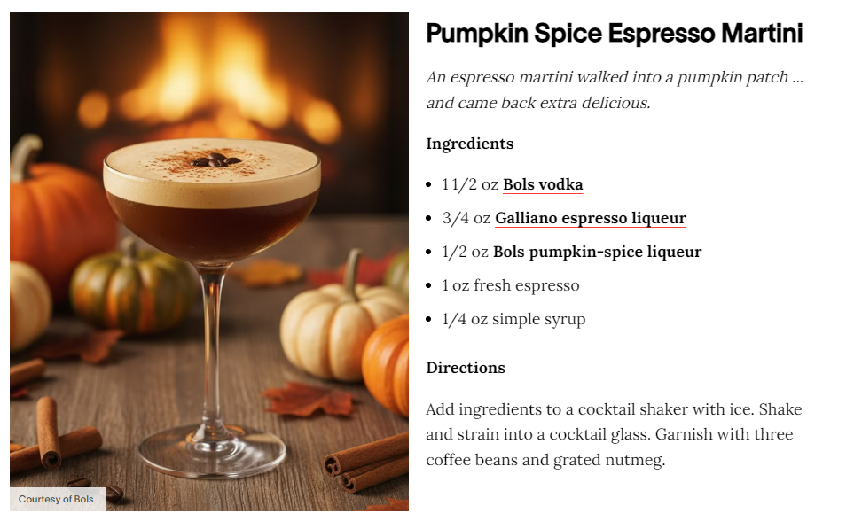
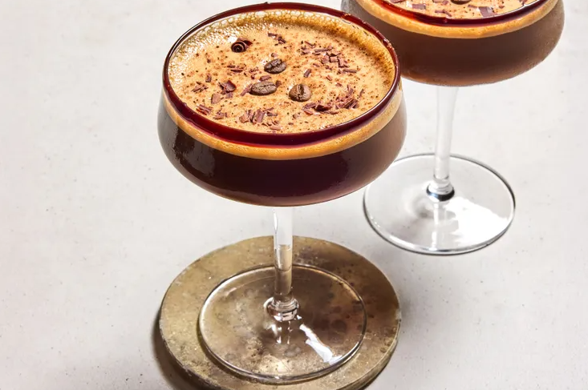
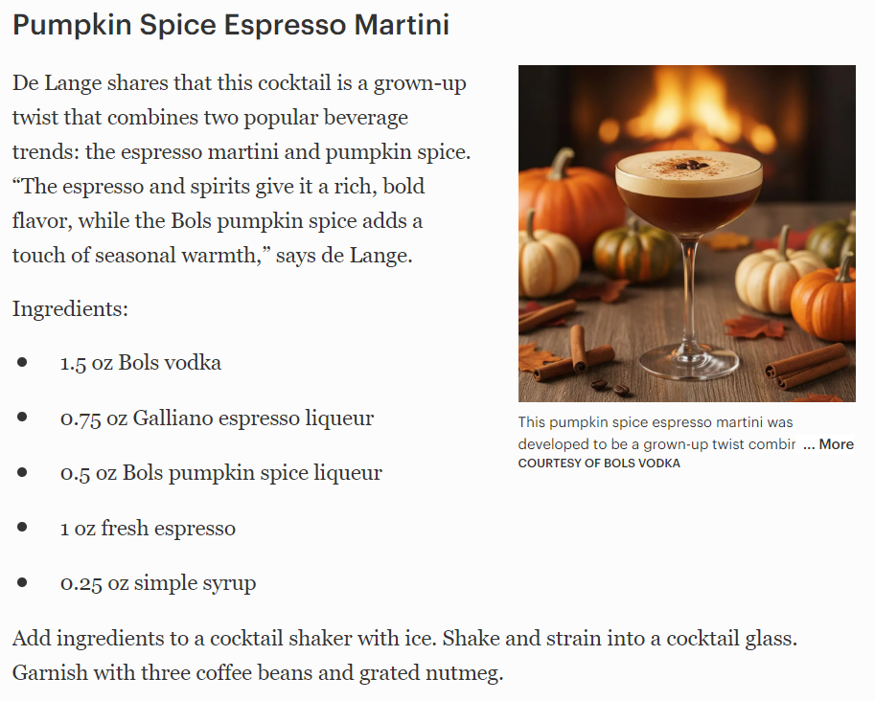
2025 - Top Media Highlights
Date: 10/24/2025
UVM: 12,883,348
Link
Date: 12/9/2025
UVM: 10,093,996
Link
Date: 11/13/2025
UVM: 50,739,115
Link

Slide 12



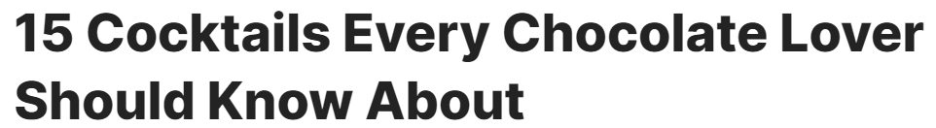
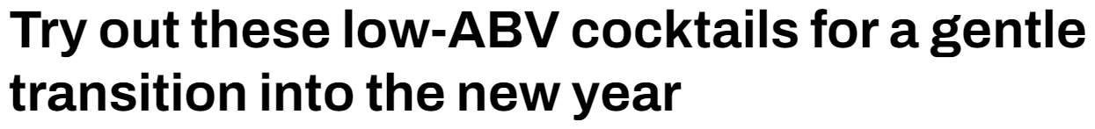
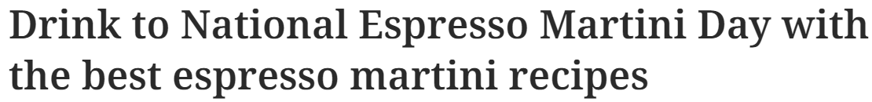
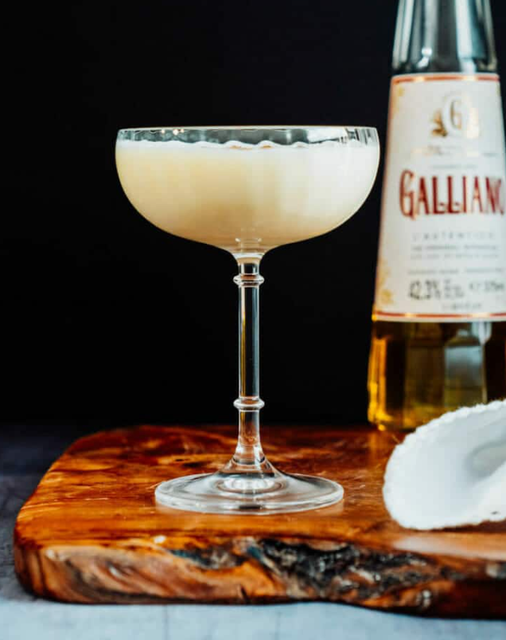
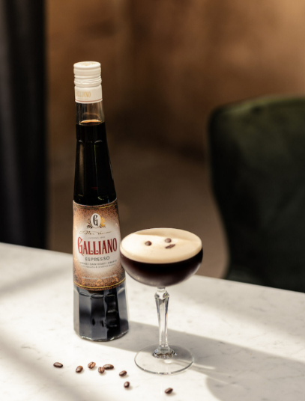
2025 - Top Media Highlights
Date: 3/18/2025
UVM: 5,514,941
Link
Date: 3/10/2025
UVM: 4,662,578
Link
Date: 1/15/2025
UVM: 350,825
Link

Slide 13
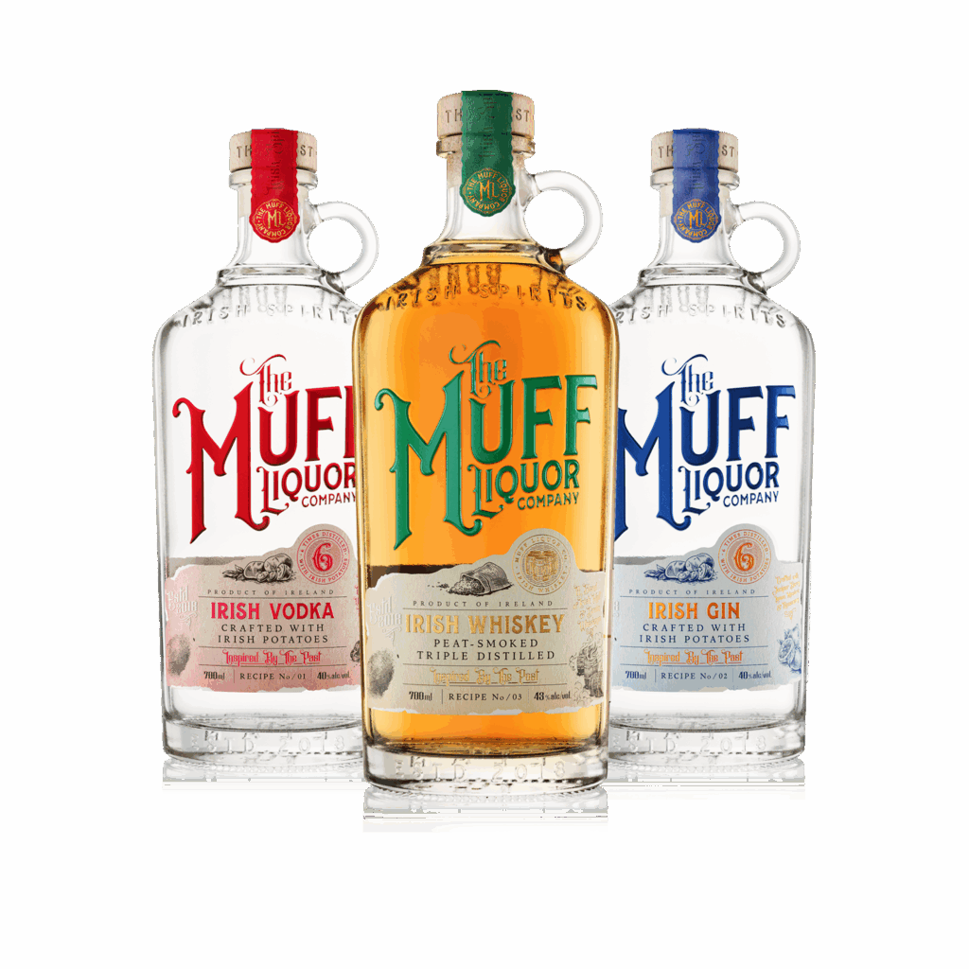

2025 Top Media
Hits Recap

Slide 14



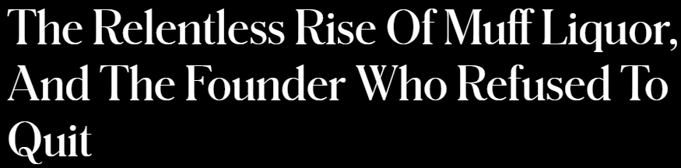
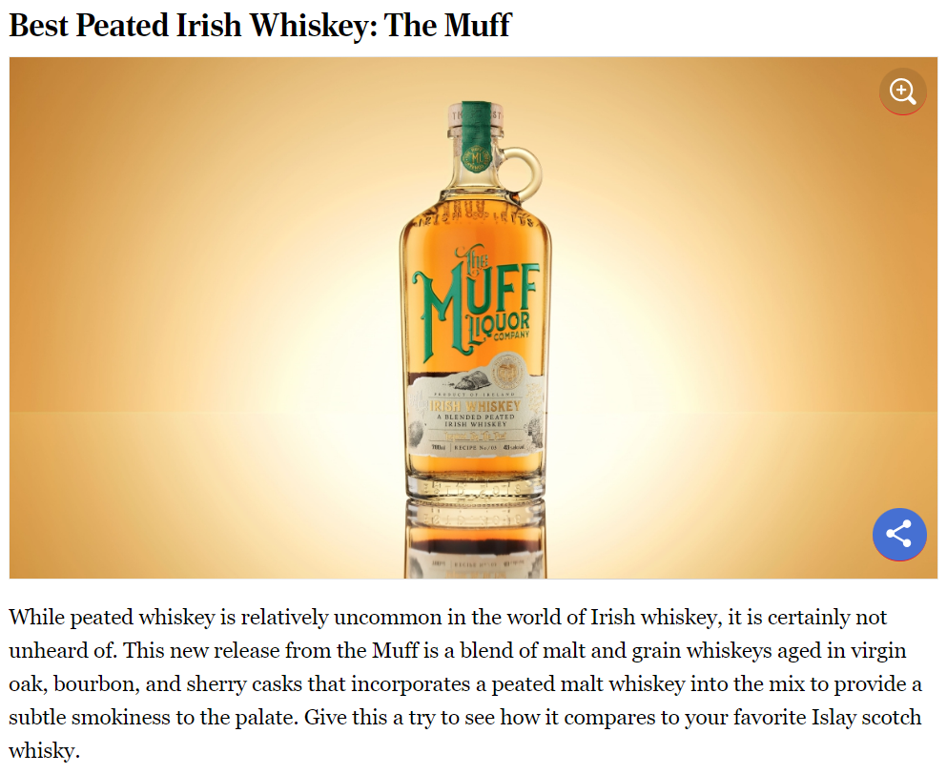
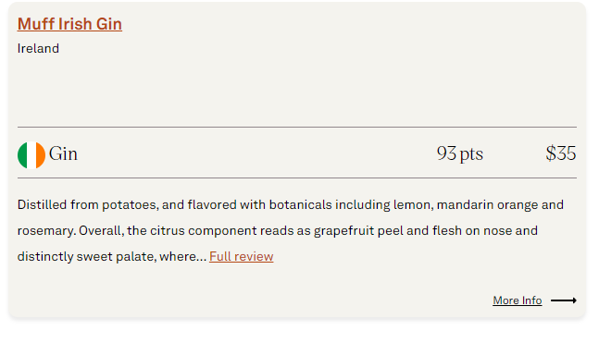
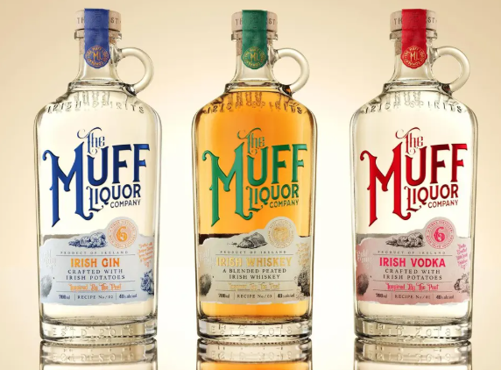
2025 - Top Media Highlights
Date: 2/25/2025
UVM: 1,861,181
Link
Date: December 2025
UVM: 782,202
Link
Date: 12/5/2025
UVM: 50,739,115
Link

Slide 15









2025 - Top Media Highlights
Date: 2/12/2025
UVM: 785,423
Link
Date: 3/14/2025
UVM: 3,182,153
Link
Date: 2/5/2025
UVM: 350,825
Link
Notes:
https://www.insidehook.com/spirits/muff-liquor-company-gin-vodka-irish-whiskey-review
https://robbreport.com/food-drink/spirits/gallery/best-irish-whiskey-brands-1235509136/redbreast_15/
https://www.wineenthusiast.com/toplists/100-best-spirits-of-2025/?srsltid=AfmBOorO2sIB5ICAsSpSH8R0rSM6ojZibx92BKoWPOGcl7b1v1JXbVt9
https://www.forbes.com/sites/hudsonlindenberger/2025/12/05/the-relentless-rise-of-muff-liquor-and-the-founder-who-refused-to-quit/
https://www.drinkhacker.com/2025/04/10/review-the-muff-irish-vodka-gin-and-whiskey/
https://ftw.usatoday.com/story/entertainment/pop-culture/2025/03/14/best-irish-whiskeys-st-patricks-day-guide-jameson-natterjack/81960562007/#
https://www.themanual.com/food-and-drink/muff-liquor-company/#dt-heading-where-can-i-buy-them

Slide 16


2025 Top Media
Hits Recap

Slide 17








2025 - Top Media Highlights
Date: 12/31/2025
UVM: 50,739,115
Link
Date: 5/8/2025
UVM: 33,723
Link
Date: 5/6/2025
UVM: 14,450
Link

Slide 18


2025 Top Media
Hits Recap

Slide 19








2025 - Top Media Highlights
Date: 11/23/2025
UVM: 50,739,115
Link
Date: 1/31/2025
UVM: 94,434,123
Link
Date: 12/12/2025
UVM: 27,917
Link

Slide 20



2025 Top Media
Hits Recap

Slide 21








2025 - Top Media Highlights
Date: 12/24/2025
UVM: 33,723
Link
Date: 8/25/2025
UVM: 7,586
Link
Date: 12/8/2025
UVM: 5,000
Link

