Slide 1

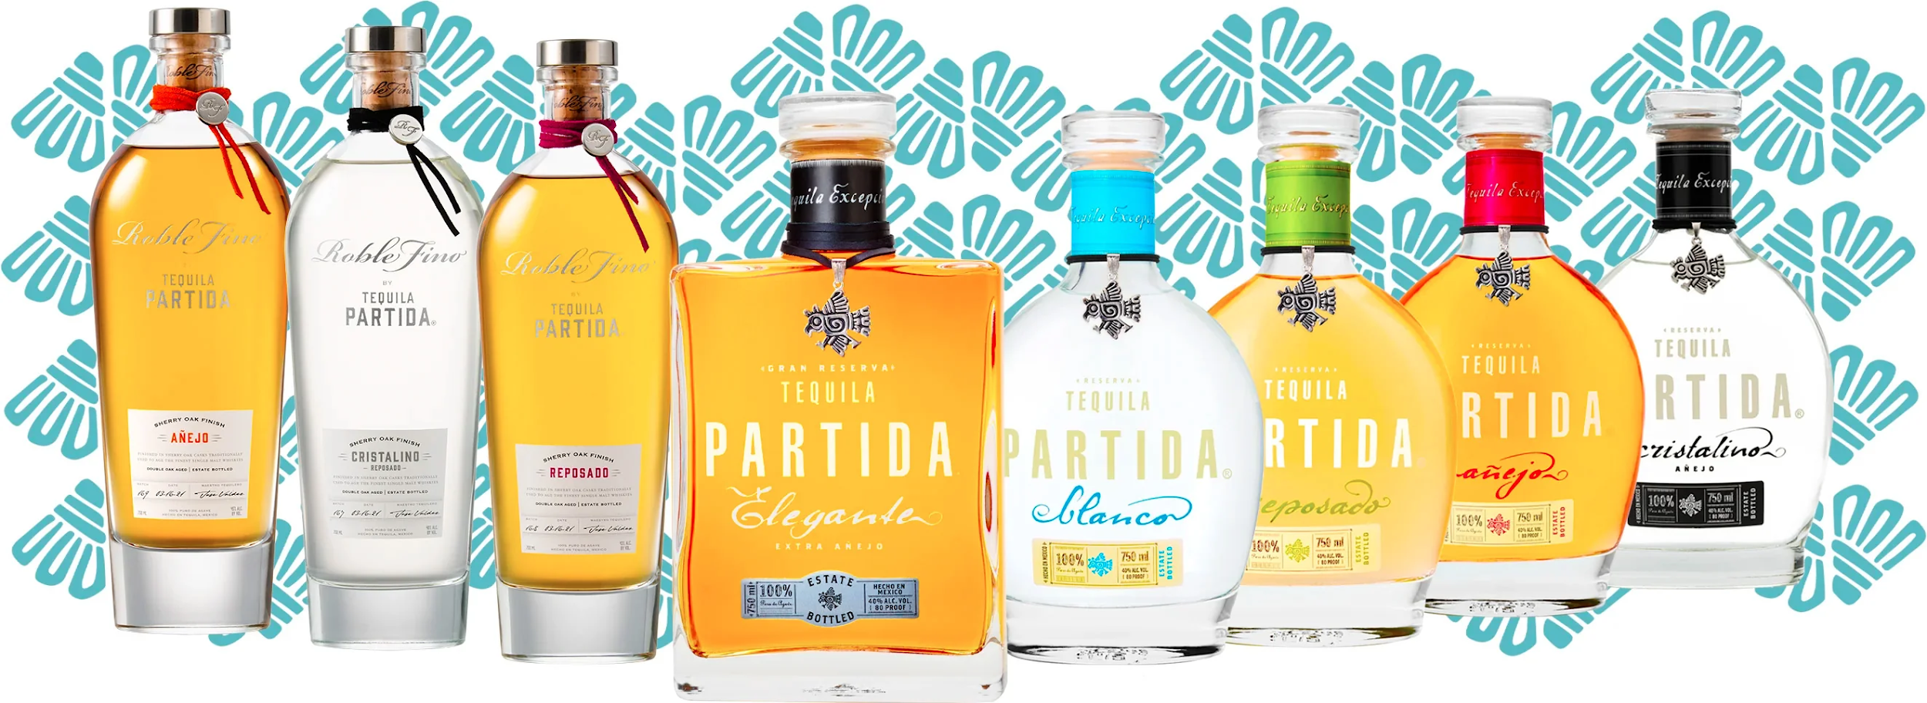


Accolades & Ratings – Updated August 2025
FAMILIA

Slide 2





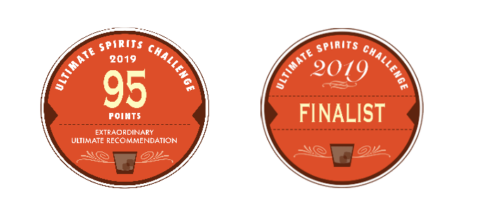
Partida Blanco
Award | Product | Medal/Score
2019 Ultimate Spirits Challenge | Blanco | Score: 95 pts and Finalist
2021 Blue Lifestyle | Blanco | Double Gold
2022 VINEPAIR | Blanco | Score: 91 pts
2023 The Fifty Best Awards | Blanco | Gold
2025 The Spirits Business | Blanco | Gold
2025 Agavos Awards | Blanco | Gold
91 POINTS

Slide 3
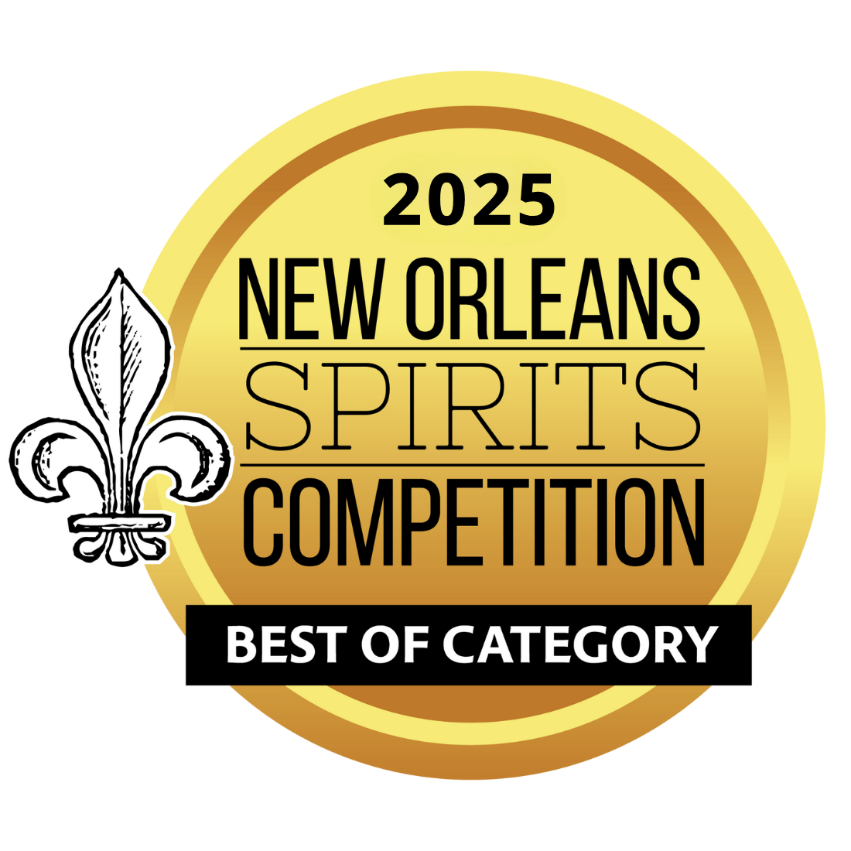
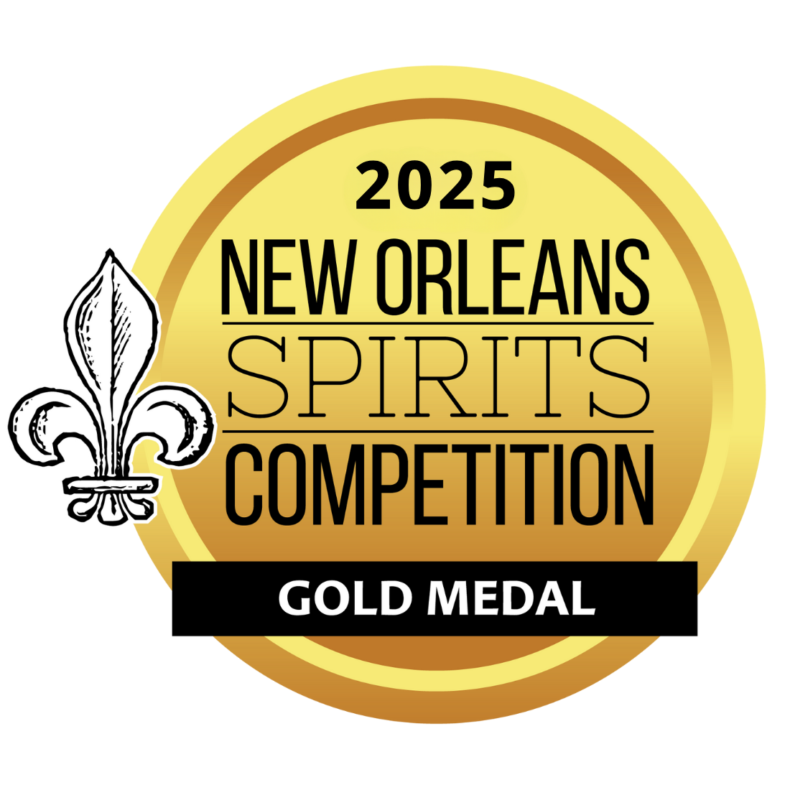


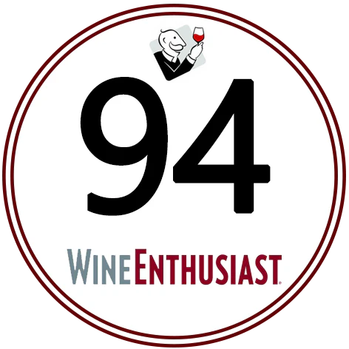

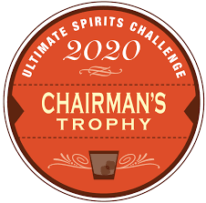
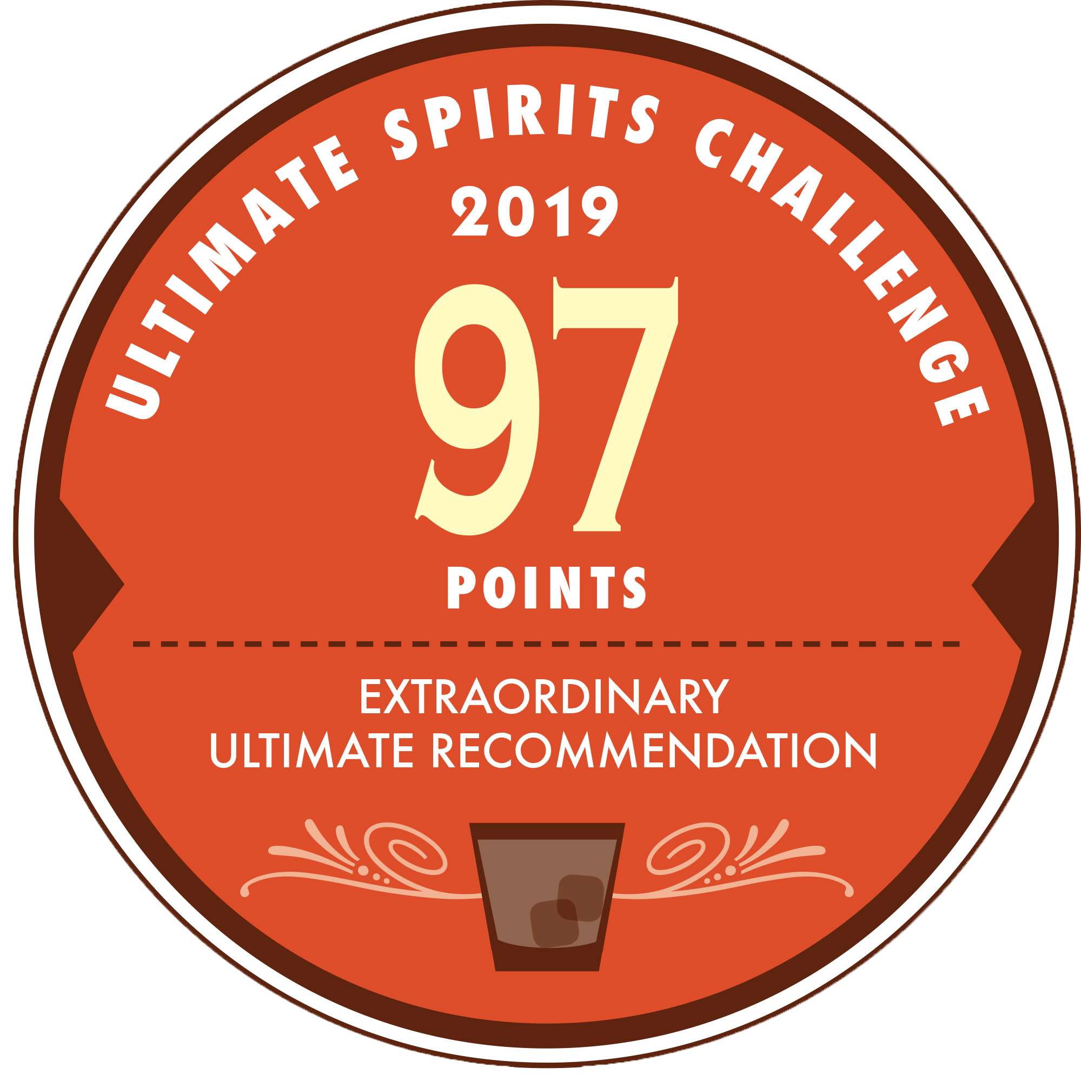
Partida Reposado
Award | Product | Medal/Score
2019 Ultimate Spirits Challenge | Reposado | Score: 97 Chairman’s Trophy
2020 International Spirits Challenge | Reposado | Gold
2021 Blue Lifestyle | Reposado | Double Gold
2021 Wine Enthusiast | Reposado | Score: 94
2022 The Fifty Best Awards | Reposado | Gold
2025 International Spirits Challenge | Reposado | Gold
2025 New Orleans Spirits Competition | Reposado | Gold/Best in Reposado Tequila Category

Slide 4


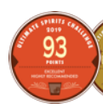
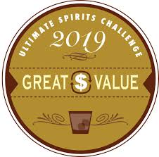
Partida Añejo
Award | Product | Medal/Score
2019 Ultimate Spirits Challenge | Añejo | Score: 93 pts/Great Value
2021 Blue Lifestyle | Añejo | Gold
2022 Wine Enthusiast | Añejo | Score: 93 pts
2022 VINEPAIR | Añejo | Score: 93 pts
2024 The Spirits Business Tequila & Mezcal Masters | Añejo | Gold
93 POINTS

Slide 5
Partida Single Barrel #11 Añejo
Award | Product | Medal/Score
2025 Agavos Awards | Single Barrel #11 Añejo | Gold

Slide 6

Partida Cristalino Anejo
Award | Product | Medal/Score
2021 Blue Lifestyle | Cristalino Añejo | Double Gold
2022 Wine Enthusiast | Cristalino Añejo | Score: 90 pts
2022 VinePair | Cristalino Añejo | Score: 94 pts
2025 The Spirits Business | Cristalino Añejo | Gold
94 POINTS

Slide 7
Accolades & Ratings – Updated August 2025
ROBLE FINO

Slide 8
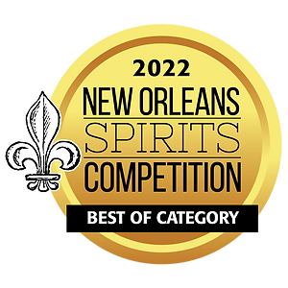
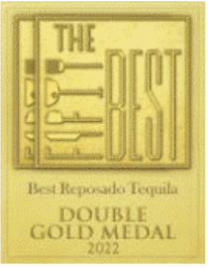

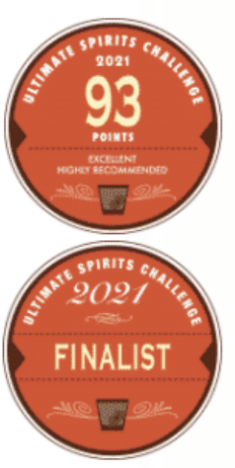
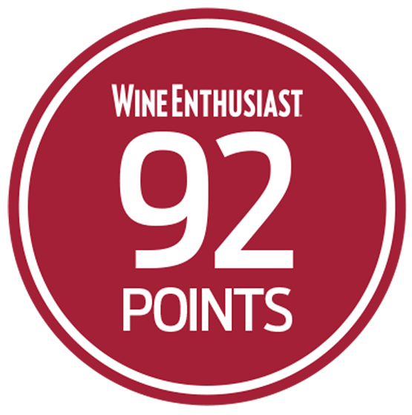
Roble Fino Reposado
Award | Product | Medal/Score
2021 Blue Lifestyle | Roble Fino Reposado | Double Gold
2021 Ultimate Spirits Challenge | Roble Fino Reposado | Finalist
2021 Ultimate Spirits Challenge | Roble Fino Reposado | Score: 93
2021 Wine Enthusiast | Roble Fino Reposado | Score: 92
2022 New Orleans Spirits Competition | Roble Fino Reposado | Best of Category
2022 The Fifty Award | Roble Fino Reposado | Double Gold

Slide 9
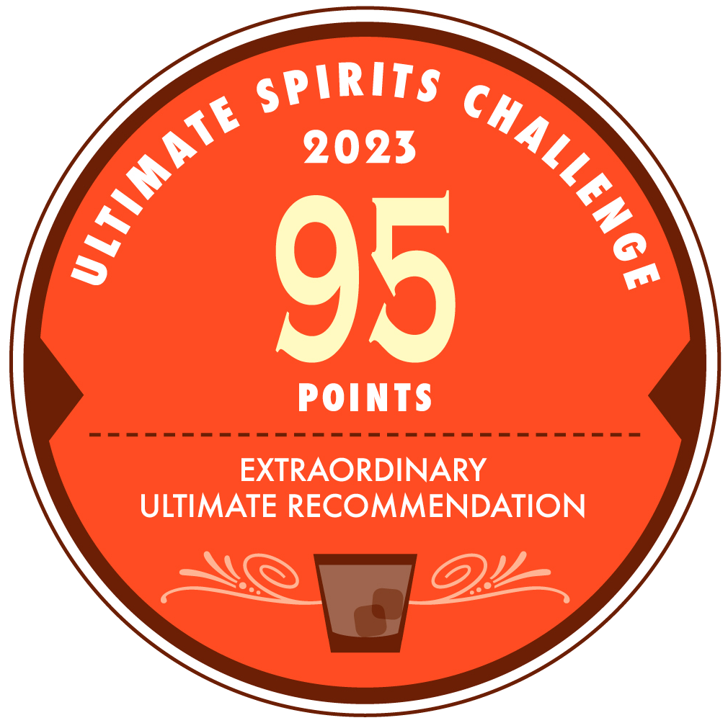
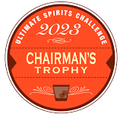
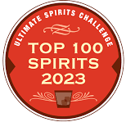
Roble Fino Cristalino
Award | Product | Medal/Score
2021 Blue Lifestyle | Roble Fino Cristalino | Double Gold
2022 VinePair | Roble Fino Cristalino | Score: 96 pts
2023 Ultimate Spirits Challenge | Roble Fino Cristalino | Score: 95 pts
2023 Ultimate Spirits Challenge | Roble Fino Cristalino | Chairman's Trophy
2023 Ultimate Spirits Challenge | Roble Fino Cristalino | Top 100 Spirits
96 POINTS

Slide 10

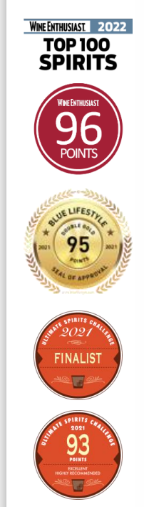



Roble Fino Anejo
Award | Product | Medal/Score
2021 Ultimate Spirits Challenge | Roble Fino Añejo | Finalist/ Score: 93 pts
2022 Wine Enthusiast | Roble Fino Añejo | Top 100 Spirits/Score: 96 pts
2024 WSWA Access Live | Roble Fino Añejo | Best of Show/Double Gold
2024 Wine Enthusiast | Roble Fino Añejo | Best Tequila Under $150
2025 Agavos Awards | Roble Fino Añejo | Gold
2025 VinePair | Roble Fino Añejo | Score: 93
2025 The Spirits Business | Roble Fino Añejo | Master Medal

Slide 11
Accolades & Ratings – Updated August 2025
ELEGANTE

Slide 12
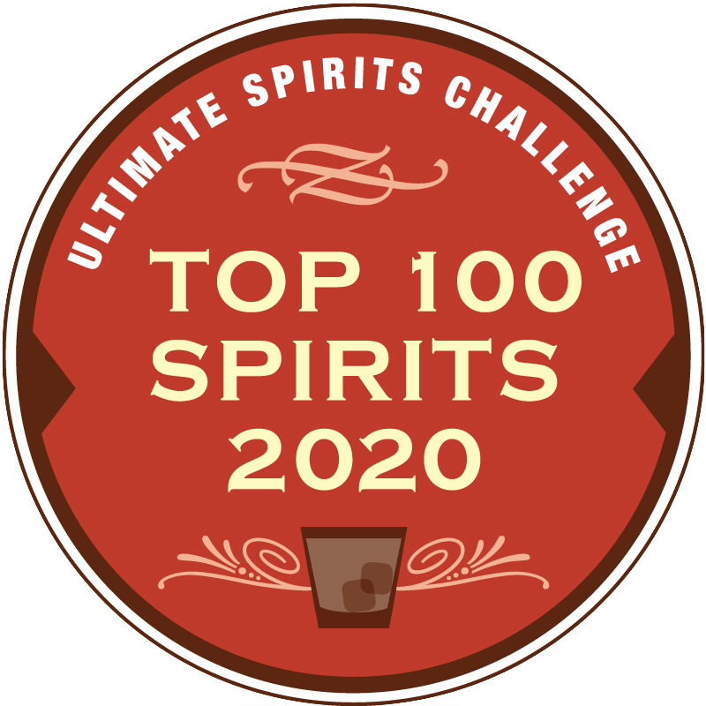
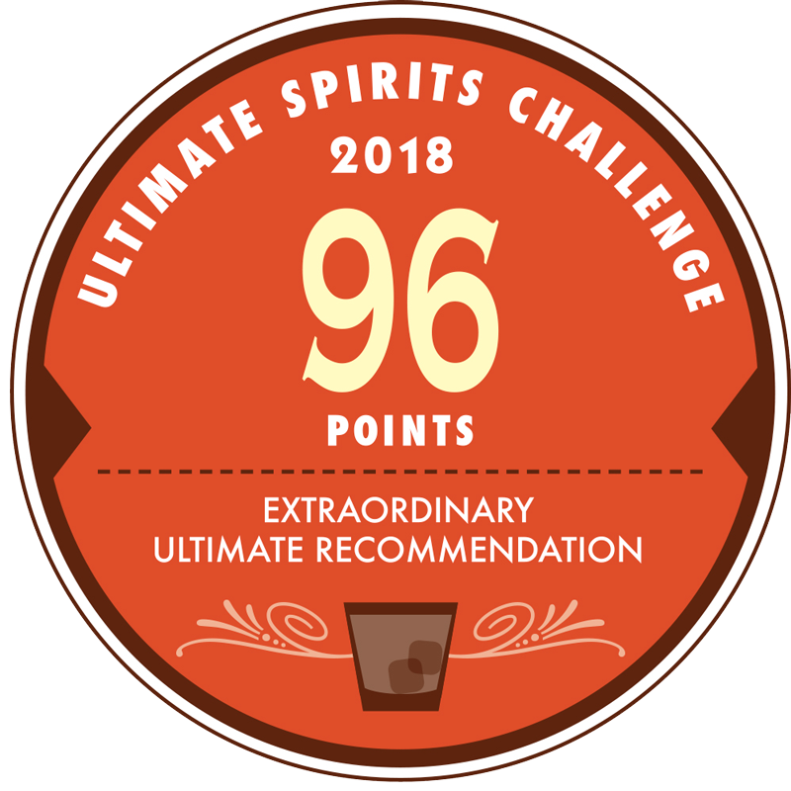
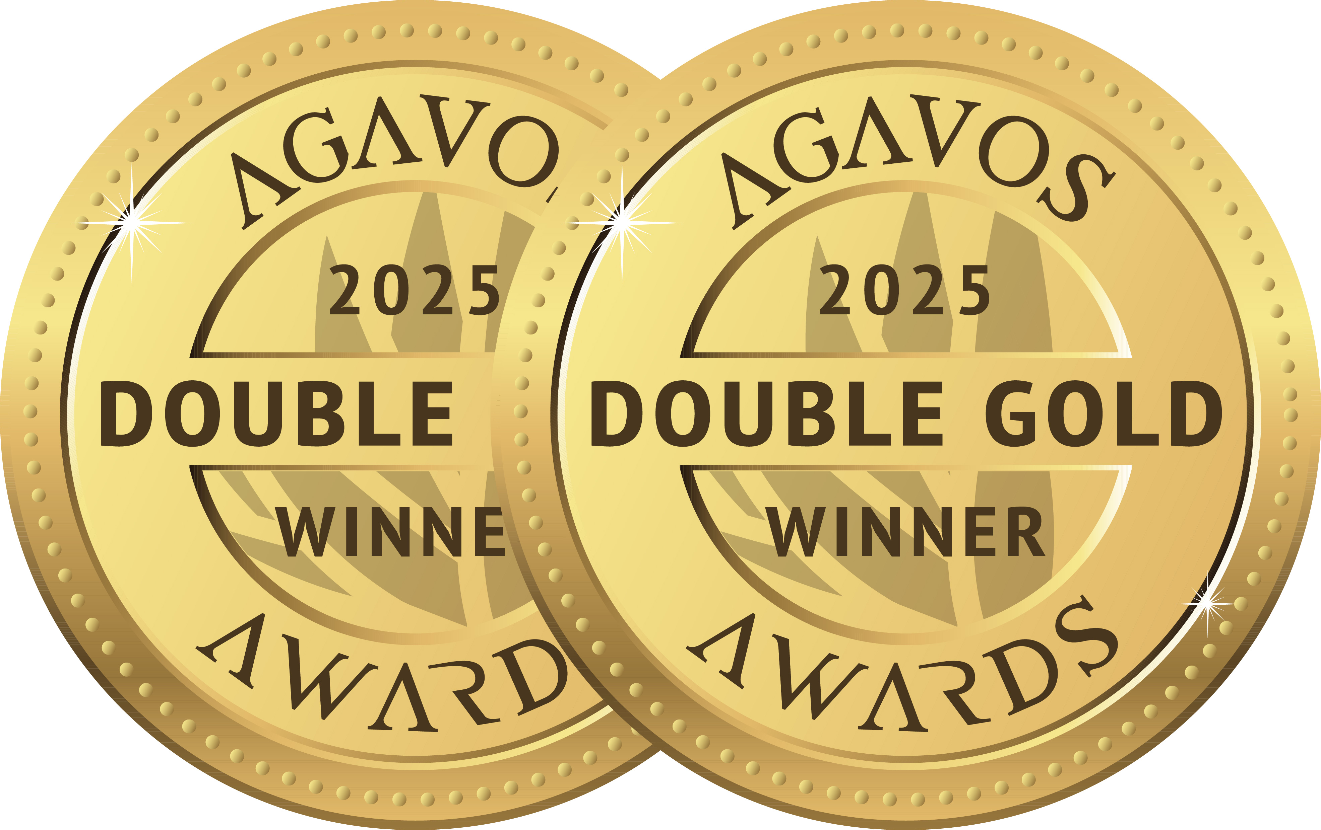
Partida Elegante
Award | Product | Medal/Score
2019 Ultimate Spirits Challenge | Elegante | Top 100 Spirits
2019 Ultimate Spirits Challenge | Elegante | Score: 96
2022 Wine Enthusiast | Elegante | Score: 96 Top 100 Spirits
2025 Agavos Awards | Elegante | Double Gold

