Slide 1
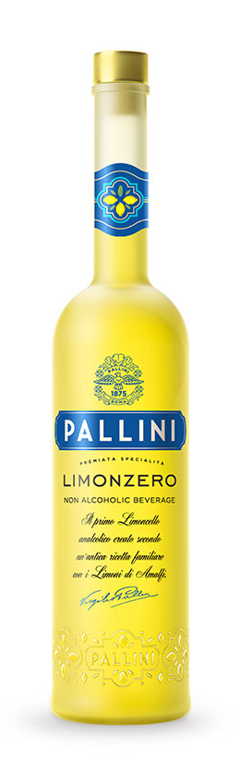
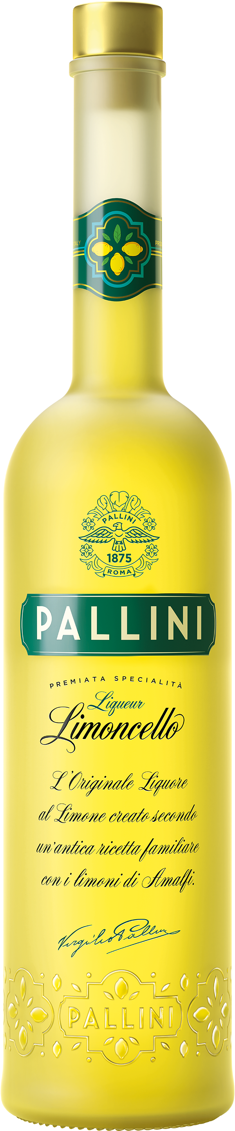
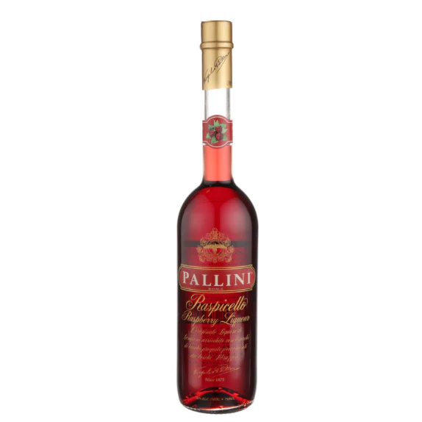
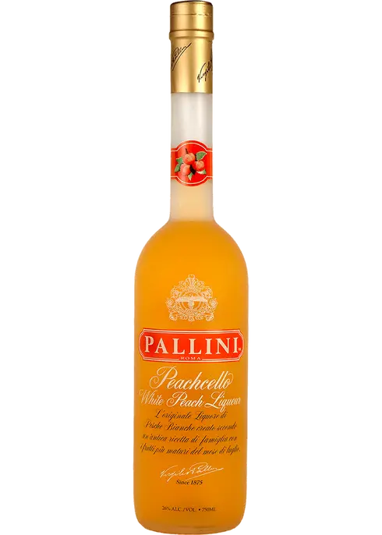



Accolades & Ratings – Updated August 2025

Slide 2
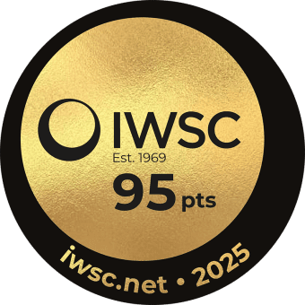
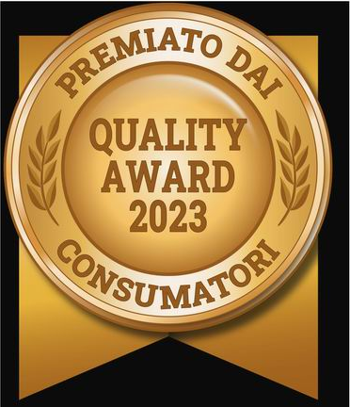

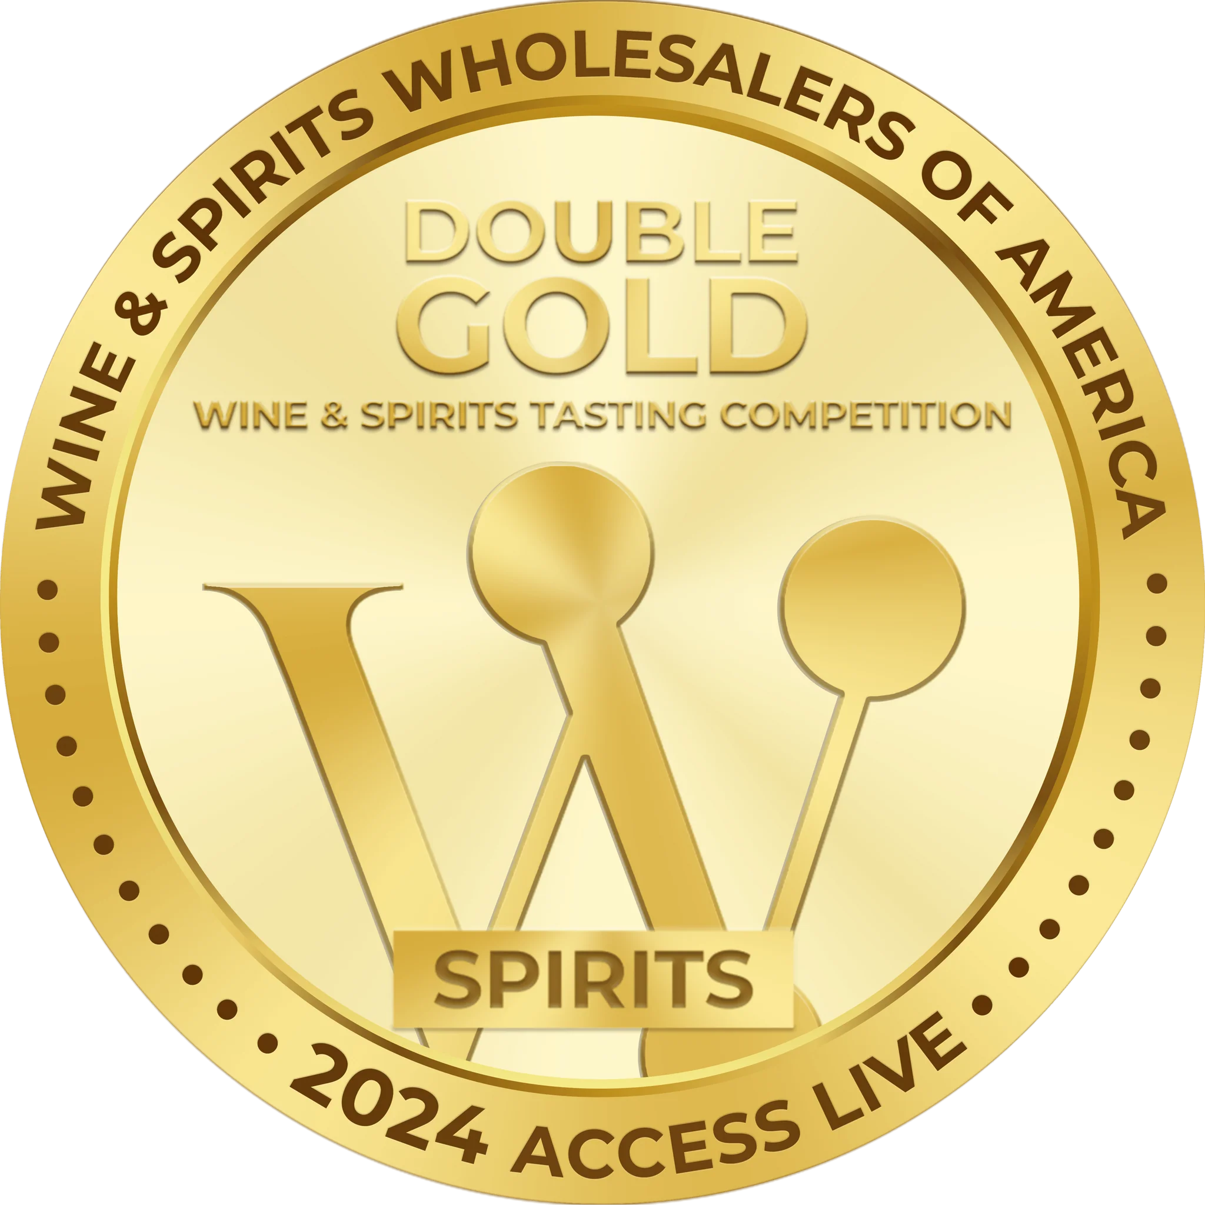

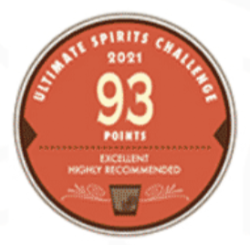
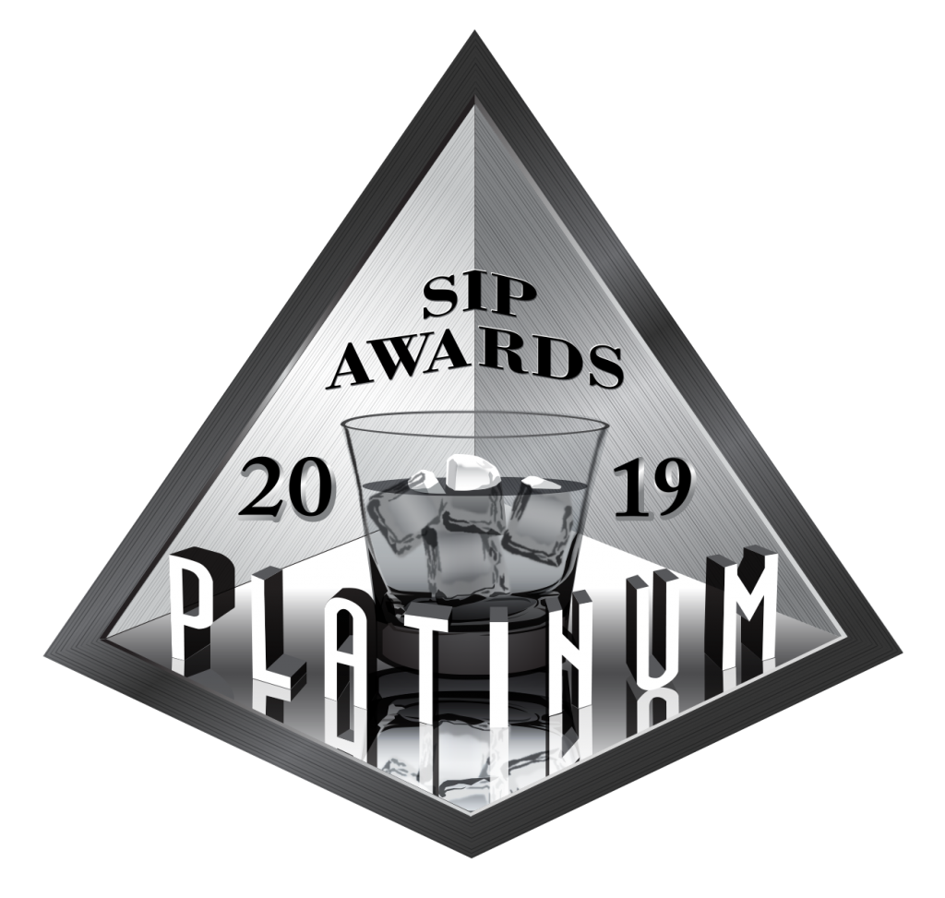
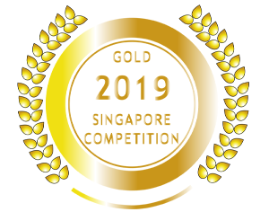
Pallini Limoncelllo
Award | Product | Medal/Score
2019 Sip Award | Limoncello | Platinum
2021 Ultimate Spirits Challenge | Limoncello | Score: 93
2023 Quality Award | Limoncello | Quality Award
2023 WSWA Access Live | Limoncello | Best of Show
2023 WSWA Access Live | Limoncello | Double Gold
2023 Concours Mondial de Bruxelles | Limoncello | Gold
2025 IWSC | Limoncello | 95 Points/Gold

Slide 3

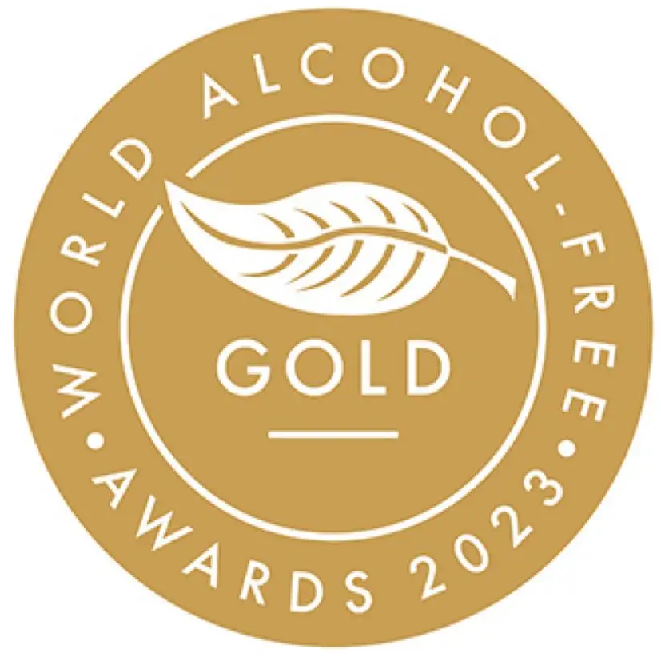

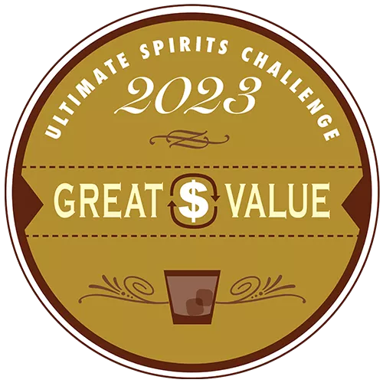
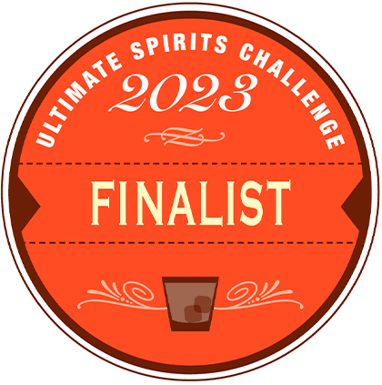
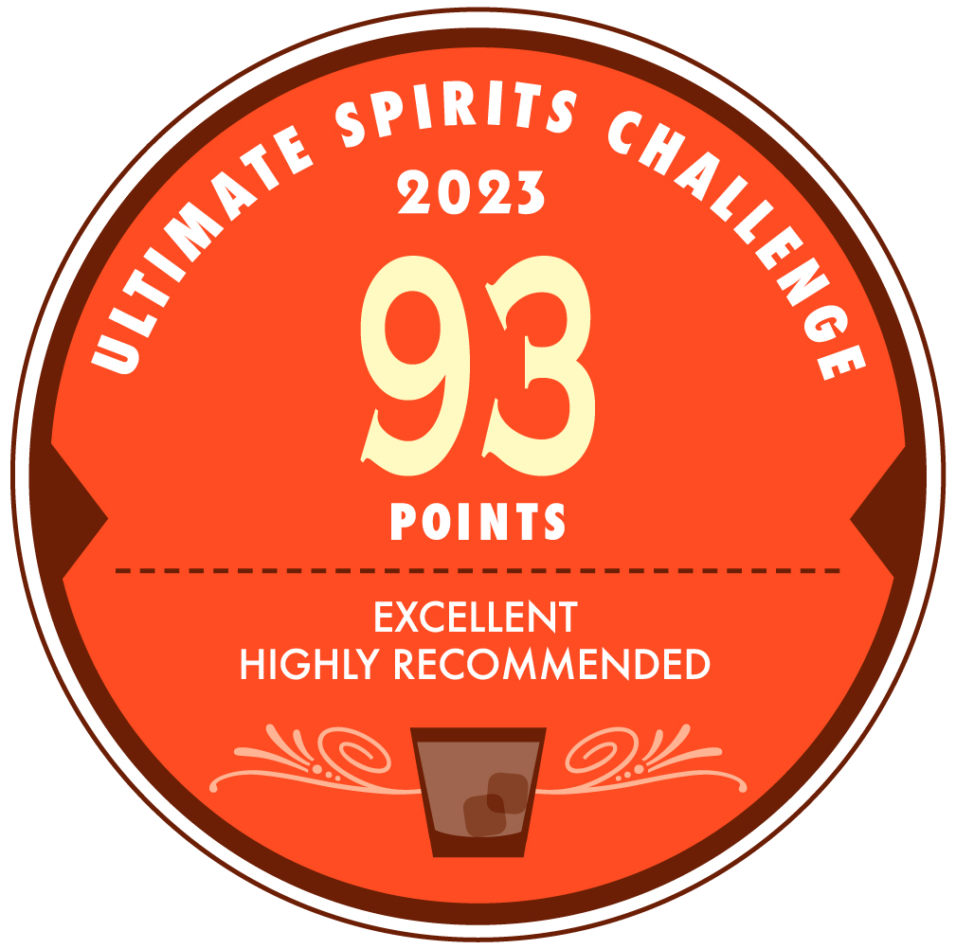
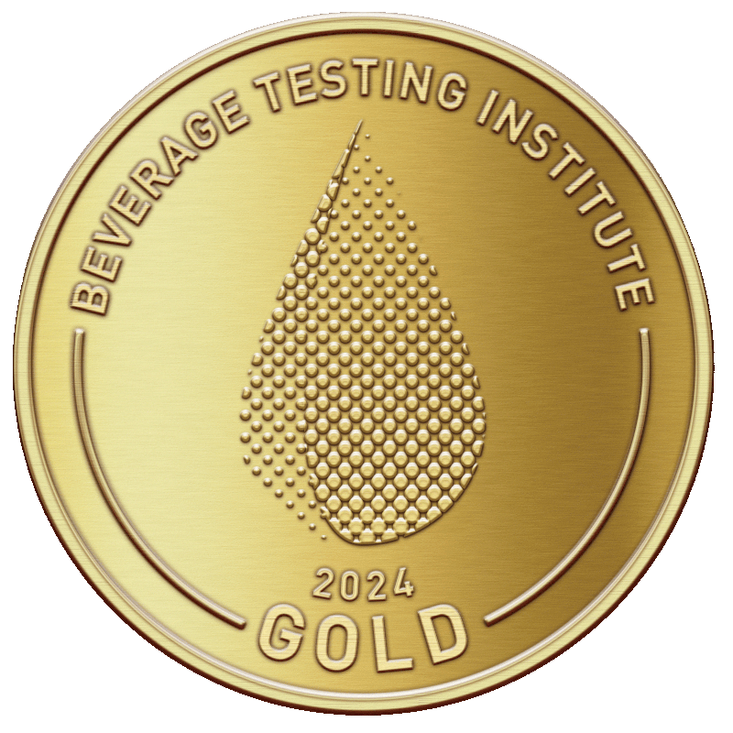
Pallini Limonzero & Peachello
Award | Product | Medal/Score
2023 International Wine & Spirit Competition | Limonzero | Gold
2023 World Alcohol Free Award | Limonzero | Gold
2023 The Low & No Masters Competition | Limonzero | Master
2023 Ultimate Spirits Challenge | Limonzero | Great Value
2023 Ultimate Spirits Challenge | Limonzero | Finalist/Score; 93
2024 Beverage Testing Institute | Peachcello | Gold/Score: 92
2024 WSWA Access Live | Limonzero | Double Gold

