Slide 1
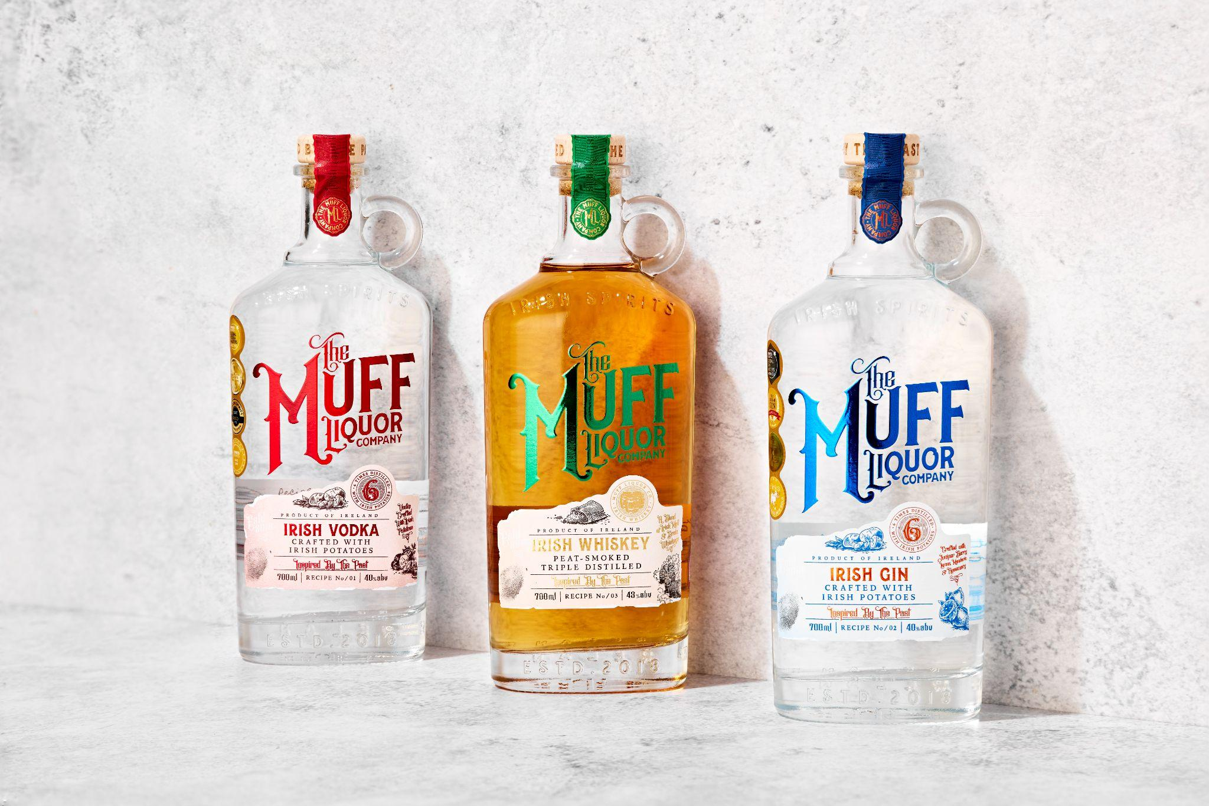
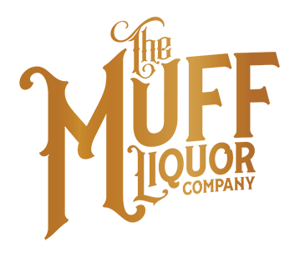


Accolades & Ratings – Updated August 2025

Slide 2
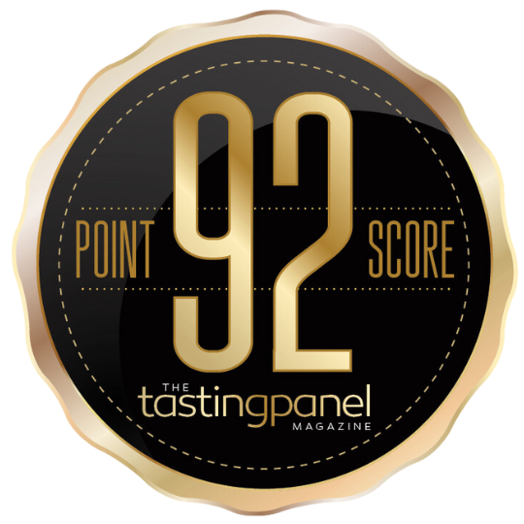
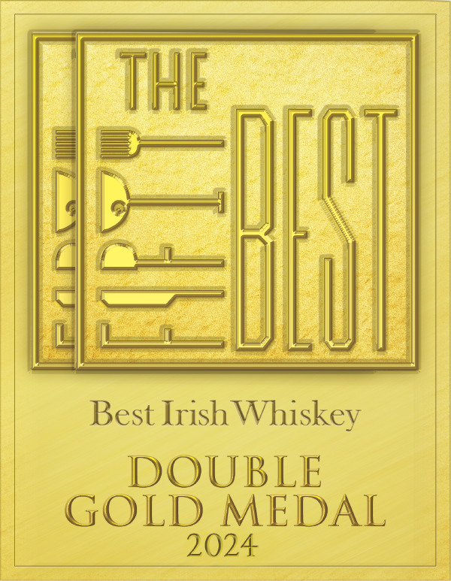

TMLC Irish Whiskey
Award | Product | Medal/Score
2024 The Tasting Panel | Muff Irish Whiskey | Score: 92
2024 The Fifty Best Awards | Muff Irish Whiskey | Double Gold
2024 Whisky Advocate | Muff Irish Whiskey | Score: 89
89 POINTS

Slide 3
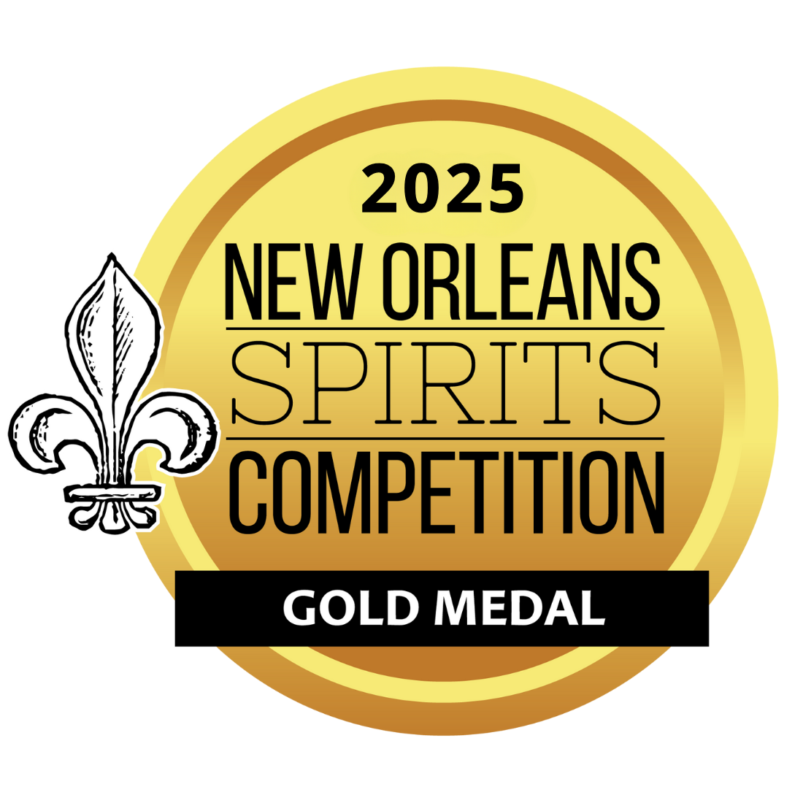
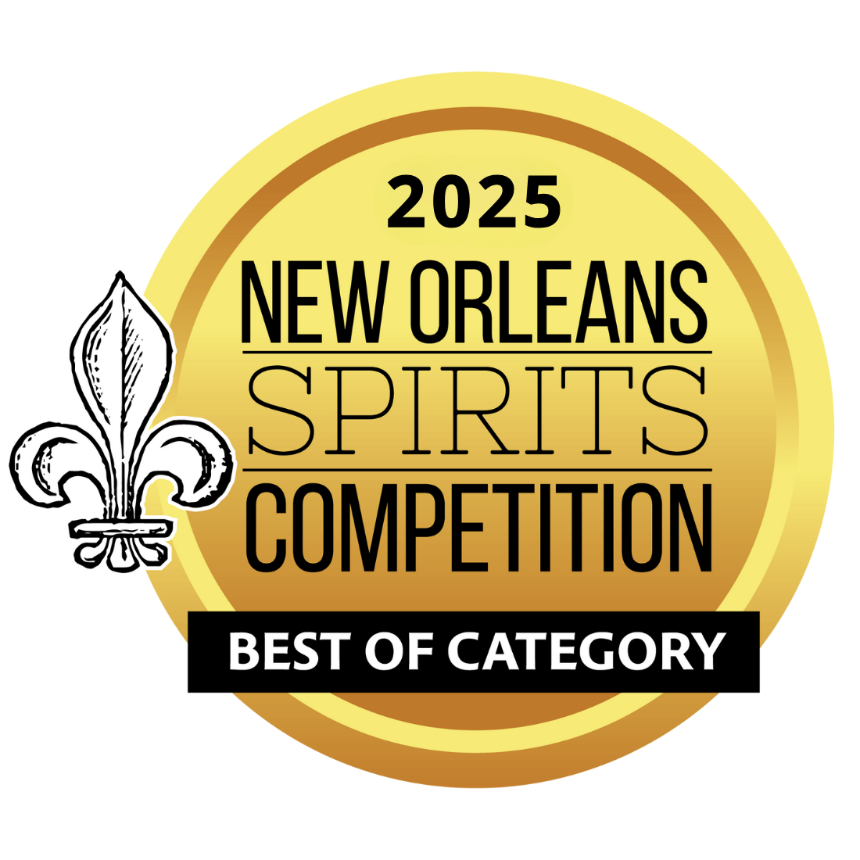
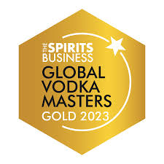
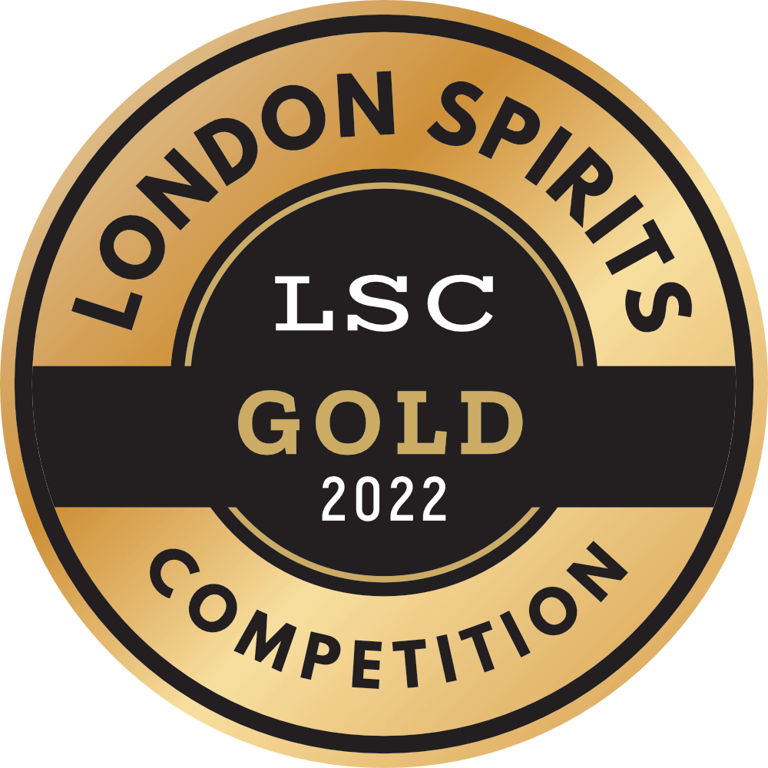
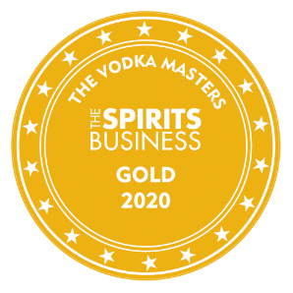
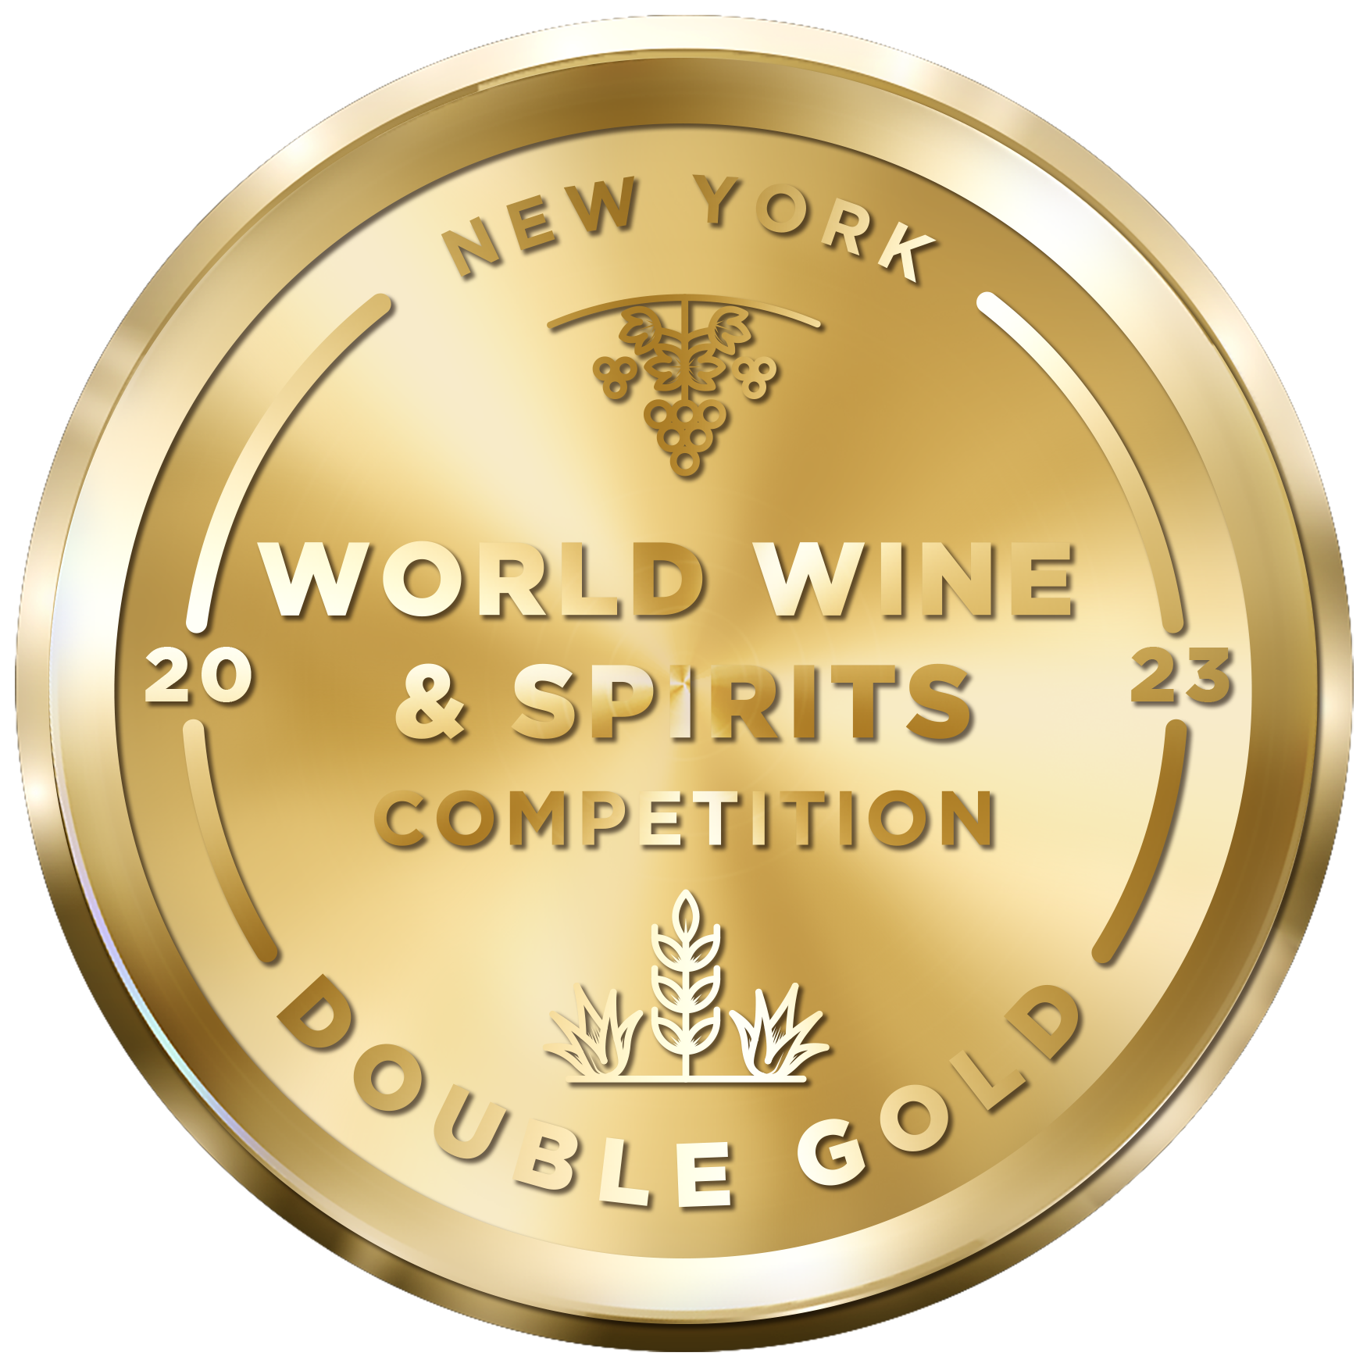
TMLC Irish Vodka
Award | Product | Medal/Score
2020 The Spirits Business Vodka Master | Muff Irish Vodka | Gold
2022 London Spirits Competition | Muff Irish Vodka | Gold
2023 New York World Wine & Spirits Competition (NYWSC) | Muff Irish Vodka | Double Gold
2023 The Spirits Business Vodka Masters | Muff Irish Vodka | Gold
2024 The Tasting Panel | Muff Irish Vodka | Score: 92
2025 New Orleans Spirits Competition | Muff Irish Vodka | Best in Vodka Category, Vodka of the Year, Gold Medal

Slide 4
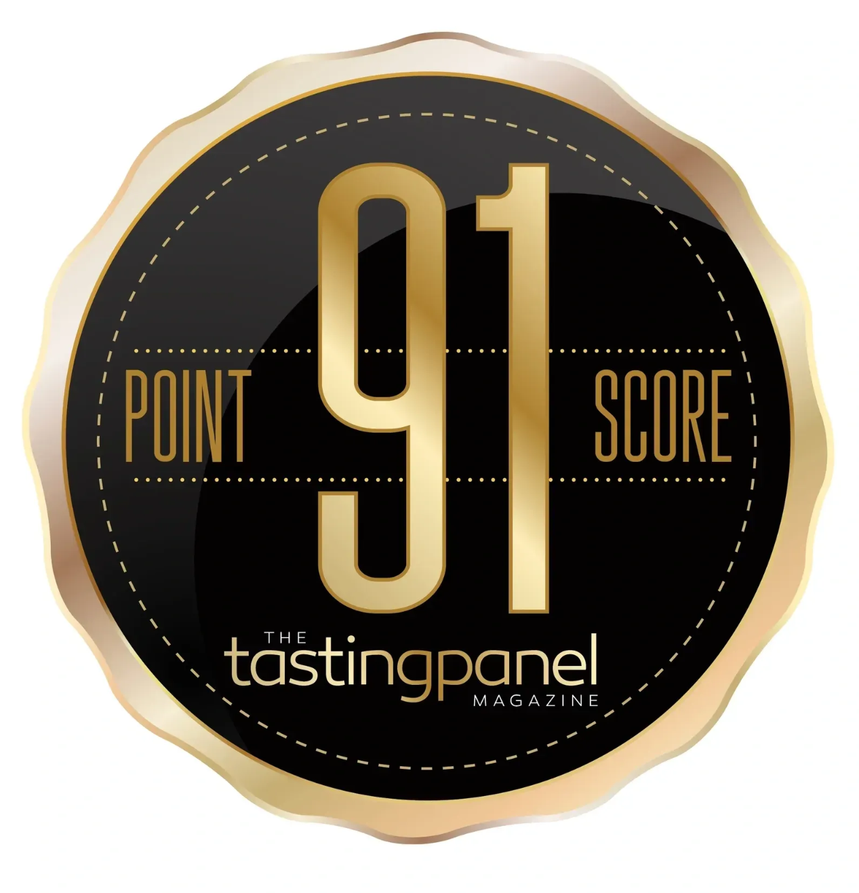
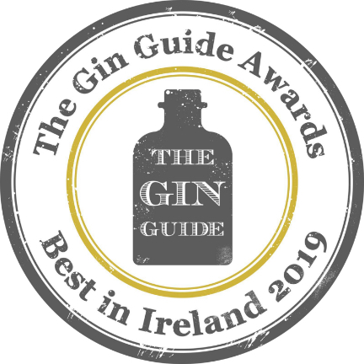
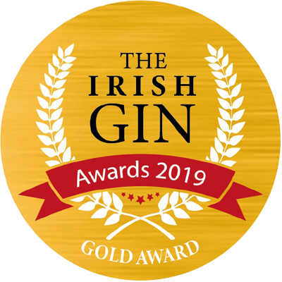
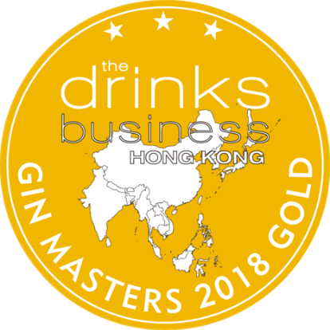

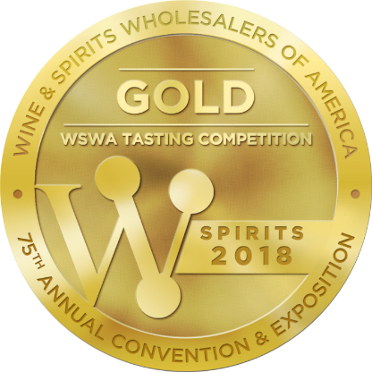
TMLC Irish Gin
Award | Product | Medal/Score
2018 The Drinks Business Hong Kong Gin Masters | Muff Irish Gin | Gold
2018 The Wine & Spirits Wholesalers of America | Muff Irish Gin | Gold/Spirit Of The Year
2019 The Gin Guide Award | Muff Irish Gin | Best in Ireland
2019 The Irish Gin Award | Muff Irish Gin | Gold
2024 The Tasting Panel | Muff Irish Gin | Score: 91
2025 Wine Enthusiast | Muff Irish Gin | Best Buy/Score: 93
93 POINTS

