Slide 1
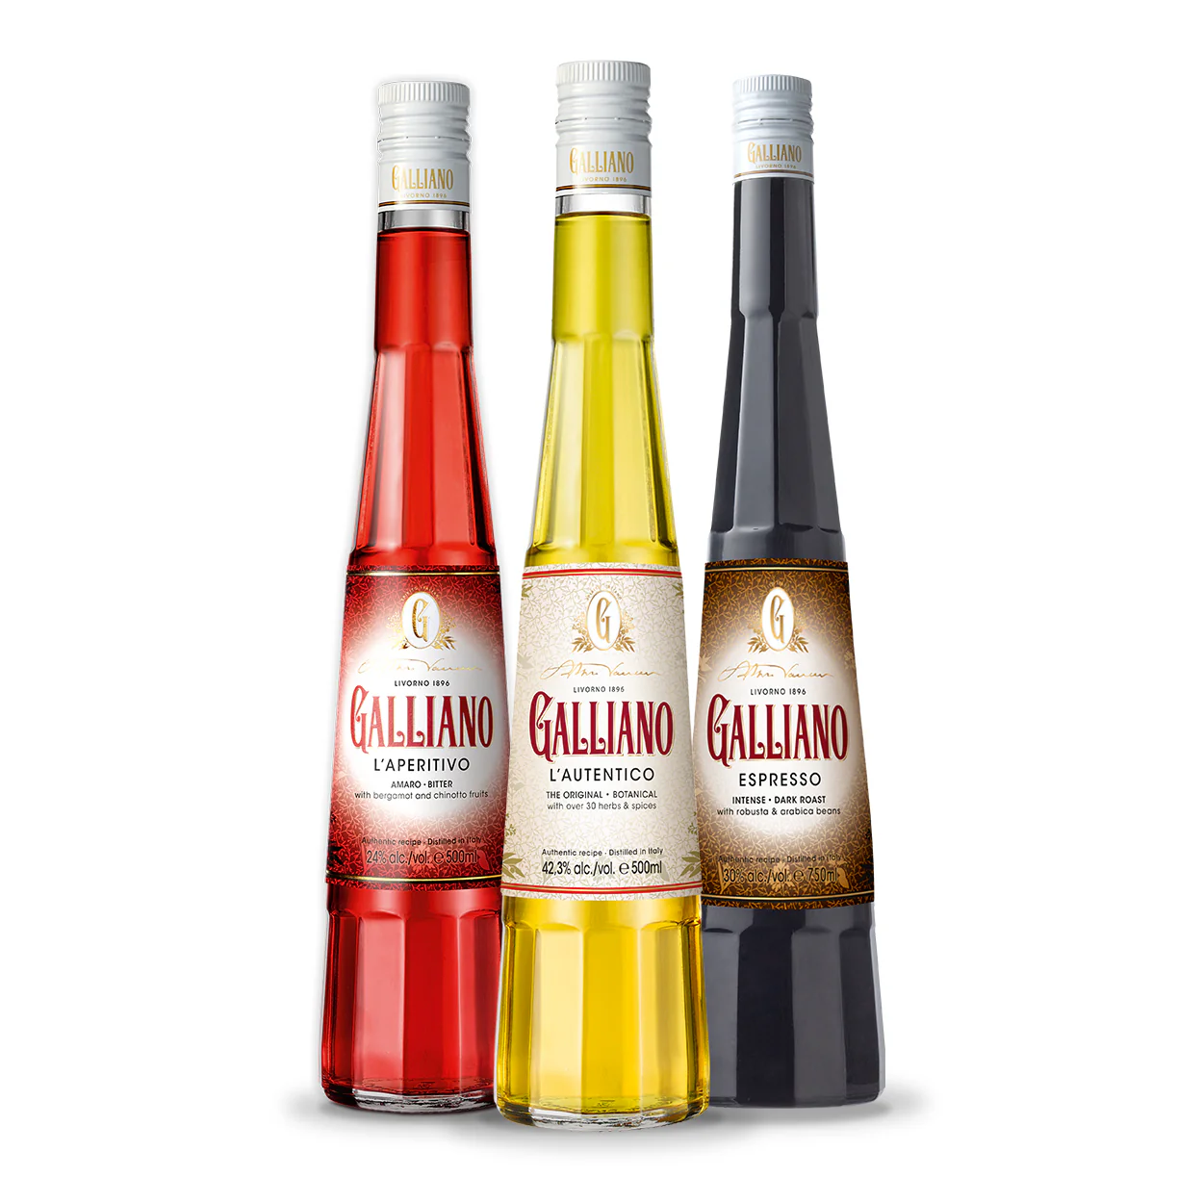
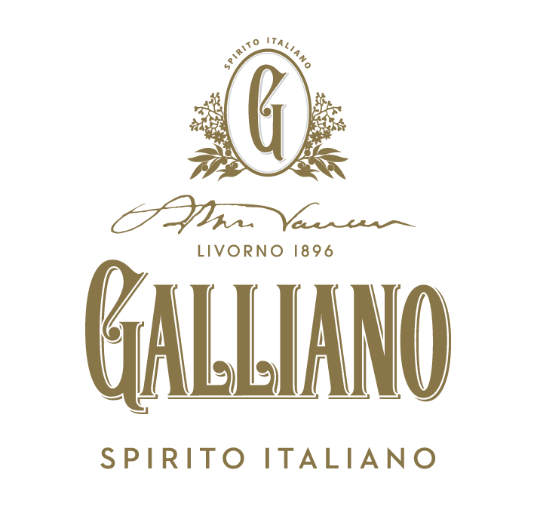


Accolades & Ratings – Updated August 2025

Slide 2
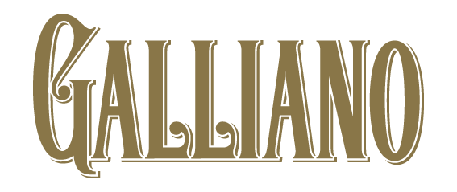

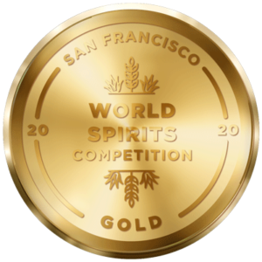
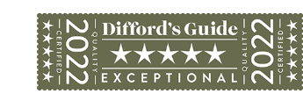
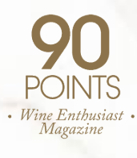
Galliano L'Autentico
Award | Product | Medal/Score
2020 San Francisco World Spirits Competition | L’Autentico | Gold
2022 International Wine & Spirit Competition | L’Autentico | Score: 95
2022 Difford’s Guide | L’Autentico | Exceptional/5 Stars
2022 Wine Enthusiast Magazine | L’Autentico | Score: 90

Slide 3
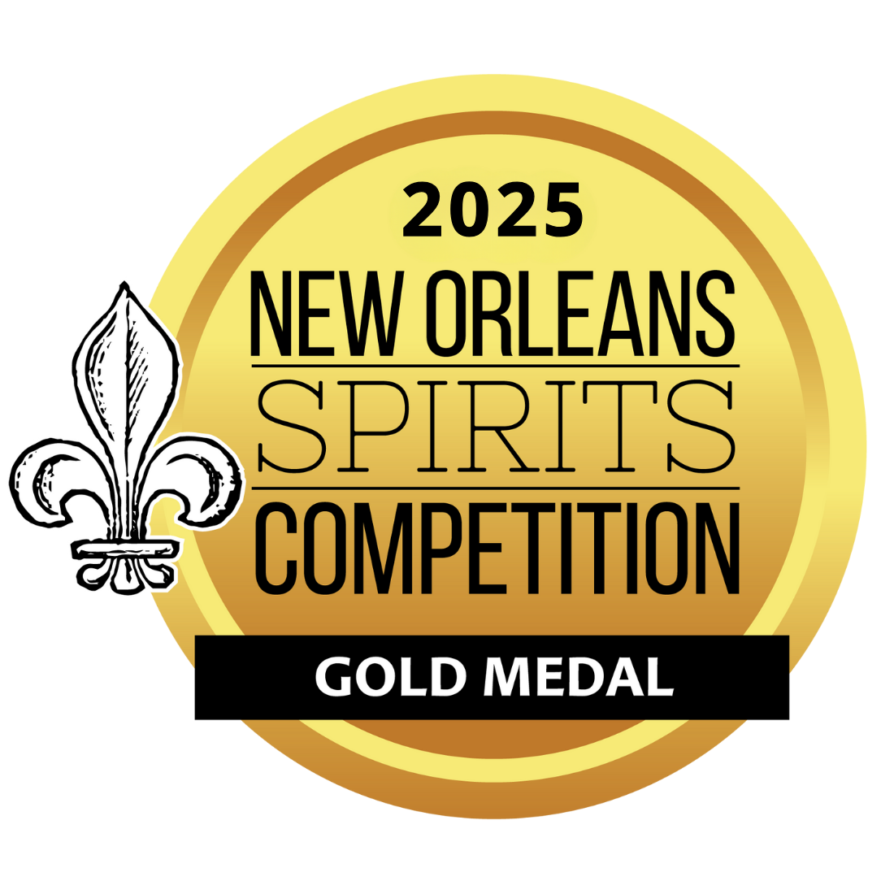
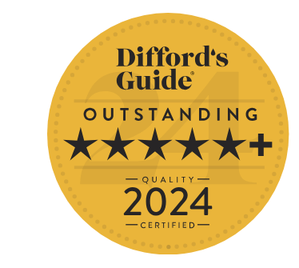
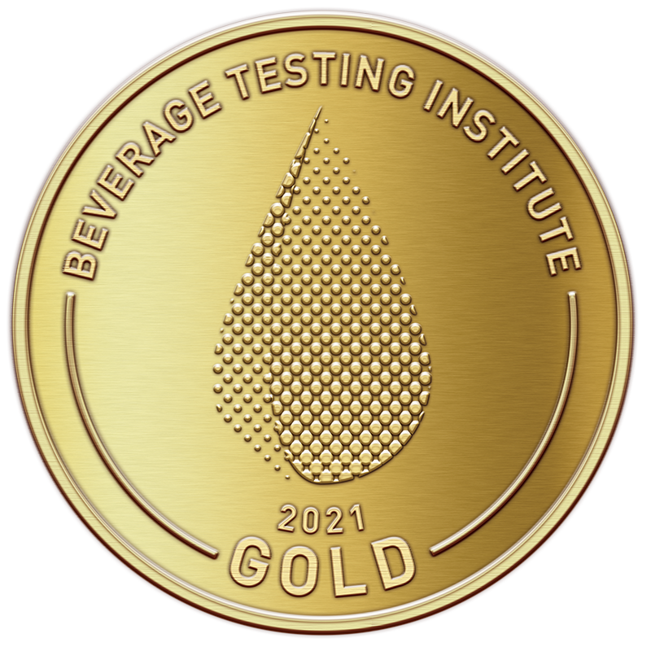
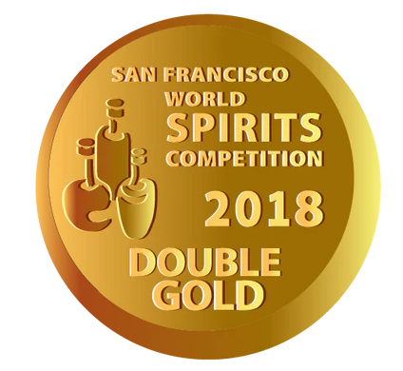
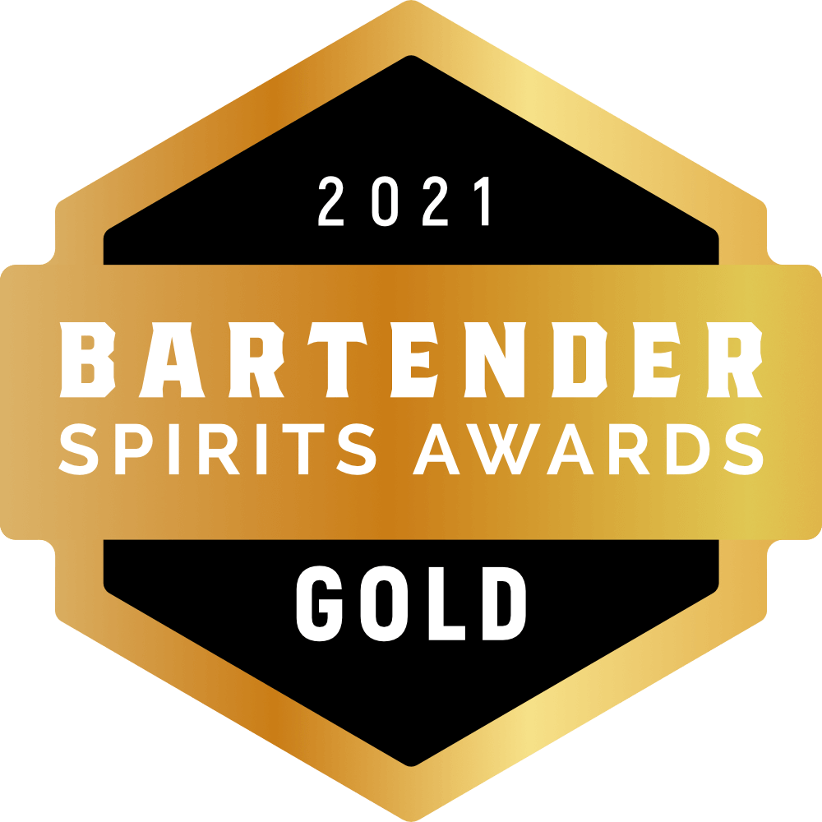
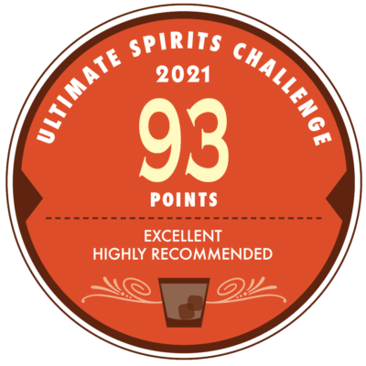
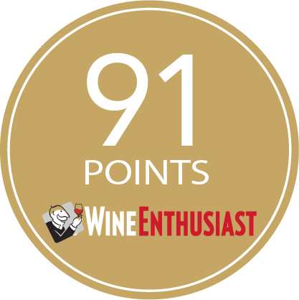
Galliano Espresso
Award | Product | Medal/Score
2017 Wine Enthusiast | Espresso | Score: 91
2018 San Francisco World Spirits Competition | Espresso | Double Gold
2021 Bartender Spirits Awards | Espresso | Gold
2021 Beverage Tasting Institute | Espresso | Gold
2021 Ultimate Spirits Challenge | Espresso | Score: 93
2024 Difford’s Guide | Espresso | Outstanding/5+ stars
2025 New Orleans Spirits Competition | Espresso | Gold

Slide 4
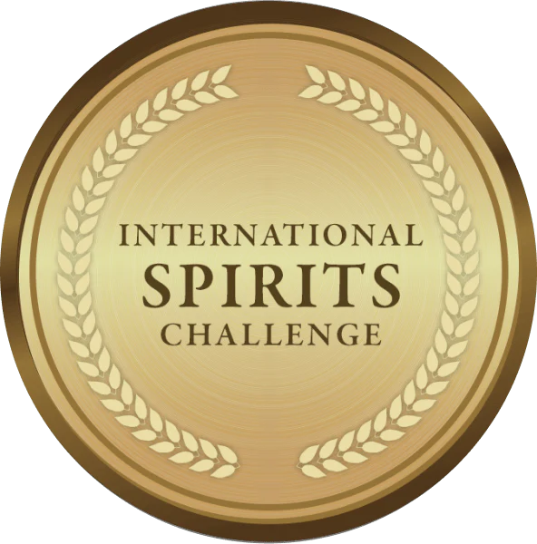
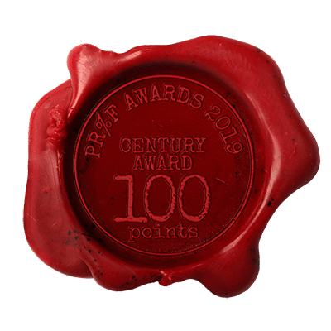
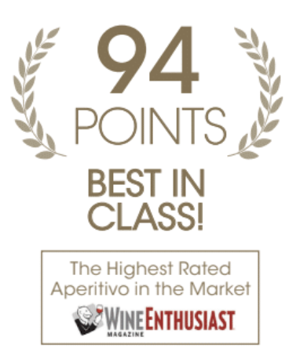
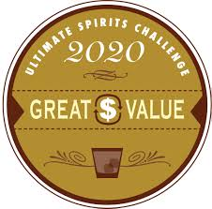
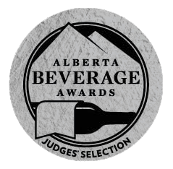
Galliano L'Aperitivo
Award | Product | Medal/Score
2018 International Spirits Challenge | L'Aperitivo | Gold
2018 Wine Enthusiast | L'Aperitivo | Score: 94, Crowned Century Award
2019 PROOF Award | L'Aperitivo | Score: 100
2020 Ultimate Beverage Challenge | L'Aperitivo | Great Value
2023 Alberta Beverage Awards | L'Aperitivo | Judges Selection

