Slide 1
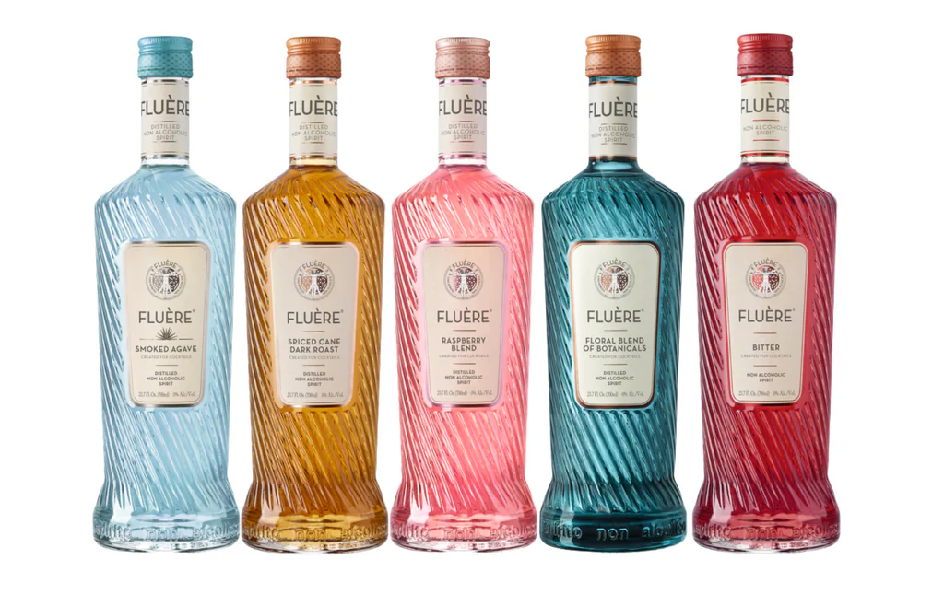



Accolades & Ratings – Updated August 2025

Slide 2

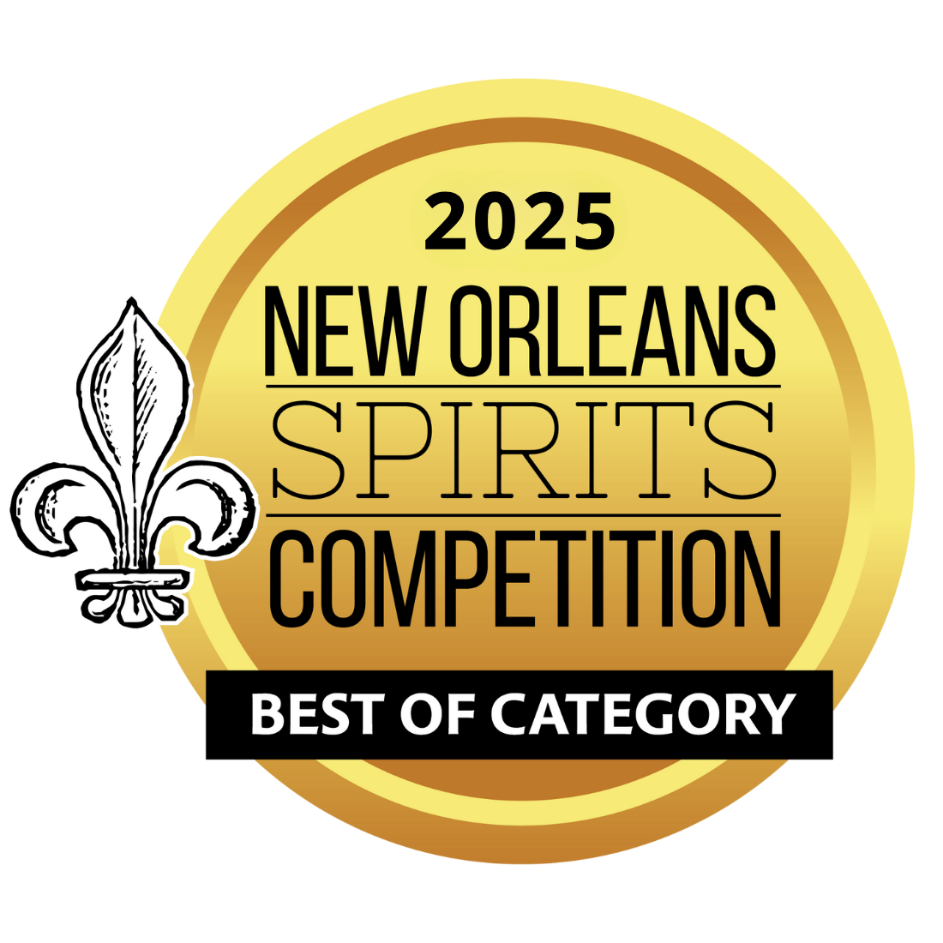
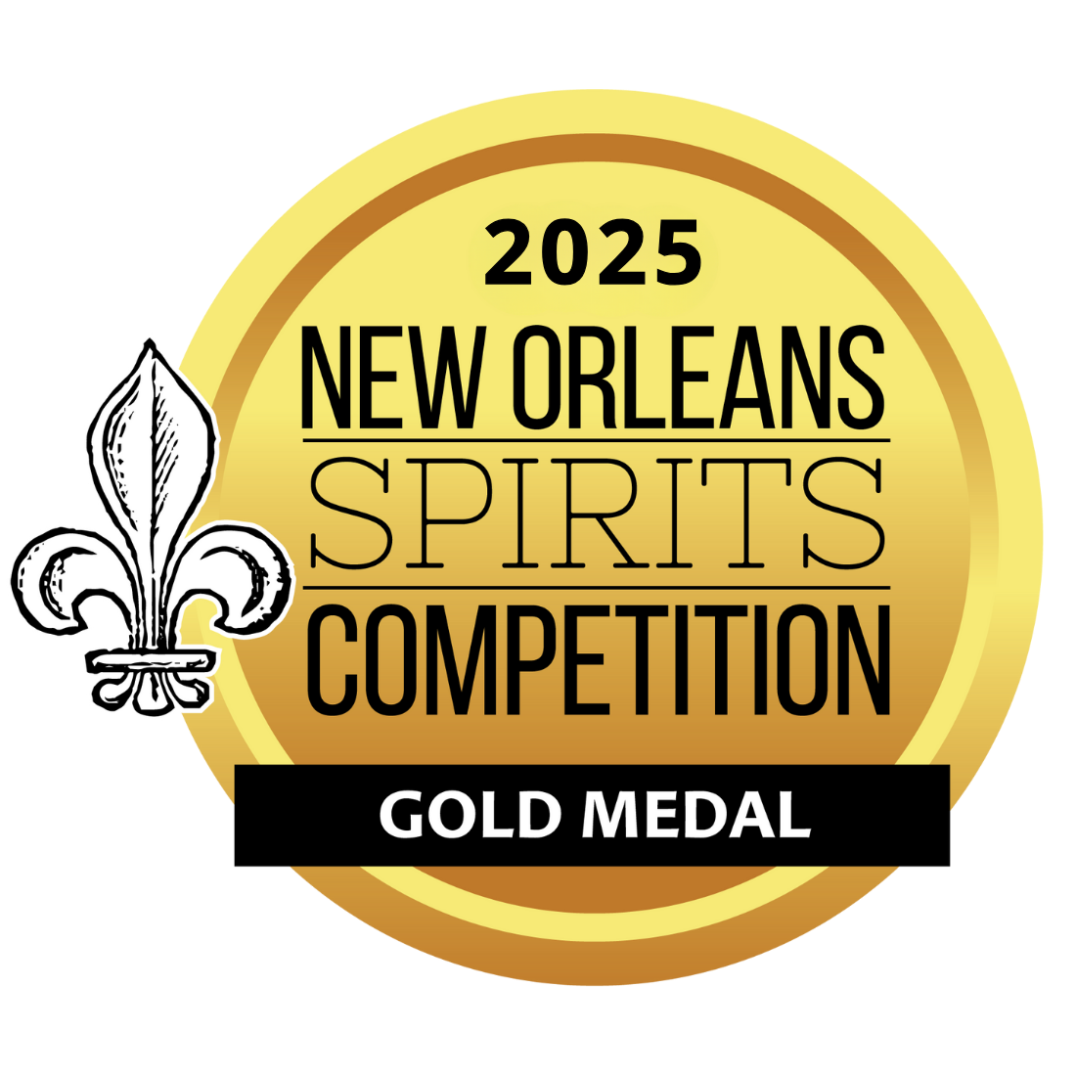
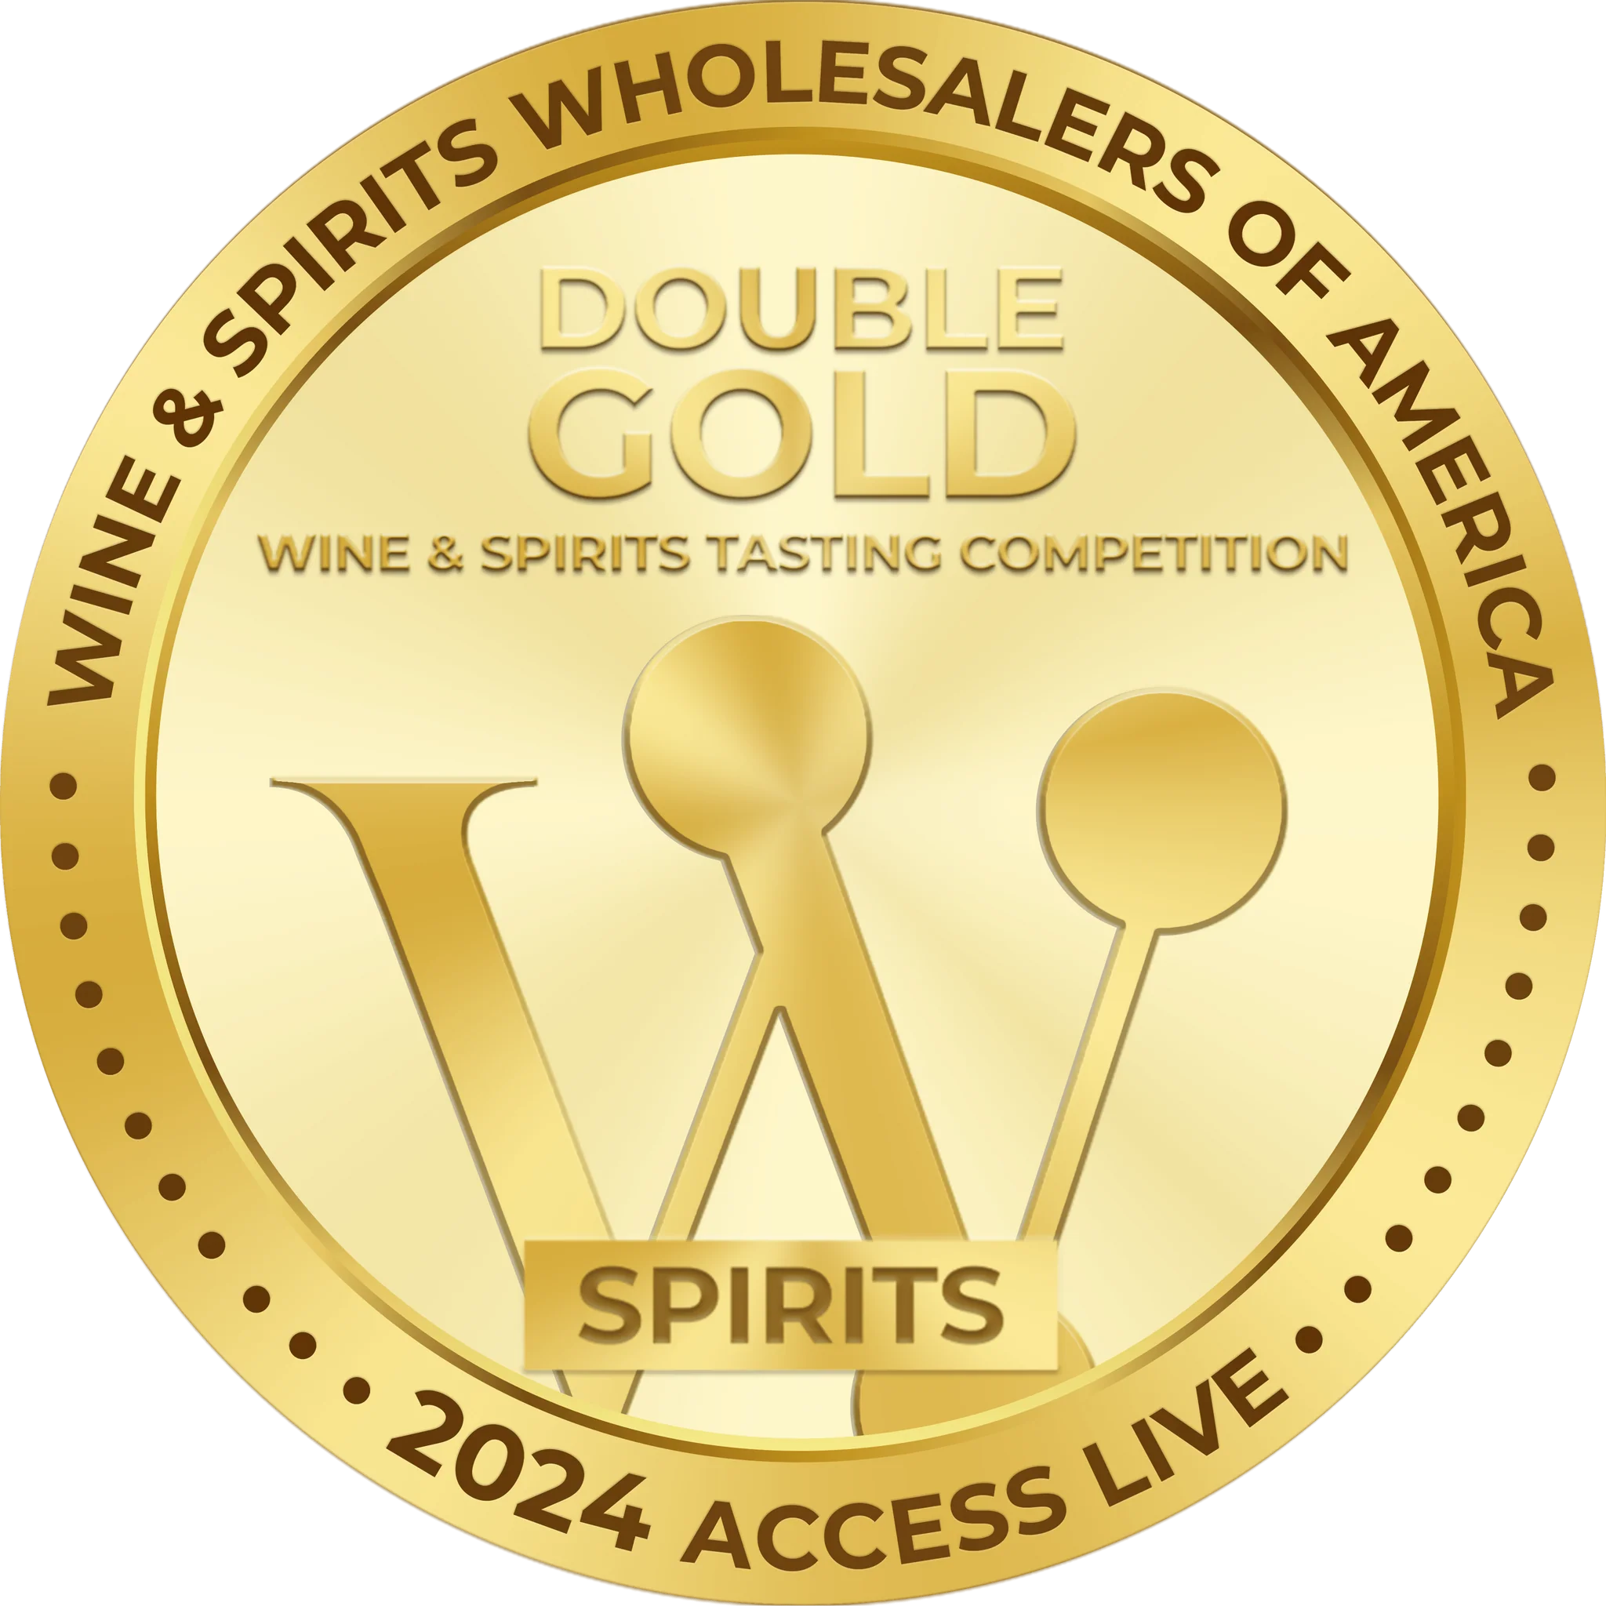
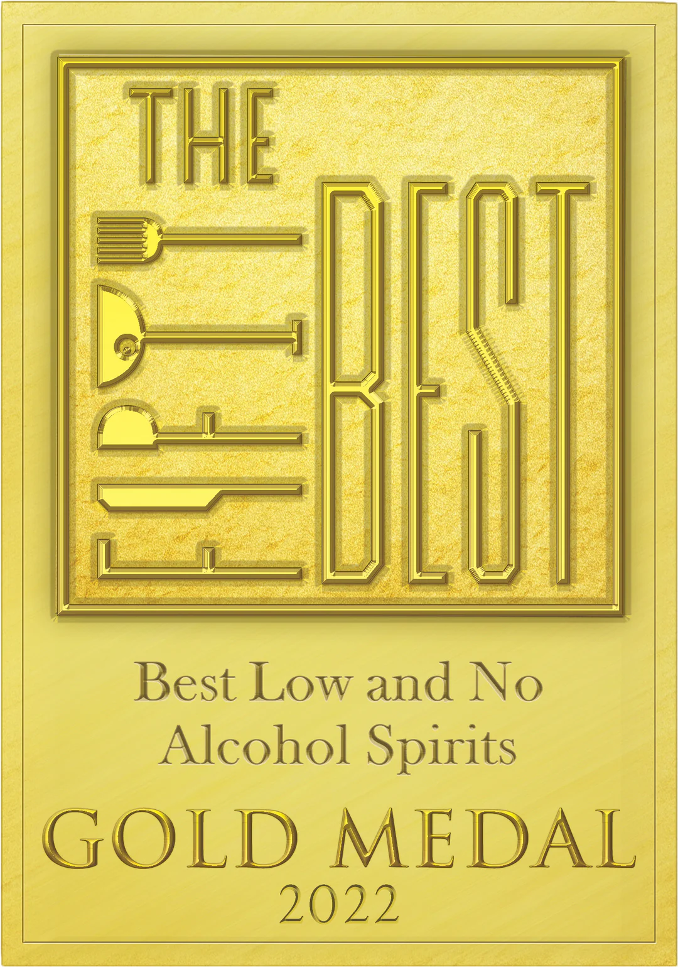
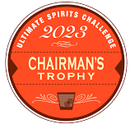
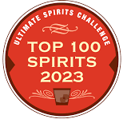
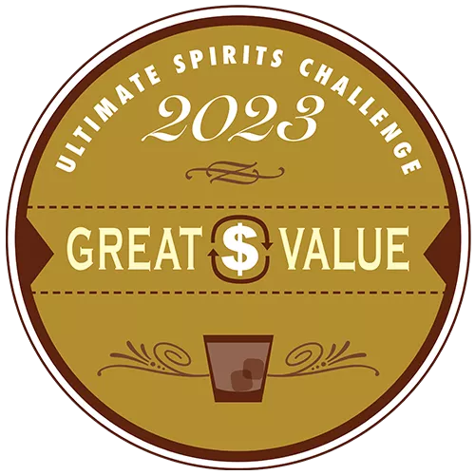

Fluère Spiced Cane
Award | Product | Medal/Score
2023 WSWA Access Live | Spiced Cane | Best of Show
2023 WSWA Access Live | Spiced Cane | Double Gold
2022 The Fifty Best Awards | Spiced Cane | Gold
2023 Ultimate Spirits Challenge | Spiced Cane | Chairman’s Trophy, Top 100 Spirits, Great Value
2025 New Orleans Spirits Competition | Spiced Cane | Best No & Low Elixir Category, No & Low Elixir of the Year, Gold

Slide 3
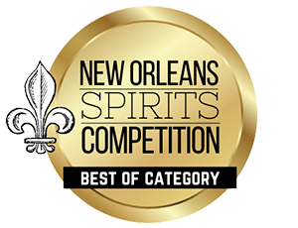
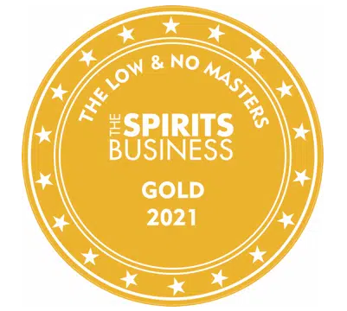
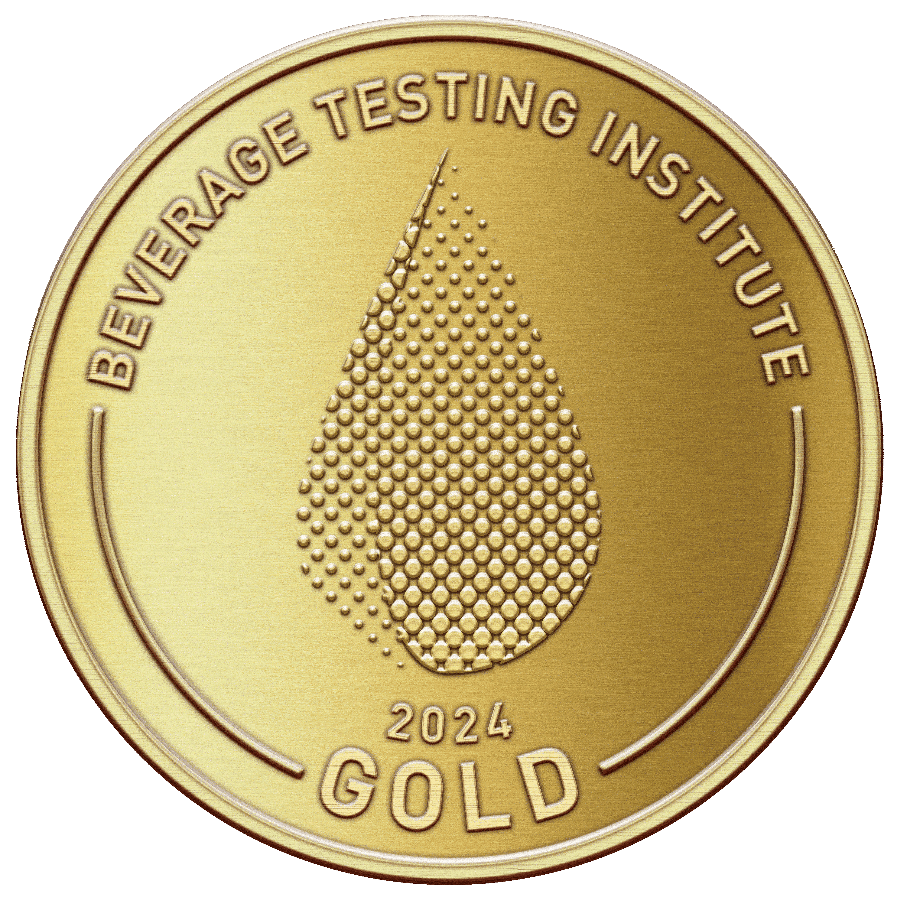
Fluère Bitter
Award | Product | Medal/Score
2023 WSWA Access Live | Bitter | Best of Show
2023 WSWA Access Live | Bitter | Double Gold
2023 The Low & No Masters Competition | Bitter | Gold
2024 New Orleans Spirits Competition | Bitter | Best of Show
2025 Beverage Testing Institute | Bitter | Gold/94 Points

Slide 4
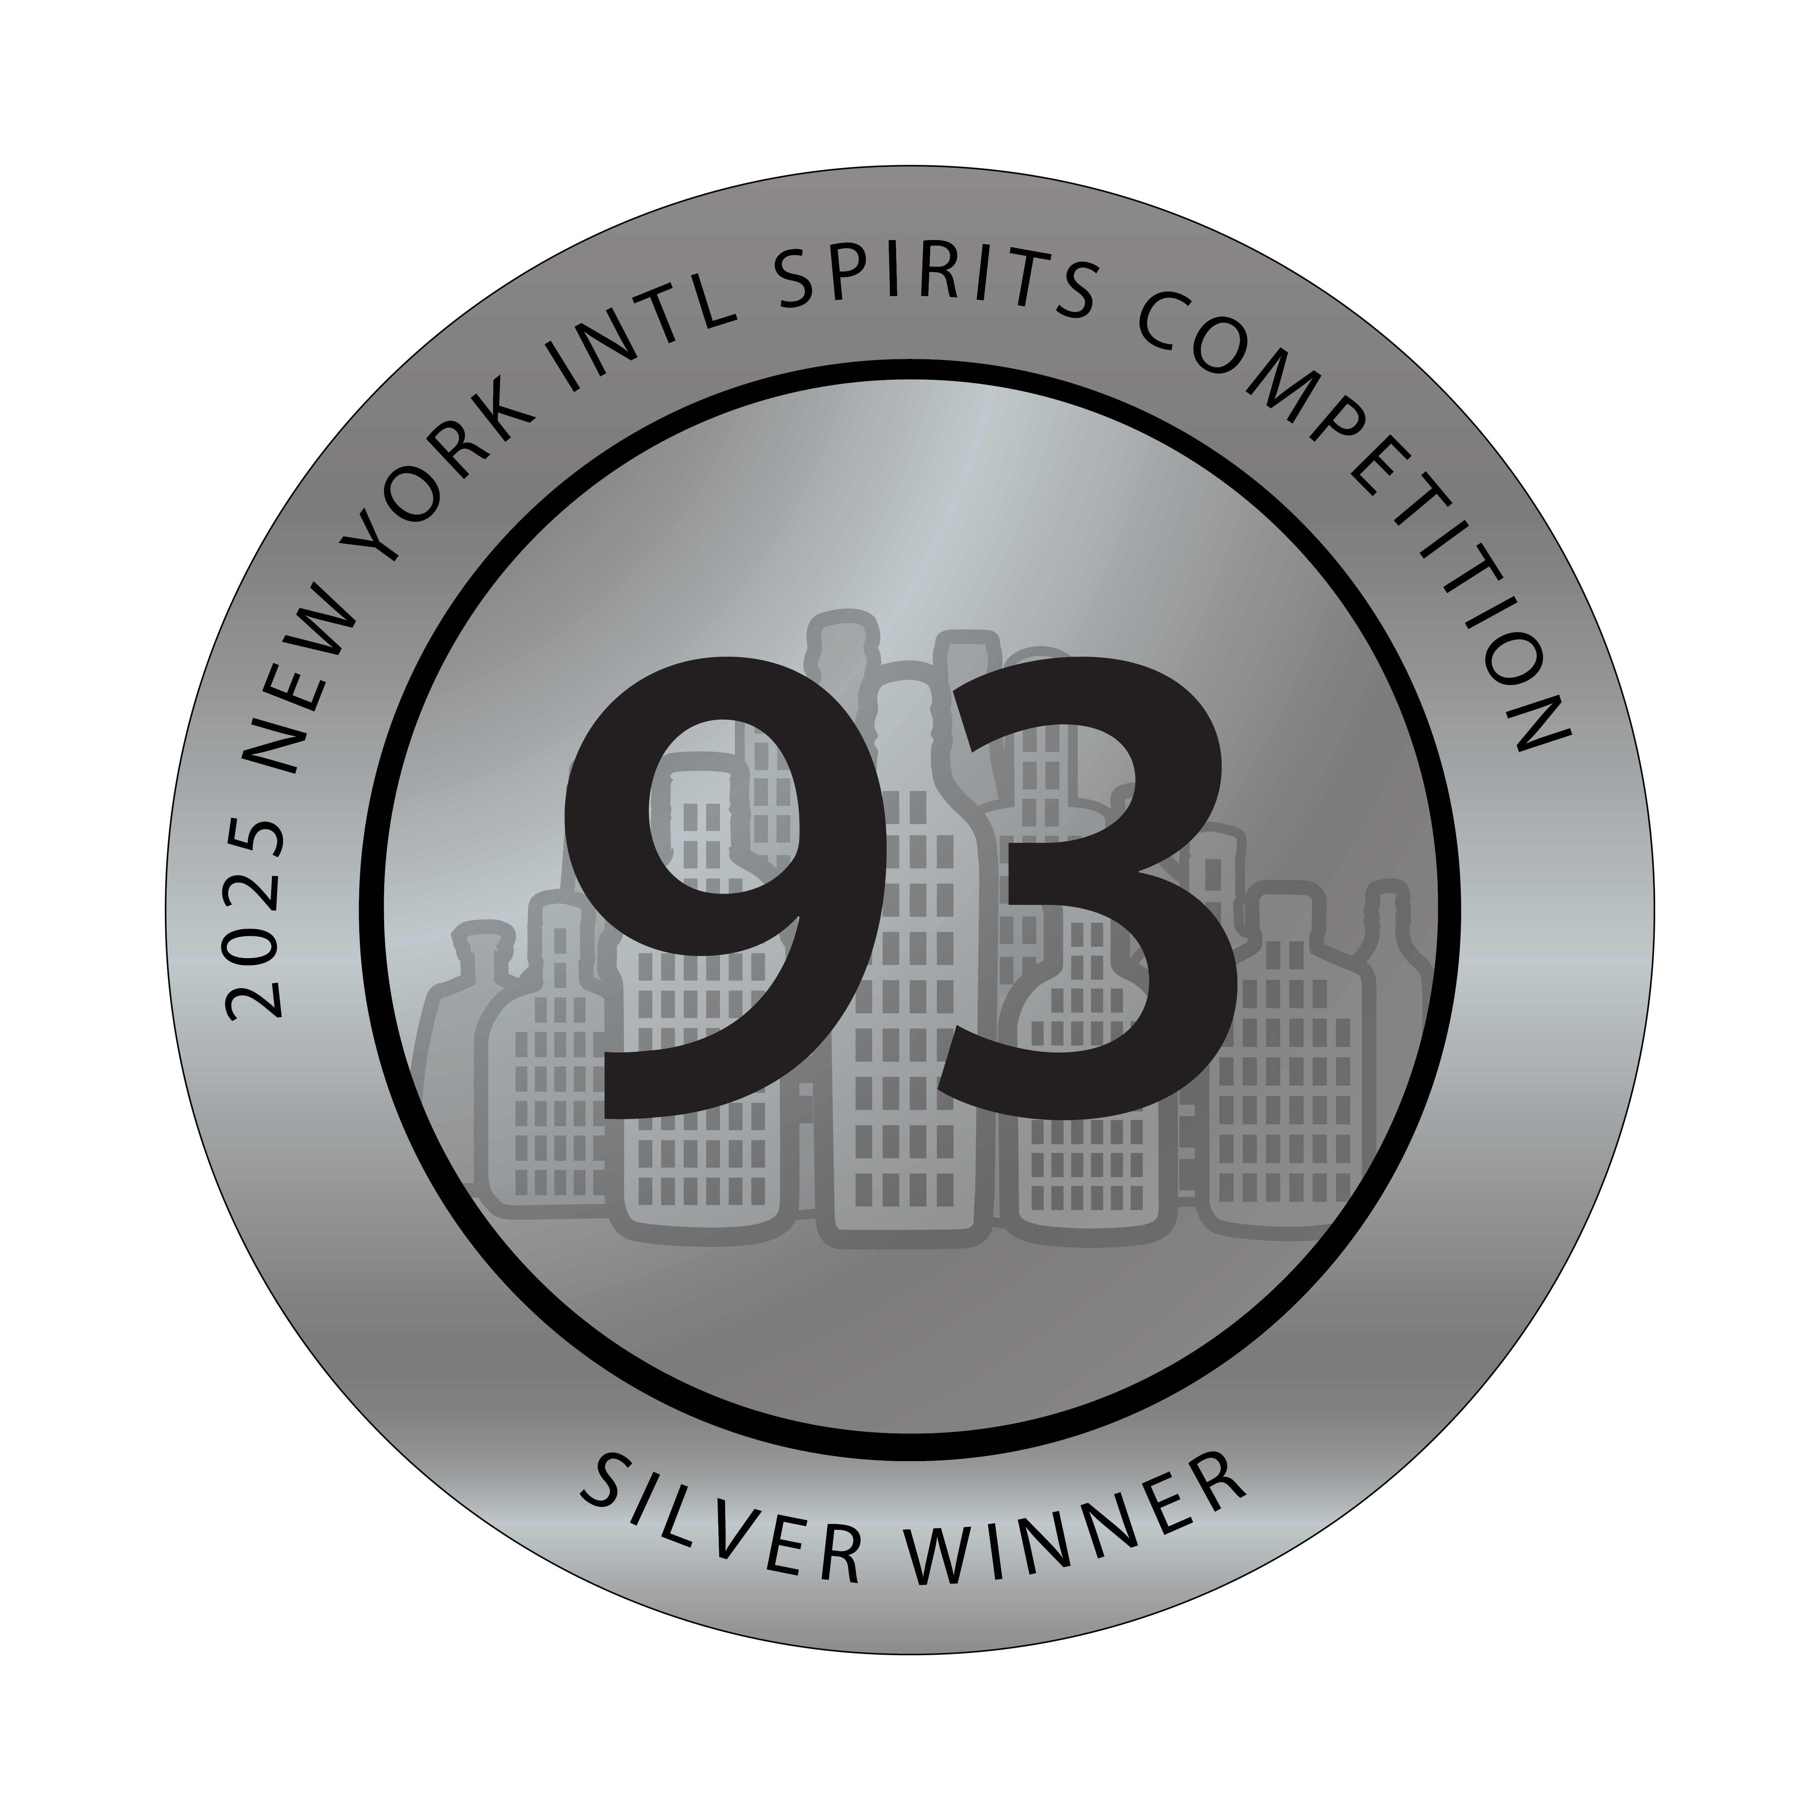
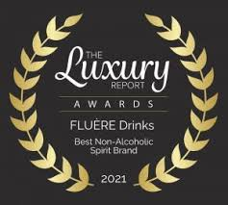
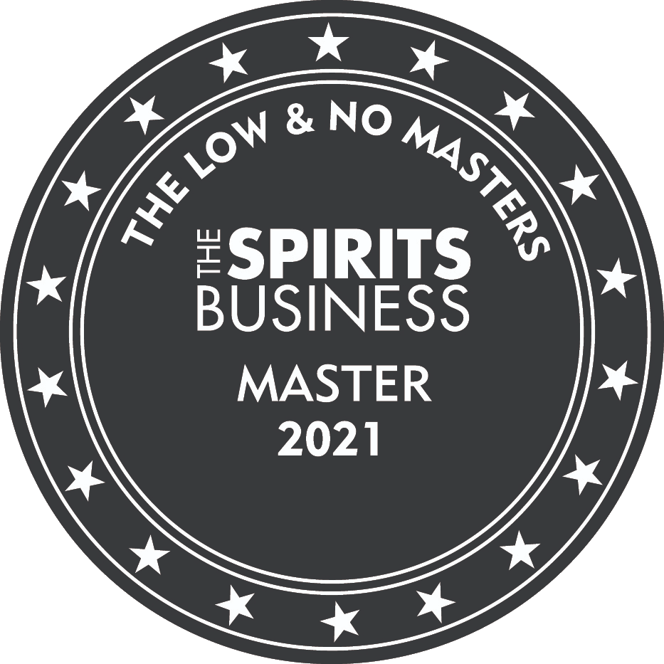
Fluère Raspberry, Smoked Agave, Botanical
Award | Product | Medal/Score
2021 Luxury Report Award | Original Blend | Top distilled non-alcoholic spirit of the year
2021 The Low & No Masters Competition | Raspberry Blend | Master Award
2021 The Low & No Masters Competition | Smoked Agave | Gold
2024 The Low & No Masters Competition | Smoked Agave | Gold
2025 Beverage Testing Institute | Smoked Agave | Gold/90 Points
2025 New York International Spirits Competition | Smoked Agave | Silver/93 Points

