Slide 1
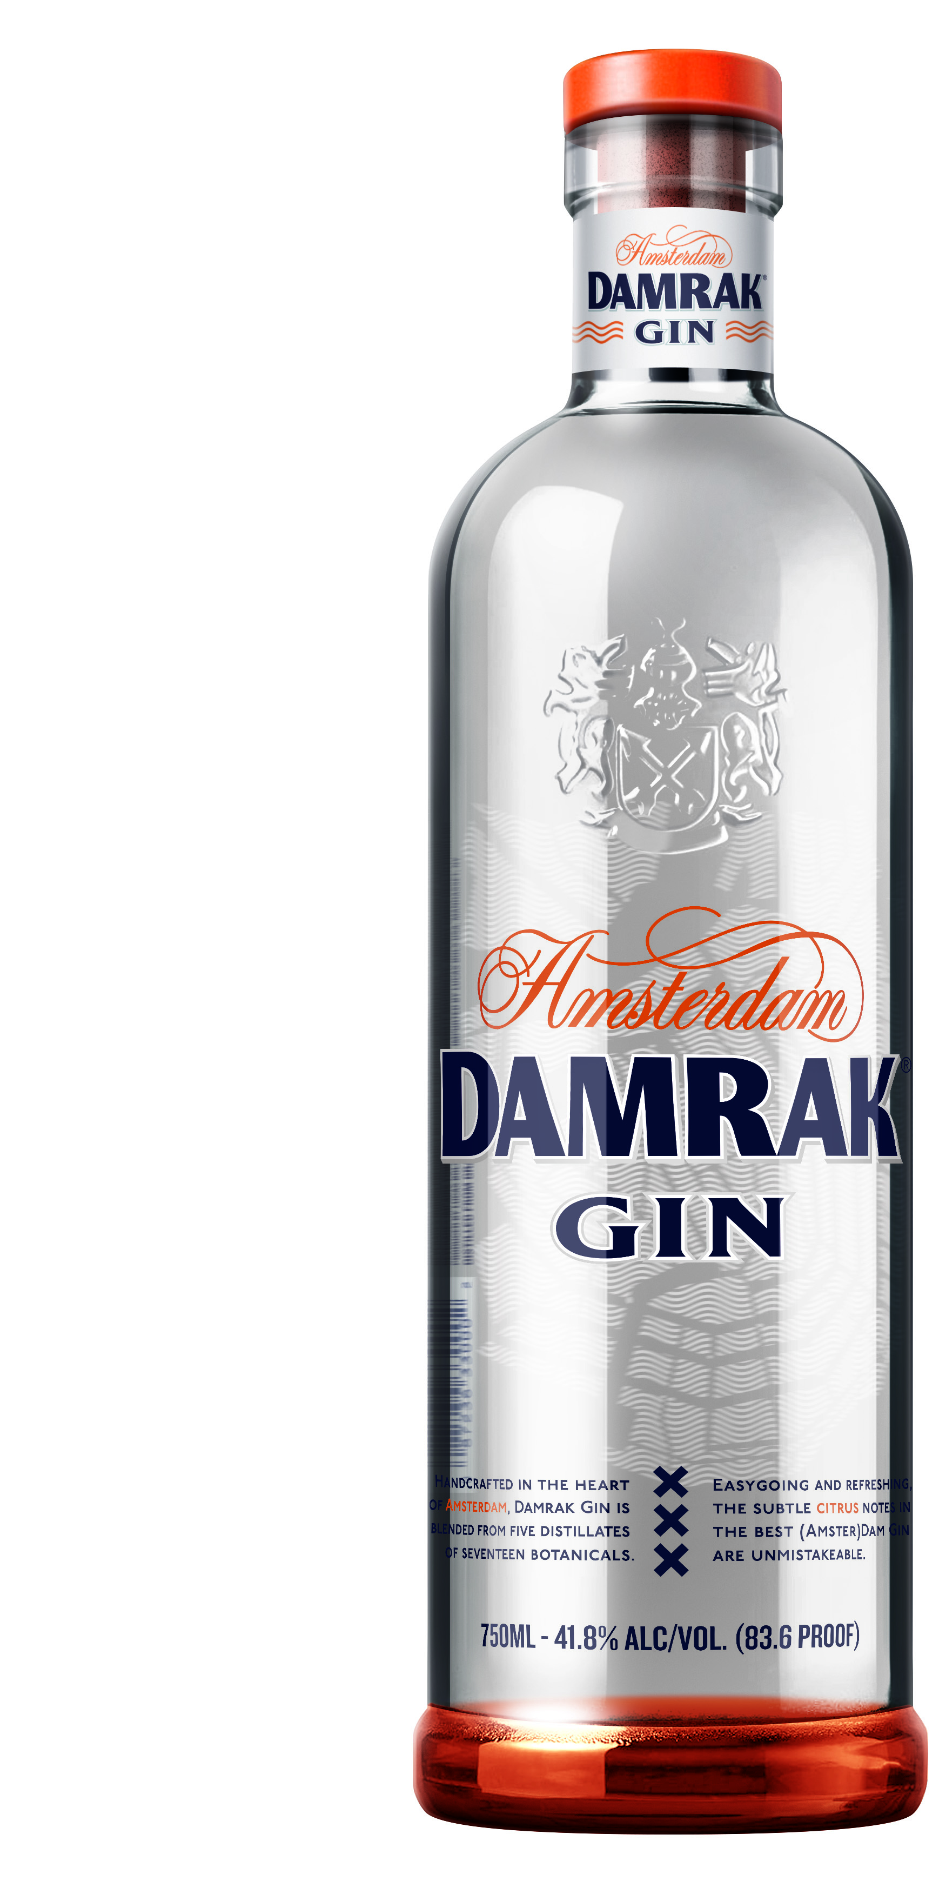
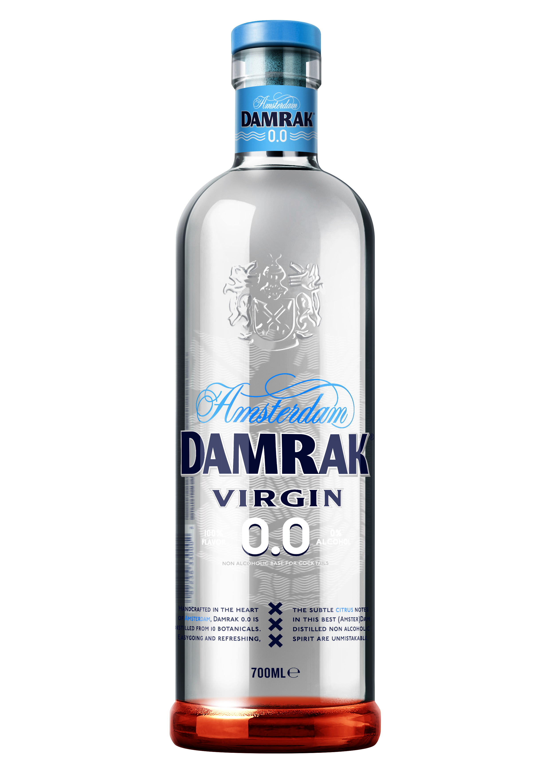

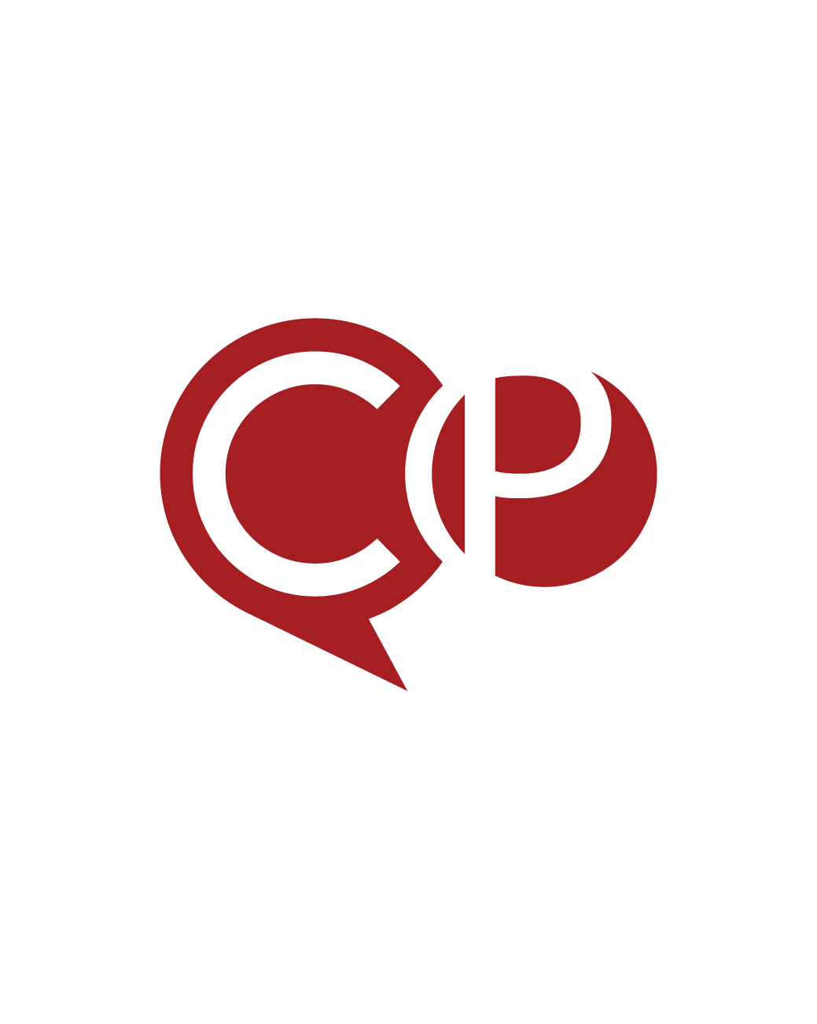
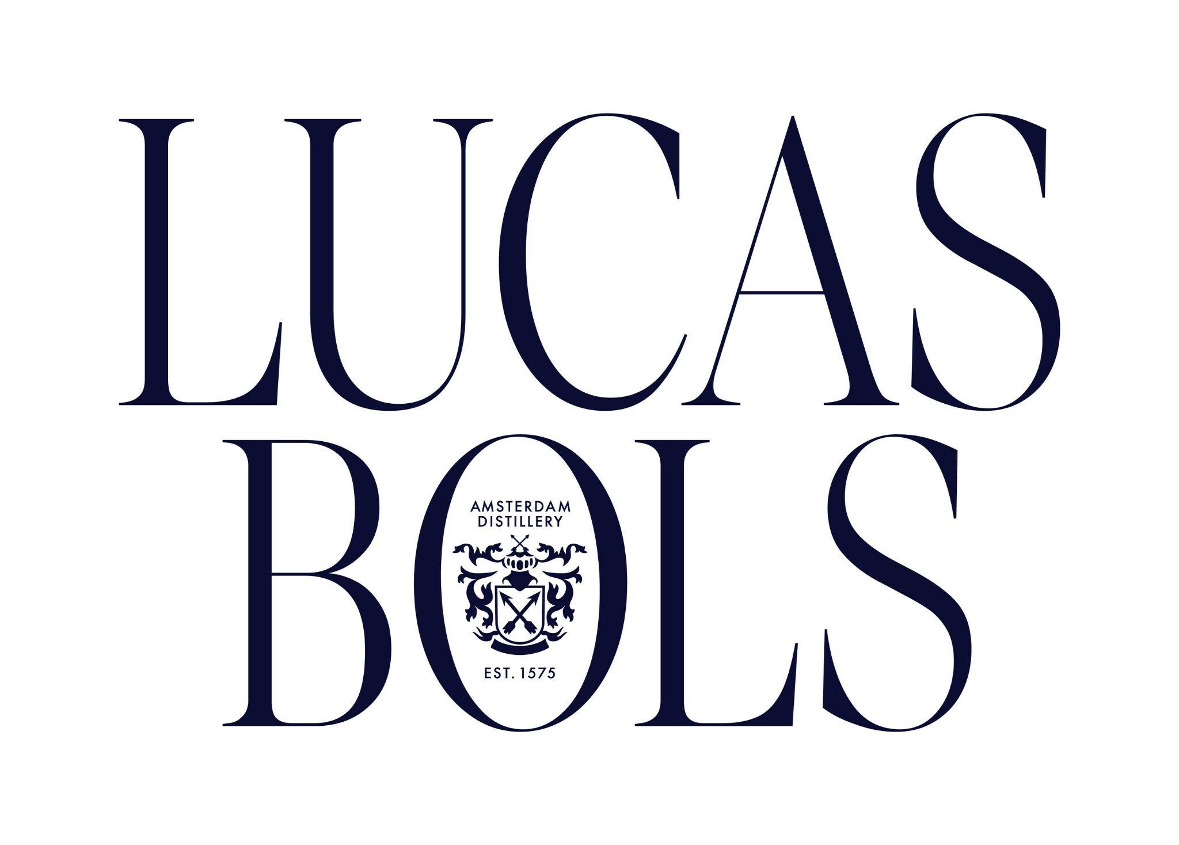
Accolades & Ratings – Updated August 2025

Slide 2
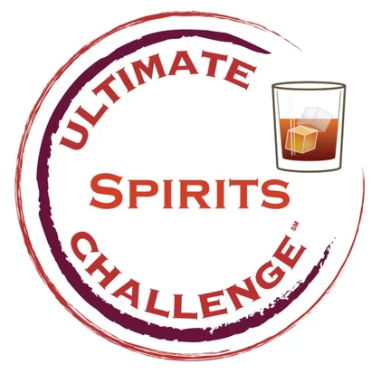
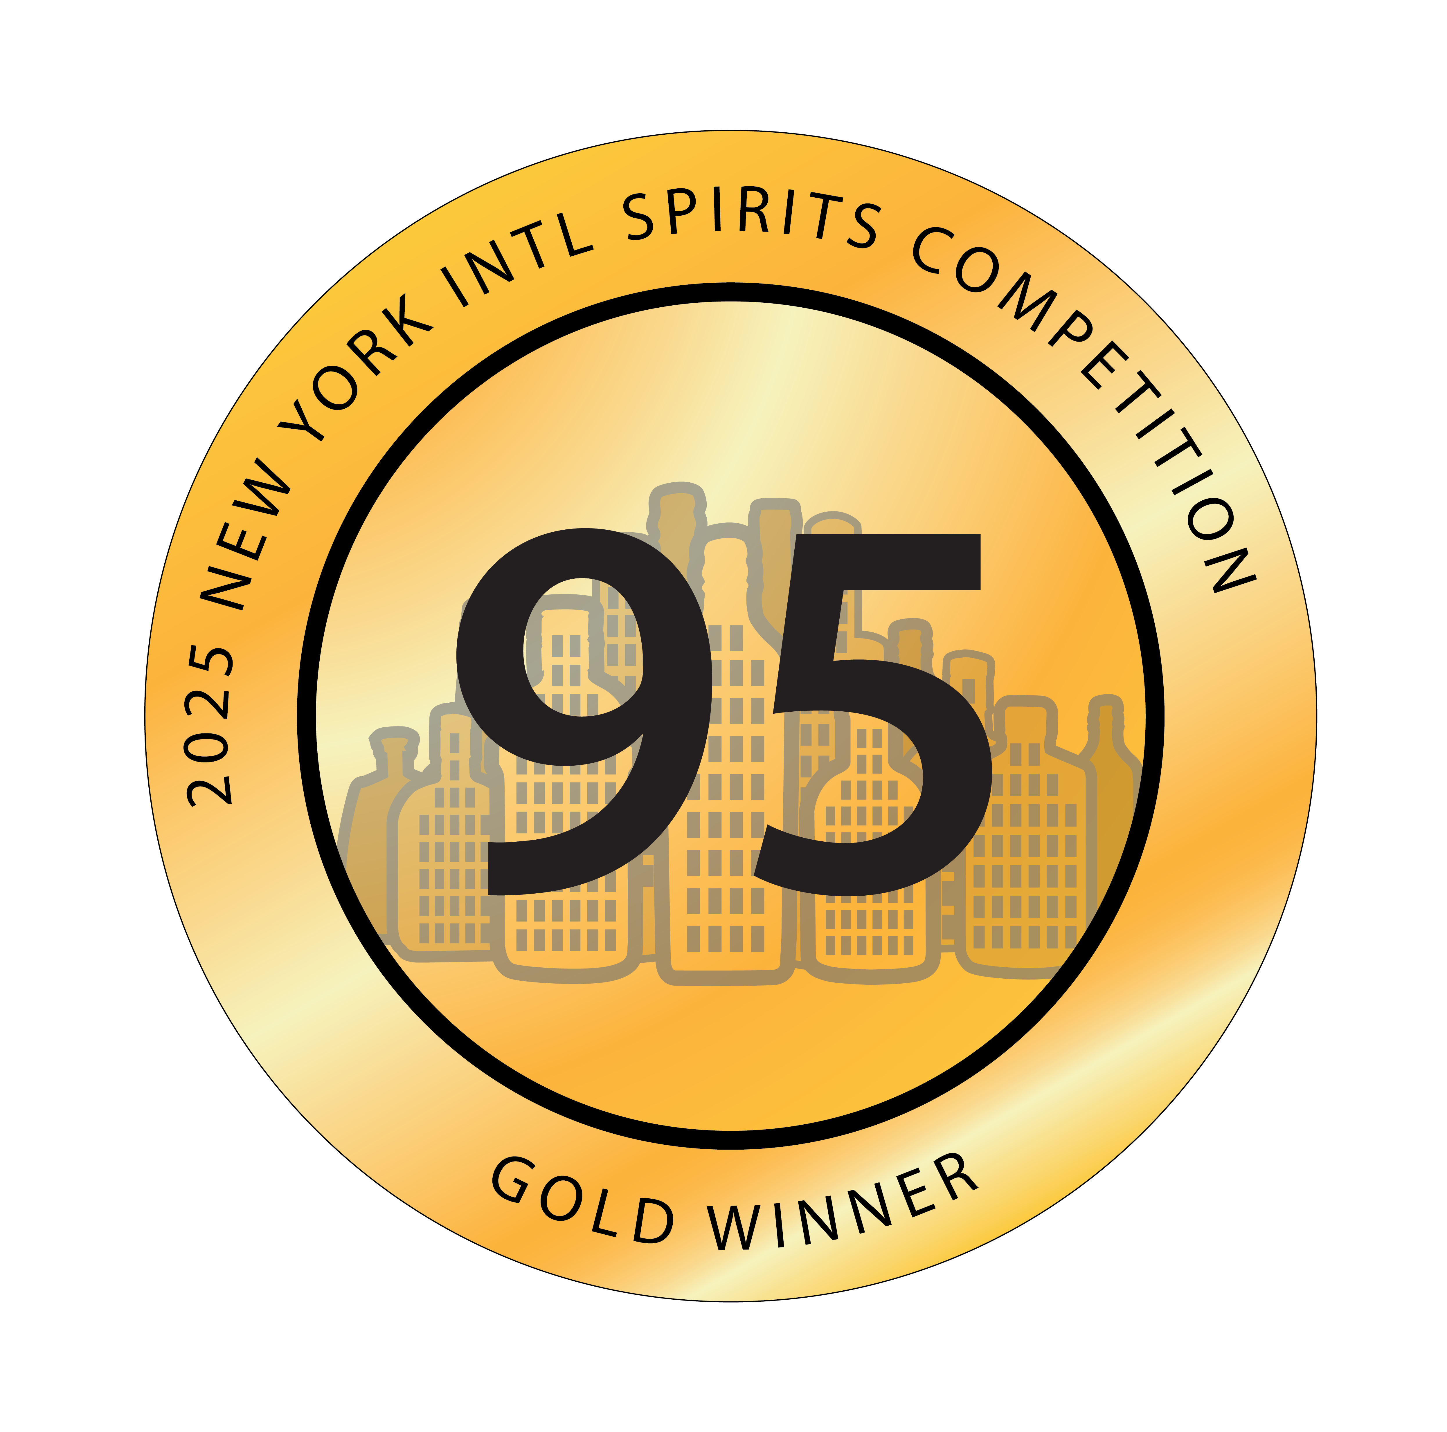
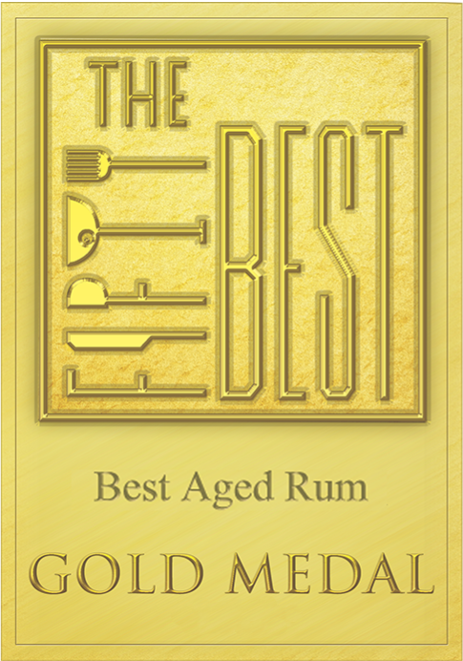
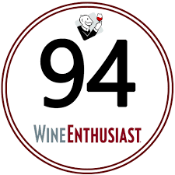
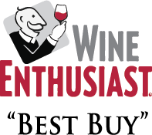
Damrak Gin & Virgin Gin
Award | Product | Medal/Score
2012 The Fifty Best Awards | Gin | Gold
2014 Wine Enthusiast | Gin | Score: 94
2014 Wine Enthusiast | Gin | Best Buy
2020 Ultimate Spirits Challenge | Virgin Gin | Best in Class
2025 New York International Spirits Competition | Virgin Gin | Gold/95 Points

