Slide 1
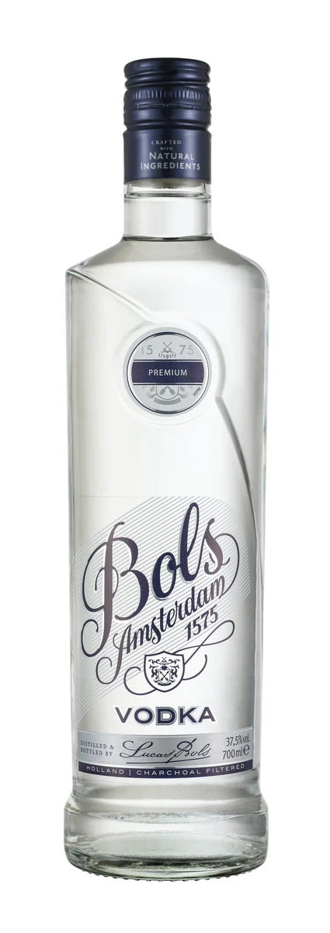
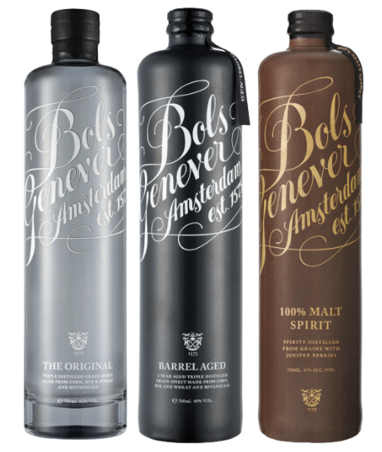



Accolades & Ratings – Updated August 2025
GENEVER & VODKA

Slide 2

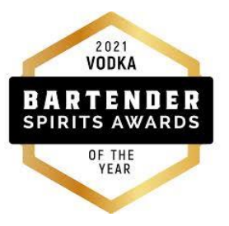



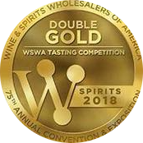

Bols Genever & Vodka
Award | Product | Medal/Score
2018 World Gin Awards | Bols Genever Original | Best of Class
2018 Wine & Spirits Wholesalers of America (WSWA) | Bols Genever Original | Best of Show
2018 Wine & Spirits Wholesalers of America (WSWA) | Bols Genever Original | Double Gold
2021 Bartender Spirits Award | Bols Vodka | Vodka of the Year
2025 The Spirits Business Gin Masters | Bols Genever Barrel Aged | MASTER
2025 London Spirits Competition | Bols Genever Barrel Aged | 94 pts

