Slide 1
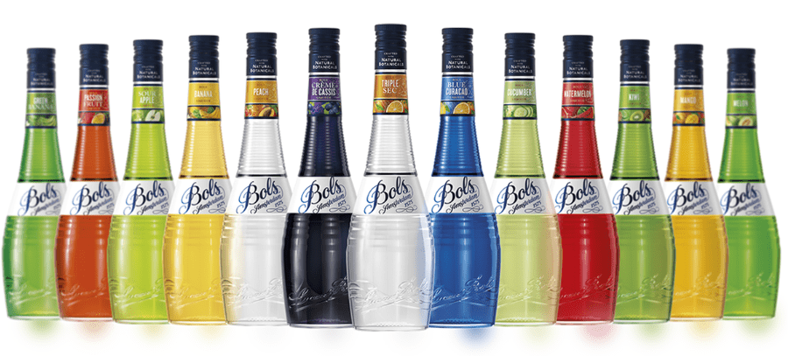


Accolades & Ratings – Updated August 2025

Slide 2


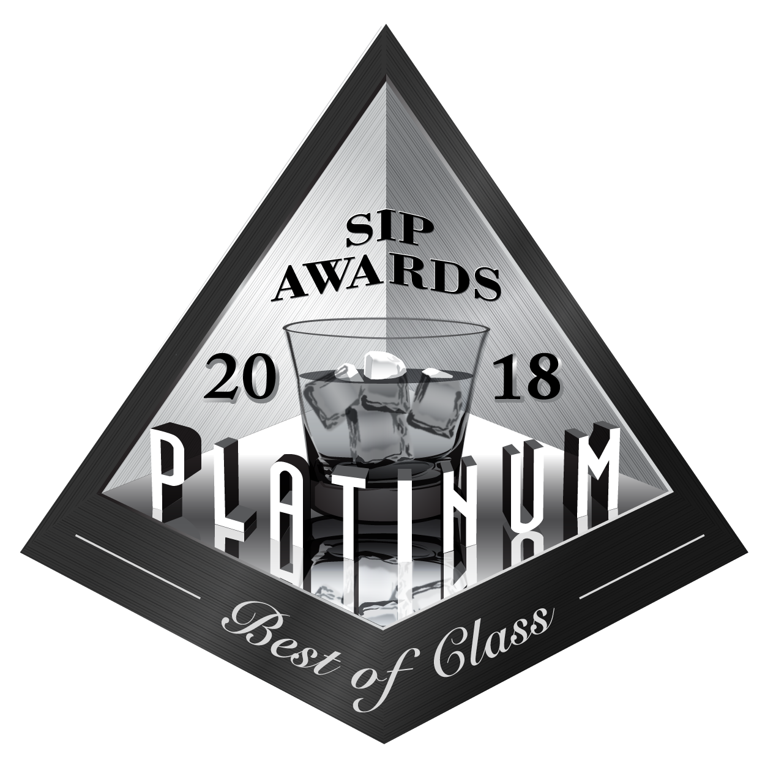

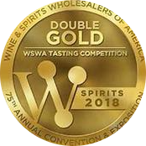



Bols Liqueurs
Award | Product | Medal/Score
2018 SIP Awards | Ginger | Platinum – Best of Class
2018 Wine & Spirits Wholesalers of America (WSWA) | Ginger | Double Gold Best of Show
2014 Wine Enthusiast | Elderflower | Best Buy
2023 The Spirits Business Global Liqueur Masters | Elderflower | Gold
2025 London Spirits Competition | Elderflower | 95 pts
2025 IWSC | Amaretto | 92 pts

Slide 3
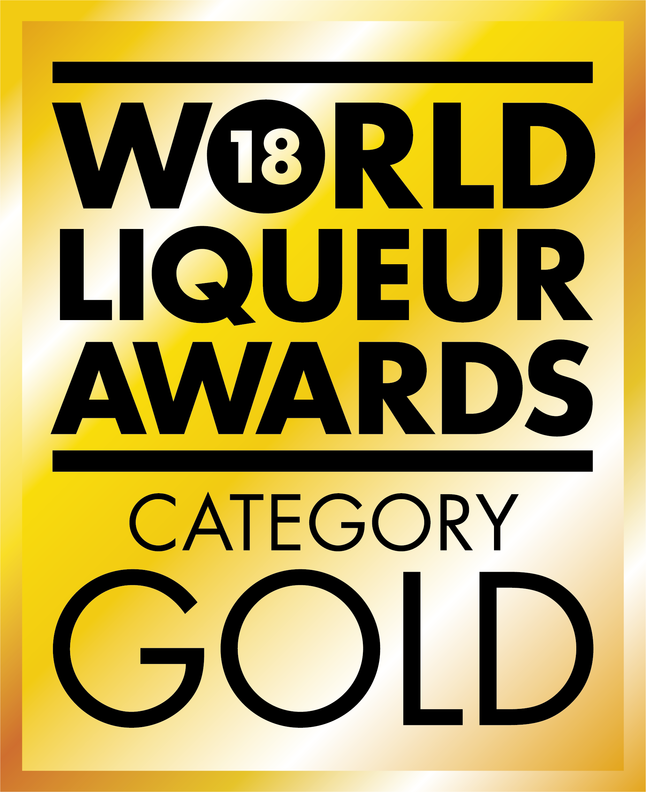
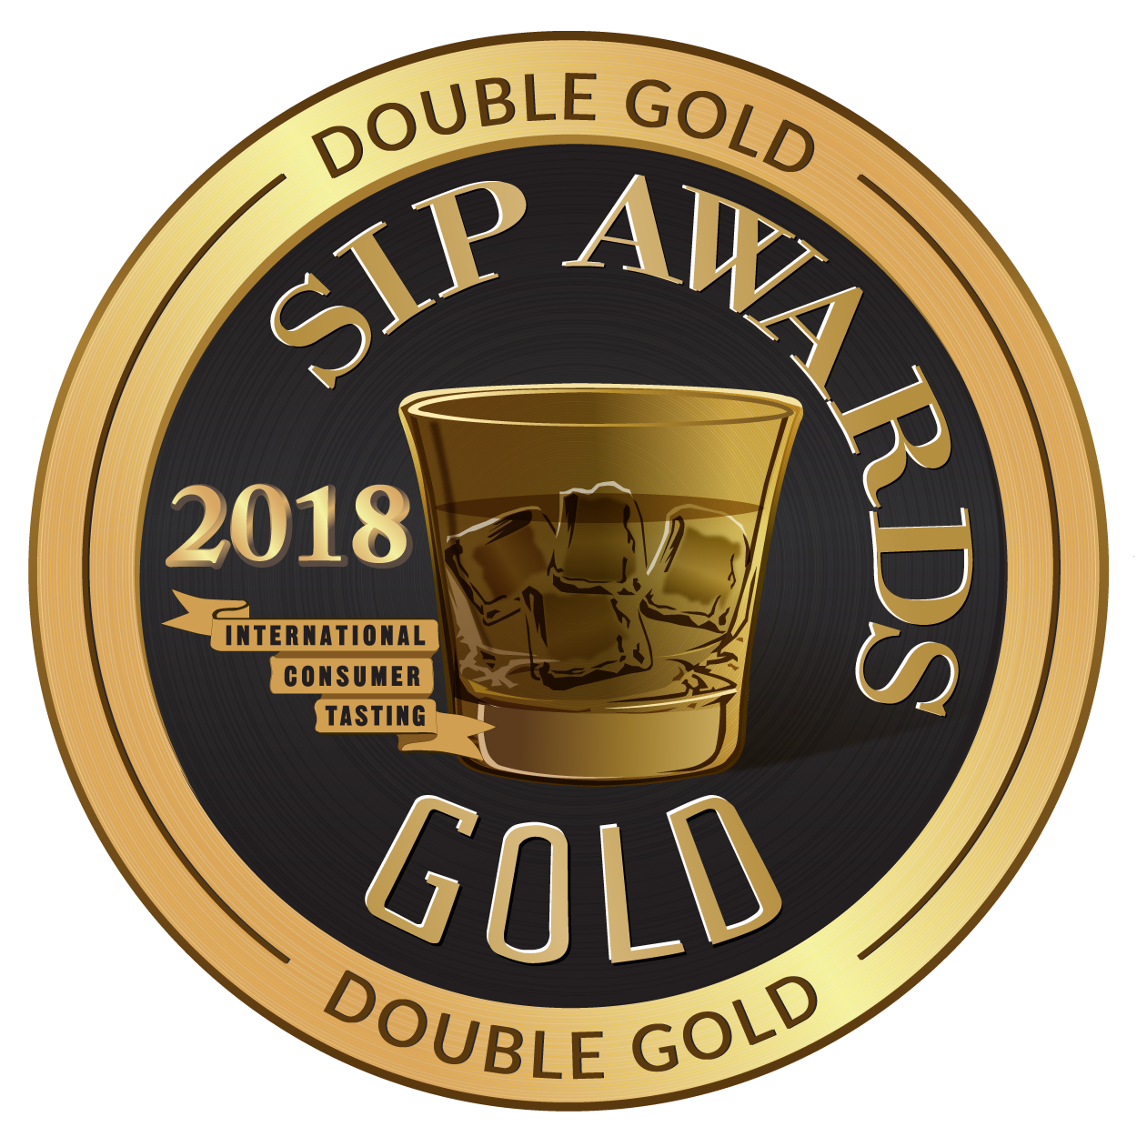
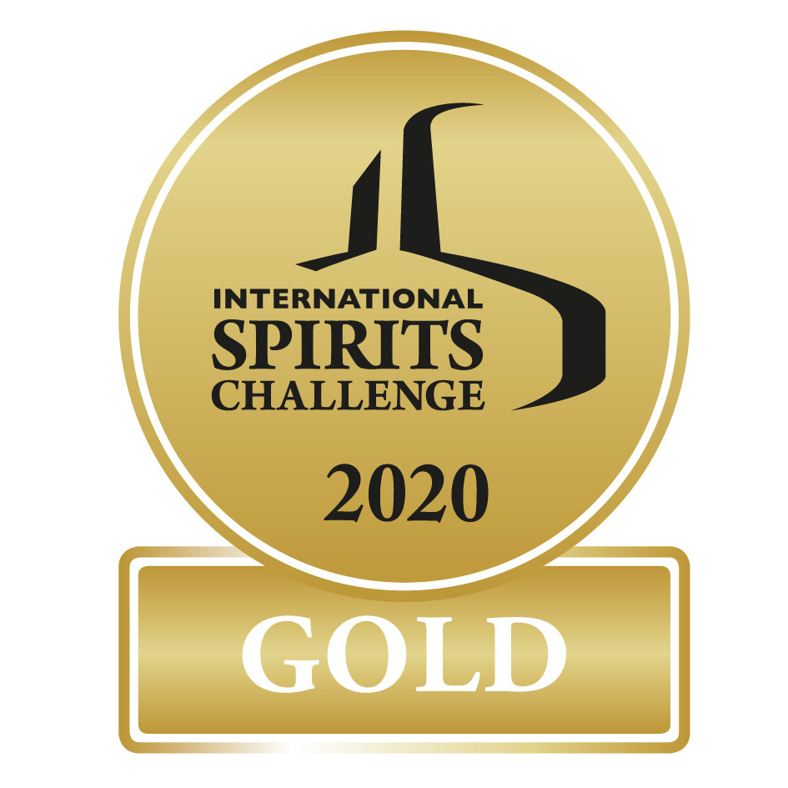
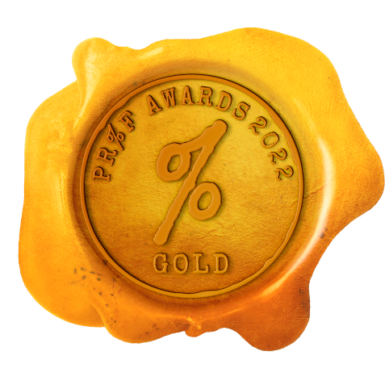

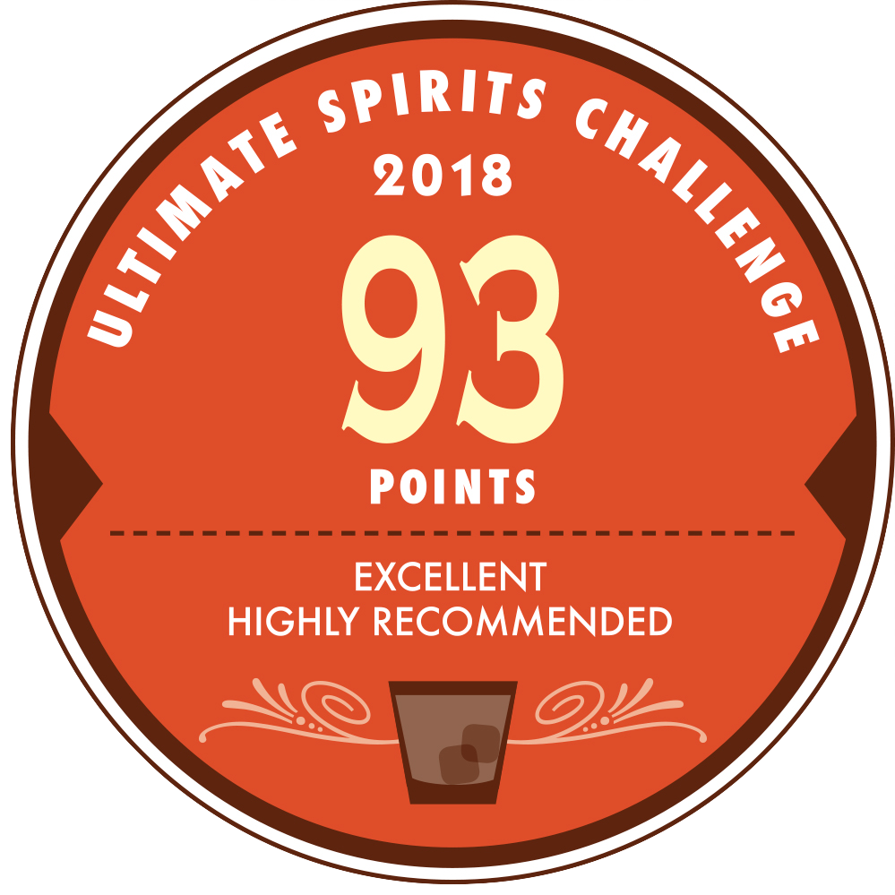
Bols Liqueurs
Award | Product | Medal/Score
2018 World Liqueur Awards | Cucumber | Gold
2018 SIP Awards | Pineapple Chipotle | Gold
2020 International Spirits Challenge | Crème de Cassis | Gold
2020 PROOF Awards | Orange Curacao | Gold
2023 Ultimate Spirits Challenge | Triple Sec | 93 pts
2023 Wine Enthusiast | Triple Sec | Best Buy
2025 IWSC | Peach | 98 pts

Slide 4
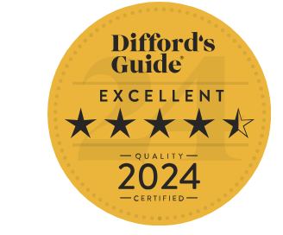
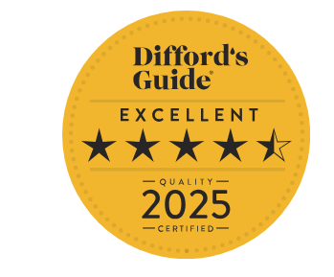
Bols Liqueurs
Award | Product | Medal/Score
Difford’s Guide 2024 | Apricot Brandy | Excellent/4.5 Stars
Difford’s Guide 2025 | Blue | Excellent/4.5 Stars

