Slide 1
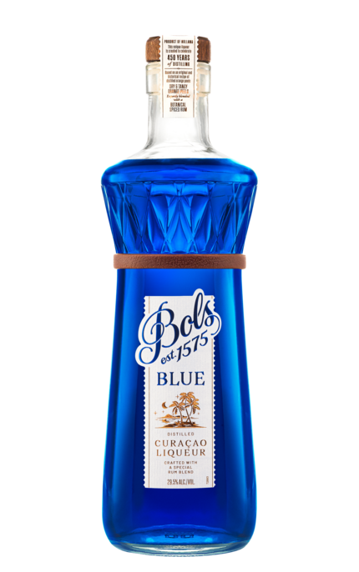
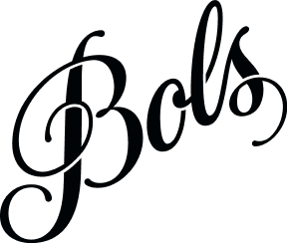
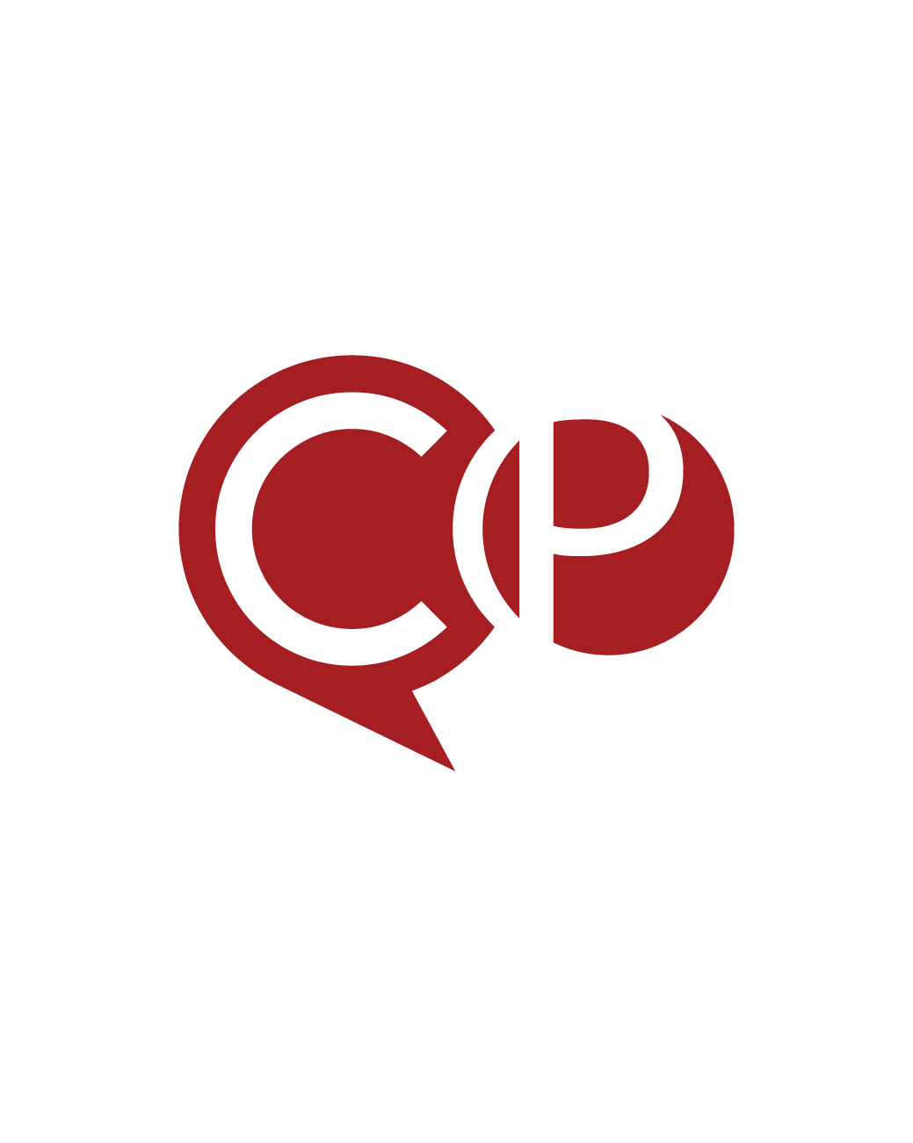

Accolades & Ratings – Updated August 2025
BLUE 1575

Slide 2
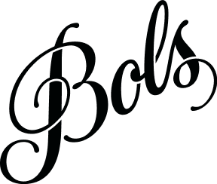
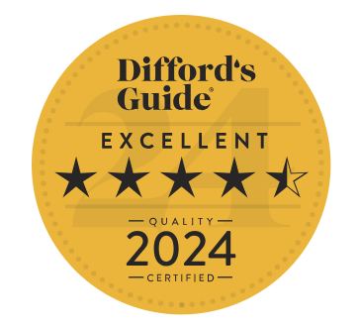
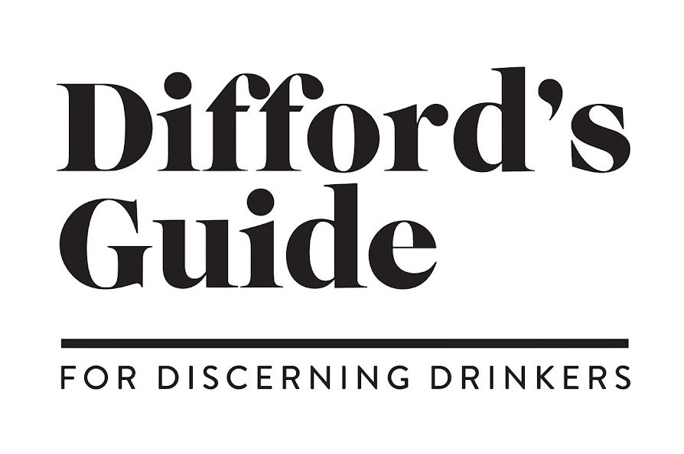
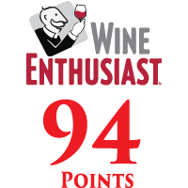
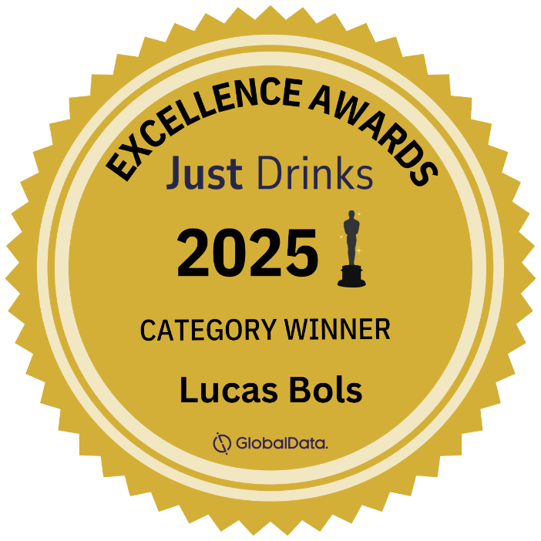
Bols Blue 1575
Award | Product | Medal/Score
2024 Difford’s Guide | Bols Blue 1575 | Excellent 4.5 Stars
2025 Just Drinks Awards | Bols Blue 1575 | Category Winner
2025 Wine Enthusiast | Bols Blue 1575 | 94 pts
“One of the best 6 new liqueurs at Berlin Bar Convent 2024”

